Slide 1
Deep vein thrombosis
Mehriban Huseynova
1 st Department of Surgery
Azerbaijan Medical University

Slide 2
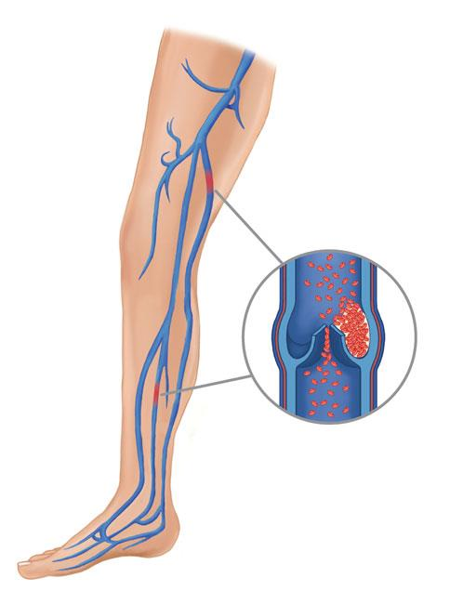
Definition of DVT
Deep vein thrombosis (DVT) is a pathological condition characterized by the formation of blood clots in deep veins.

Slide 3
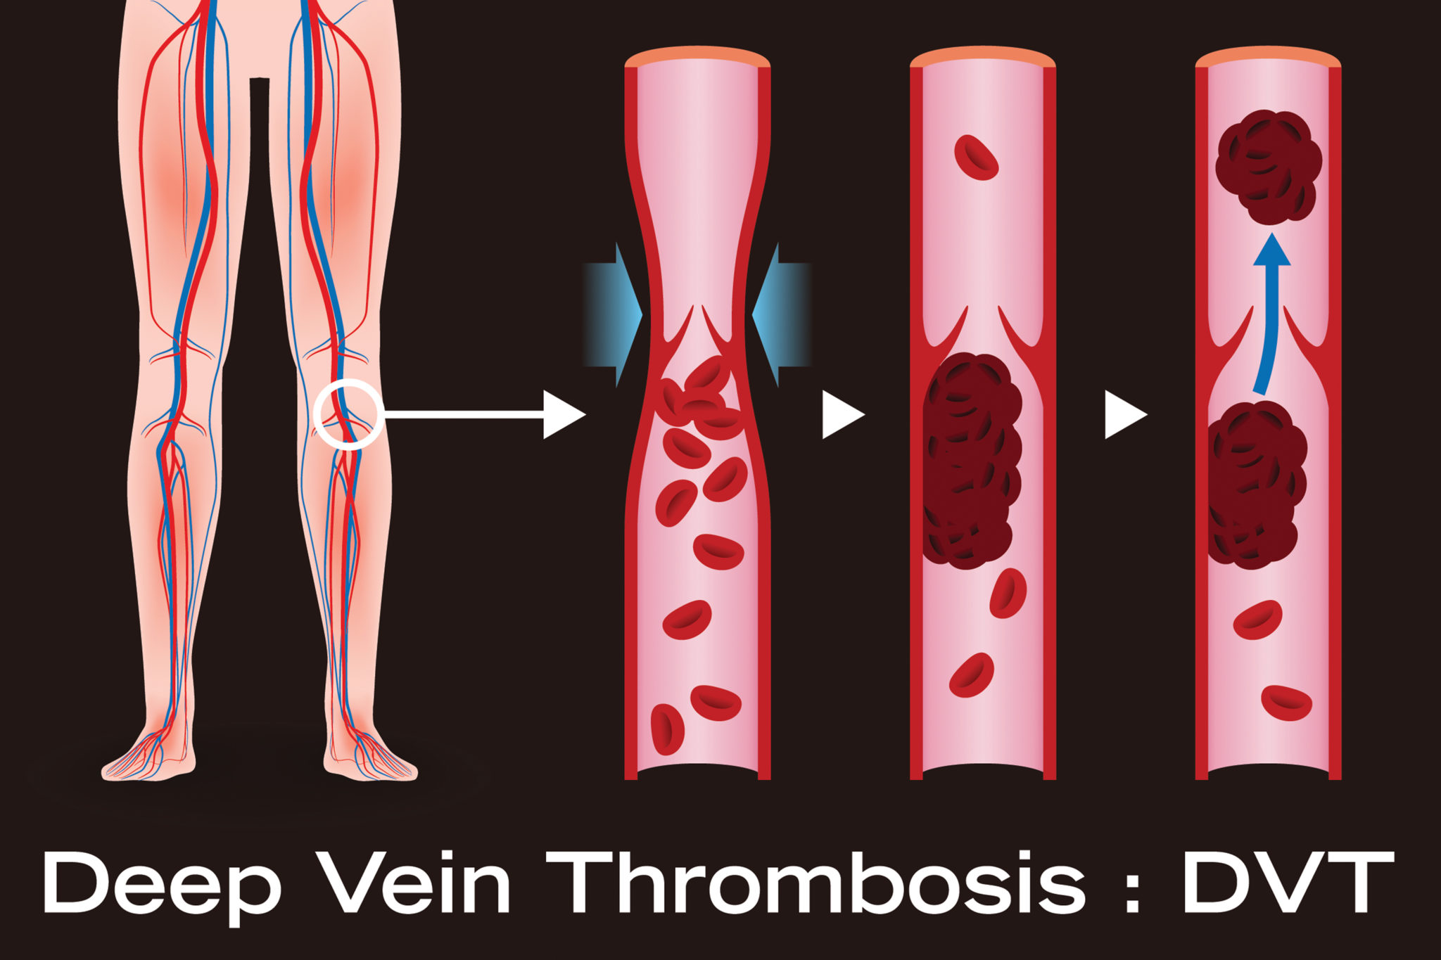
Classification of DVT
By clinical course:
Acute DVT – with a recent formation of a blood clot;
Chronic DVT – lasts more than 28 days.
By localization:
One-sided;
Bilateral;
Proximal (popliteal, femoral, iliac veins, inferior vena cava);
Distal (in the veins below the popliteal vein).

Slide 4

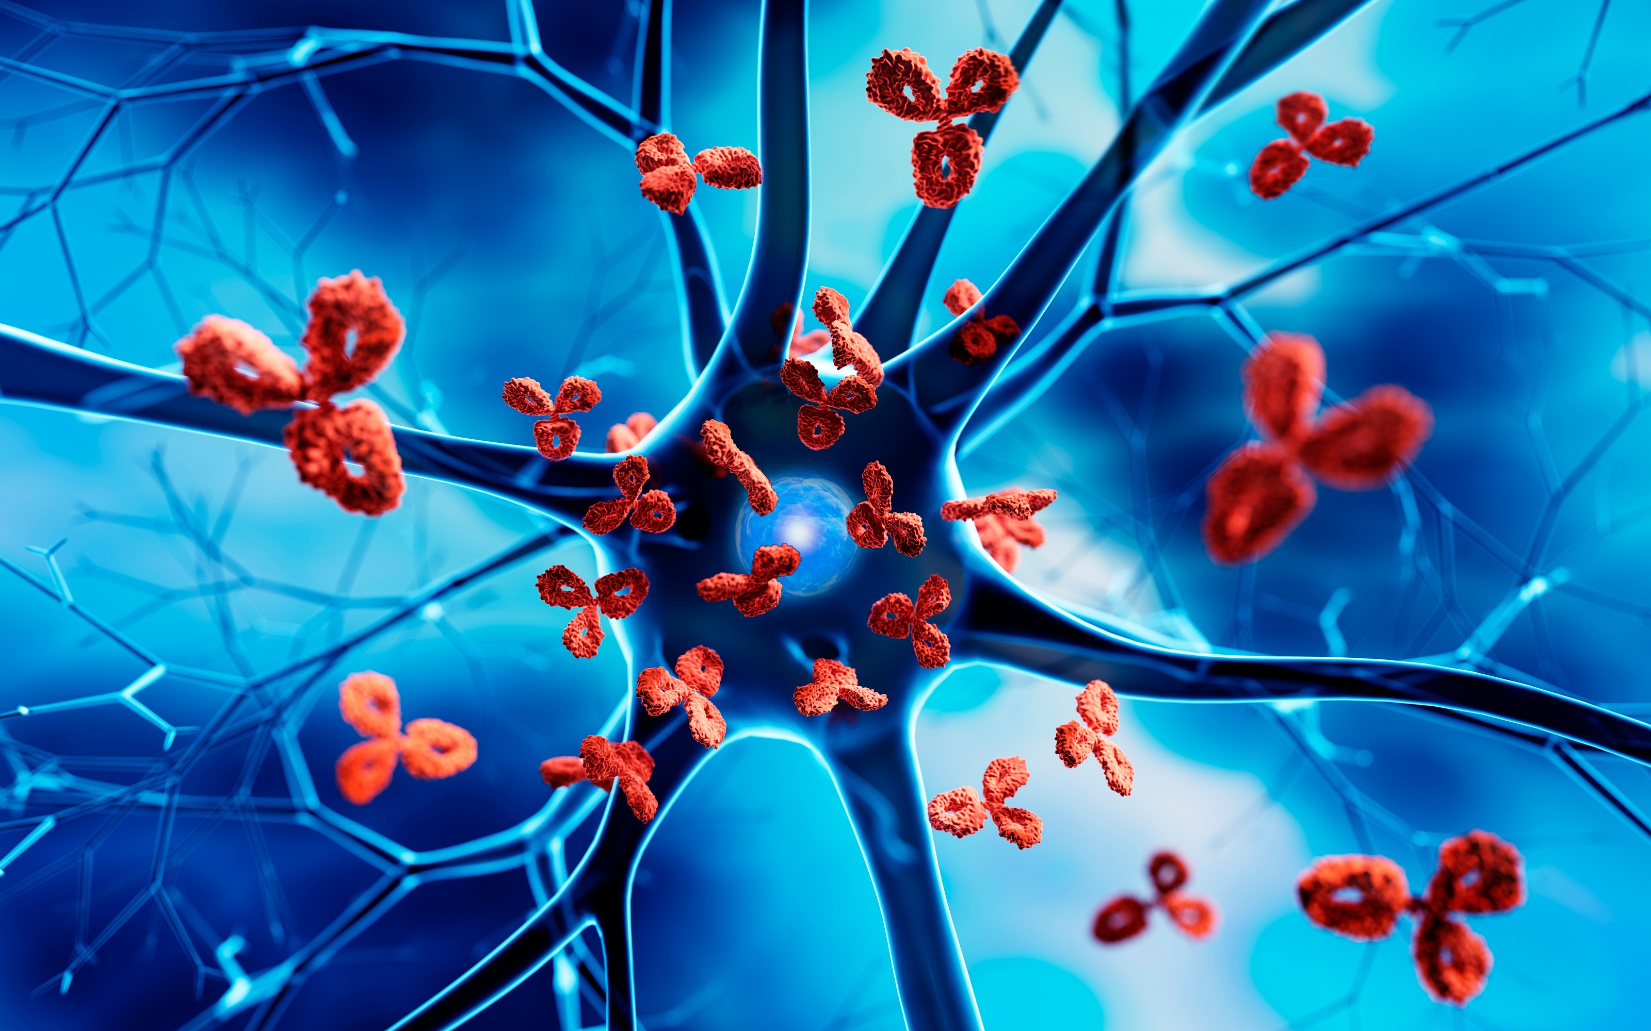


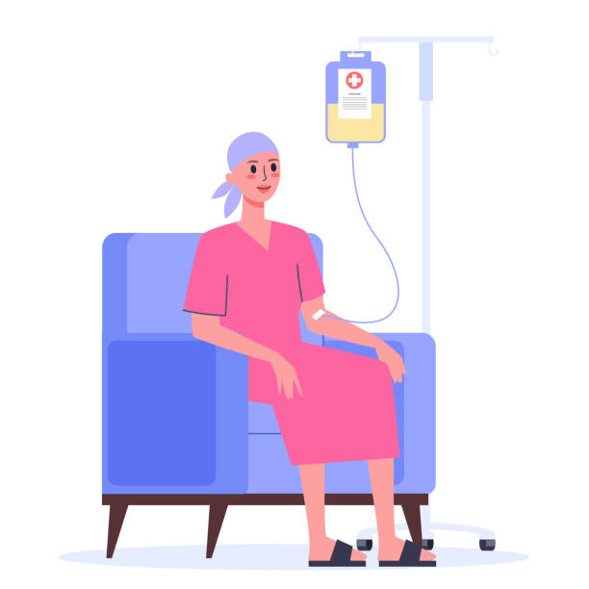
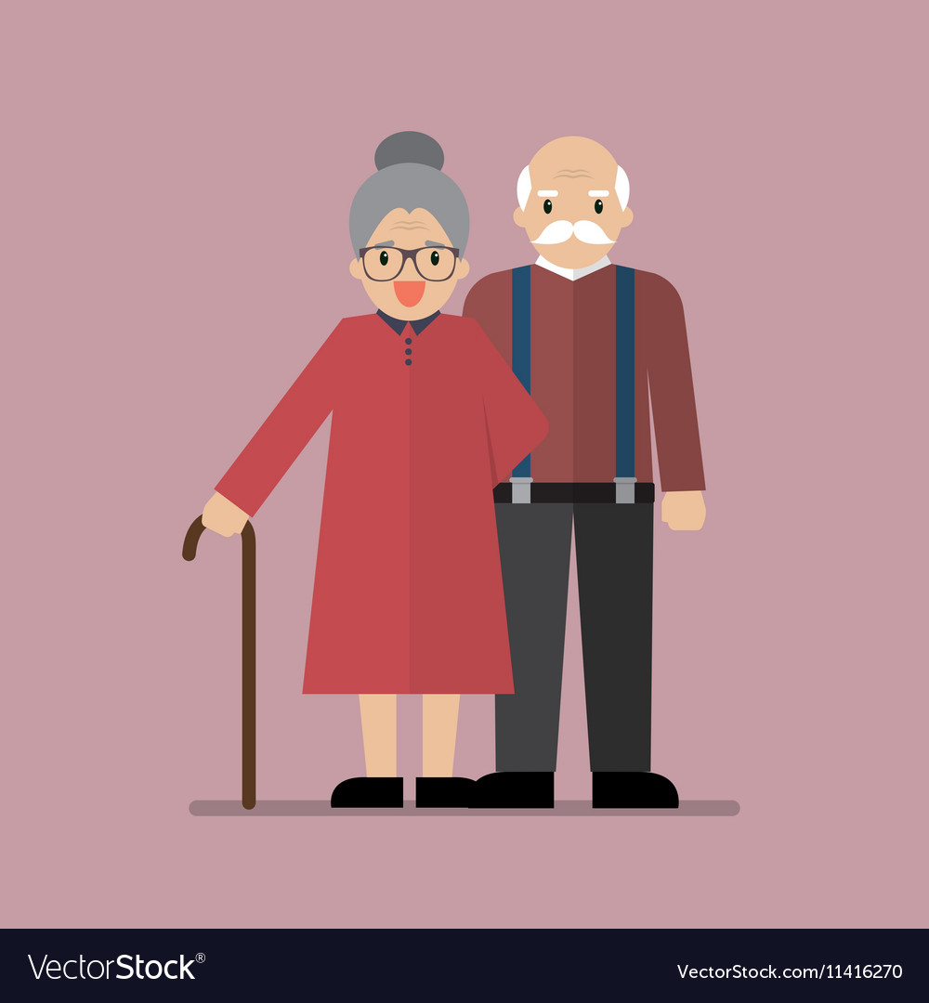
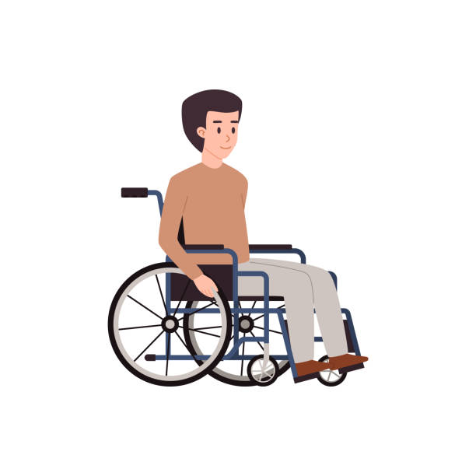

Causes of DVT
Chronic inflammation and some autoimmune diseases
Activation of the components of the immune system
Genetic factors
Elderly age
Severe surgical operations and injuries
Immobility
Sepsis
Cancer
Chemotherapy
Obesity, pregnancy, hormone therapy

Slide 5
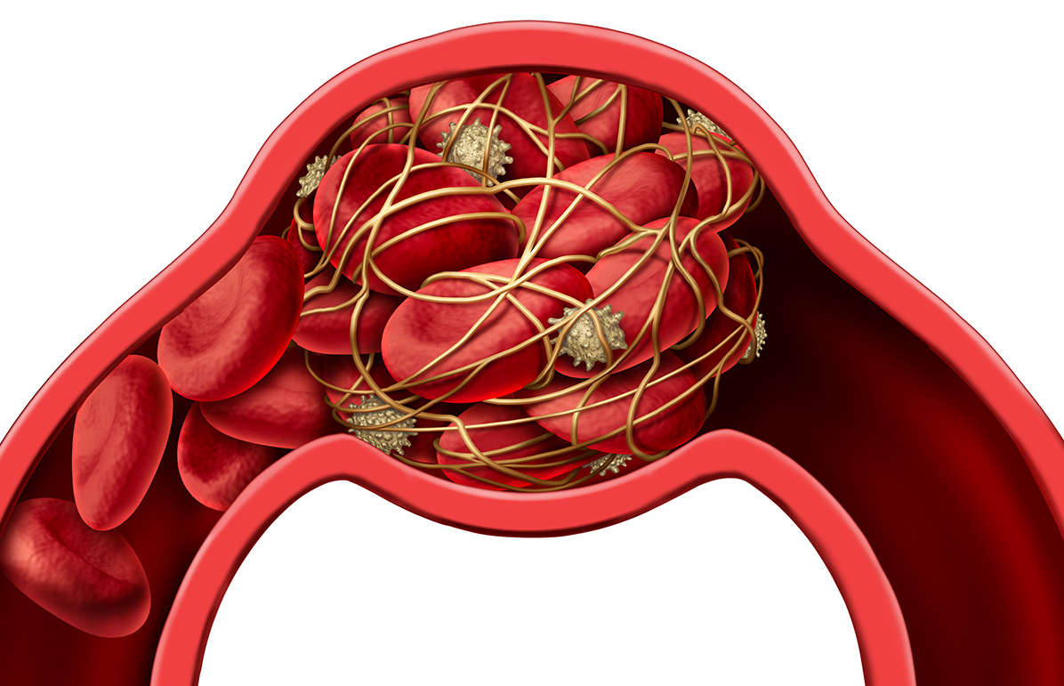
Pathogenetic mechanism of DVT
venous stasis
hypercoagulation
changes in the endothelial layer of blood vessels
DVT
Virchow's triad

Slide 6
Clinical course of DVT
Swelling
Subfebrile temperature
Pain
Local process
Thrombus is lysed
Vein is restored
Spread proximally
Thromboembolism
Venous gangrene
Cavernous transformation
Valvular damage
Re-thrombosis
Chronic venous insufficiency

Slide 7
Complications of DVT
Thromboembolism of the pulmonary arteries
Phlegmasia Alba and Cerulea Dolens
Superior vena cava syndrome
Stroke
Chronic venous insufficiency
Secondary infection

Slide 8
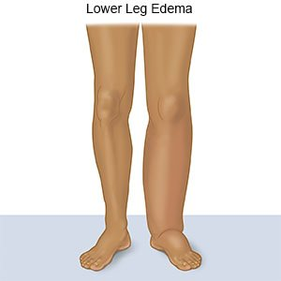
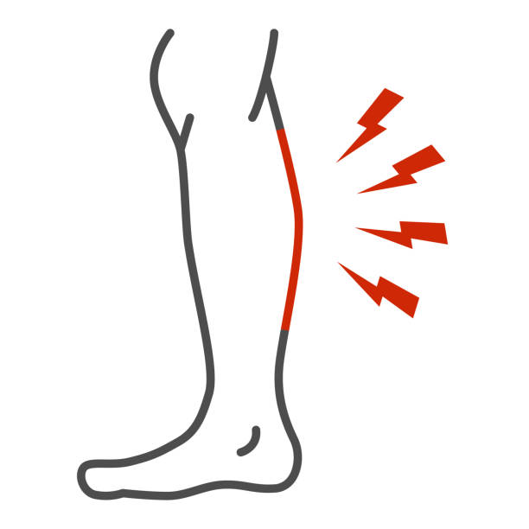
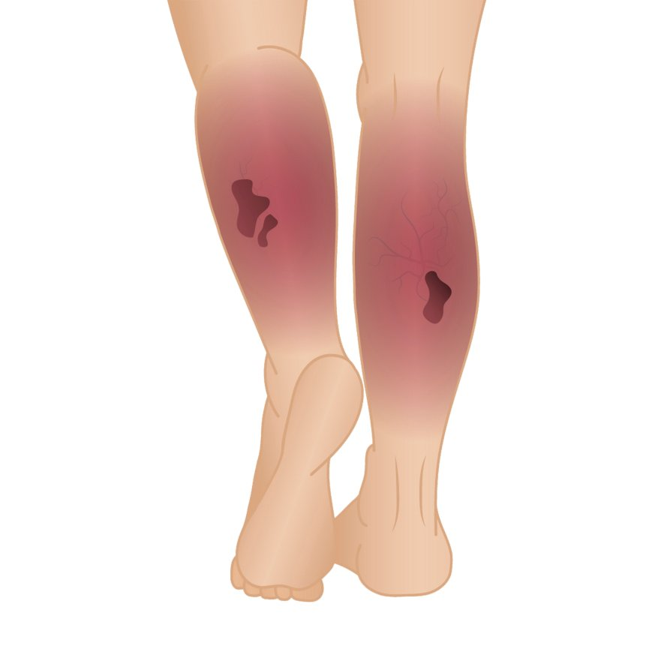
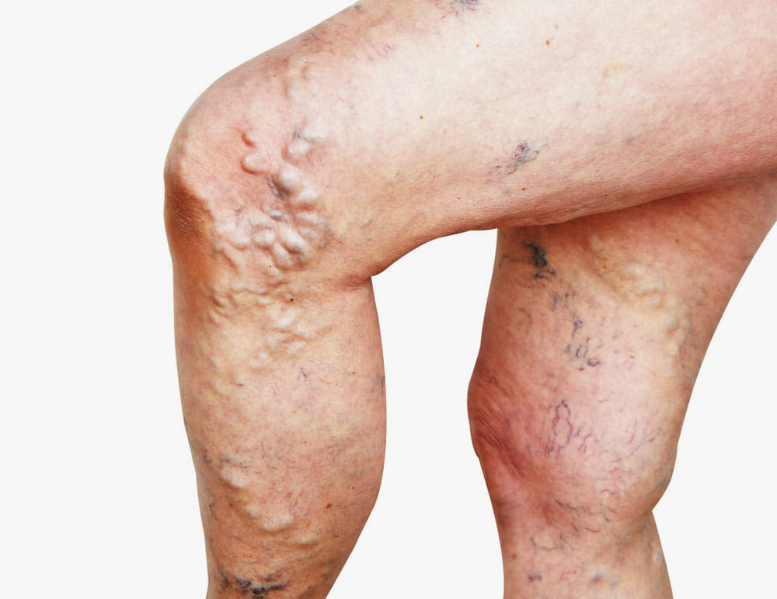
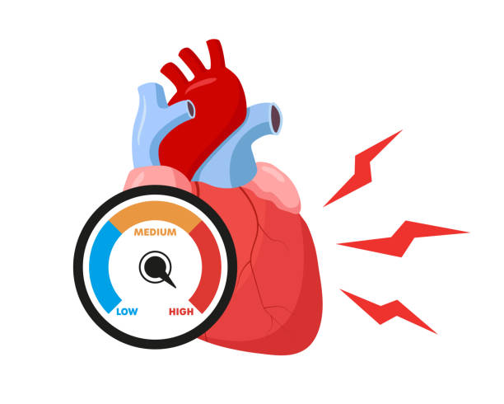
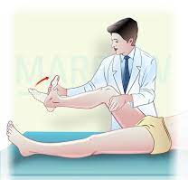
Clinical examination of DVT
Local venous stasis
Edema
Pain
Redness and hyperthermia
Protrusion of superficial veins
Subfebrile temperature and tachycardia
Homan's sign

Slide 9
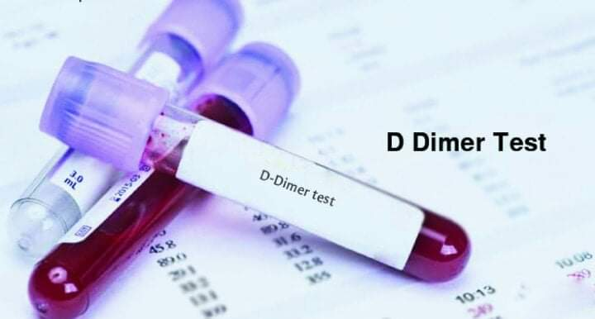
Laboratory examination of DVT

Slide 10
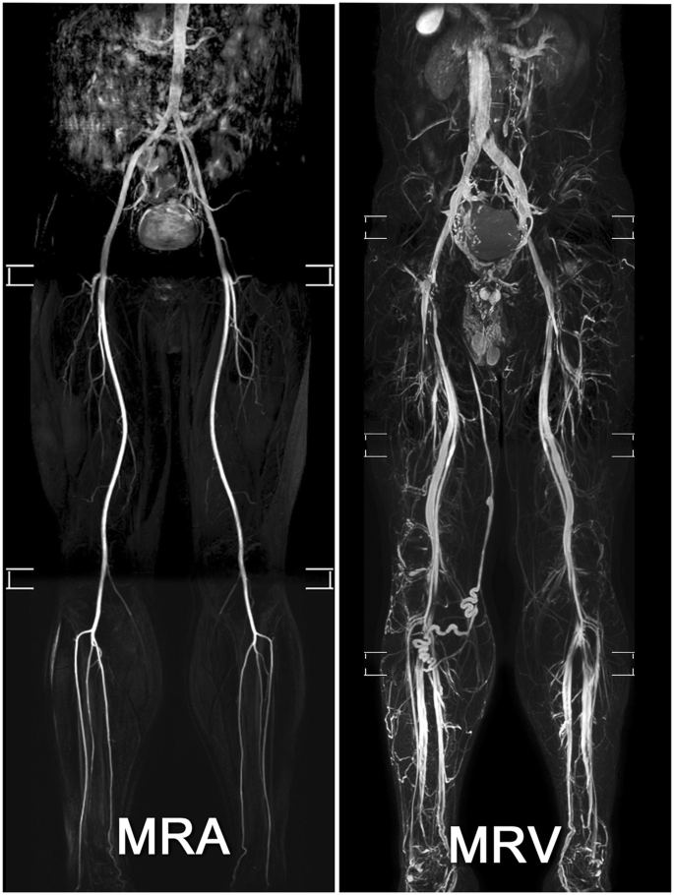
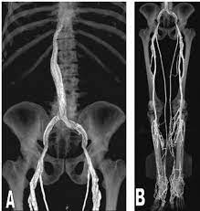
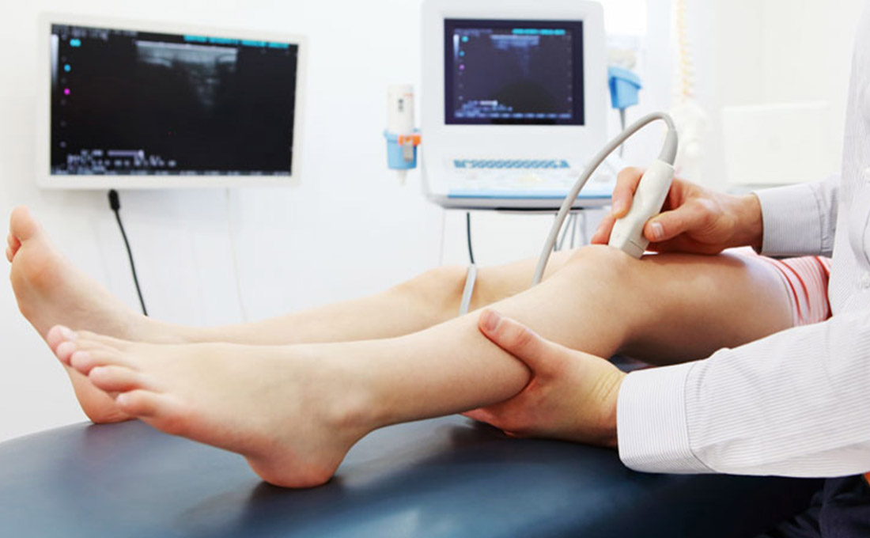
Imaging of DVT
Doppler ultrasound
CT venography
MR venography
Non-contrast MRI

Slide 11
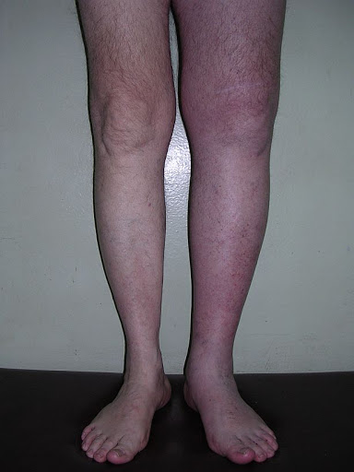
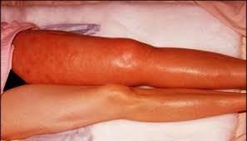
Suspicion of DVT
Calf pain and swelling — edema (circumference difference between the two calves >3 cm)
- Temporary or prolonged bed rest
- History of thrombophilia in anamnesis
- Diseases of the veins of the lower extremities in anamnesis
- High levels of D-dimer in the blood
DVT

Slide 12
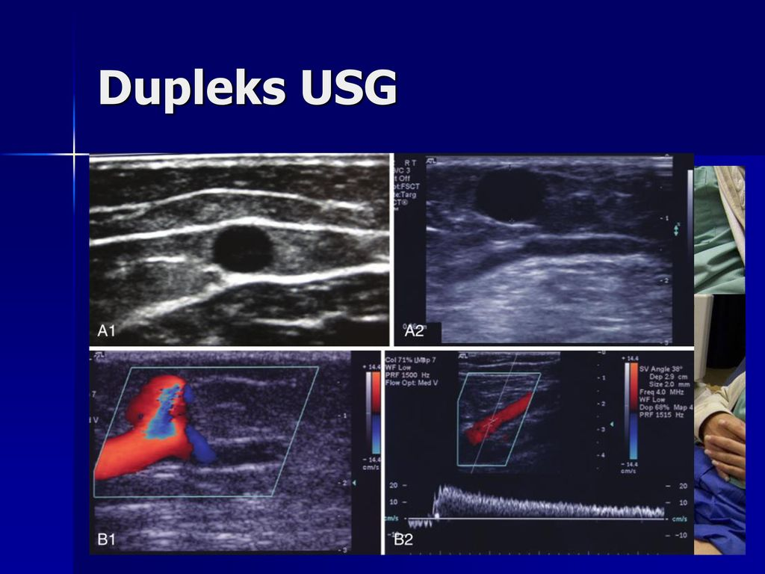
Confirmation of the diagnosis of DVT
Doppler ultrasound
Thrombus in deep veins
Changes of blood flow in the deep veins
Suboptimal DUS
CT venography
MR venography

Slide 13
Differential diagnosis of DVT
Сellulite
Chronic venous insufficiency
Tumors
Lymphedema
Hematoma
Ruptured Baker's cyst
Venous or arterial aneurysms
Connective tissue diseases
Thrombosis of superficial veins
Varicose veins

Slide 14
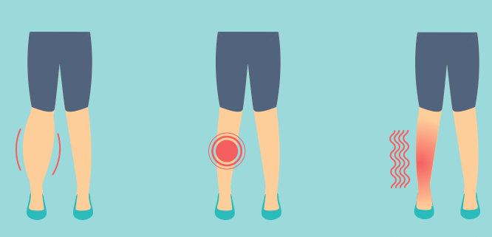
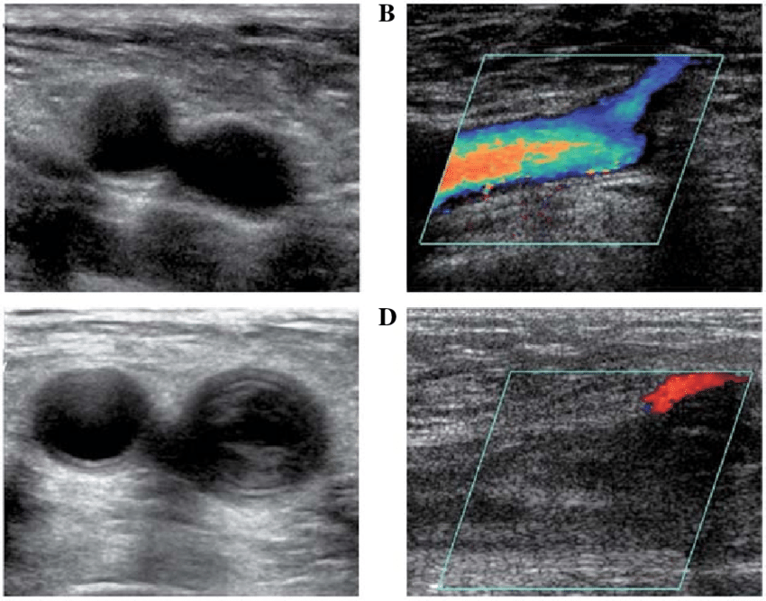
Diagnostic criterias of DVT
Characteristic clinical signs
The presence of a thrombus in the veins and/or impaired blood flow during imaging

Slide 15
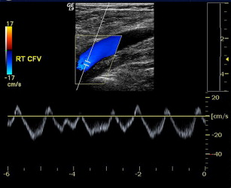
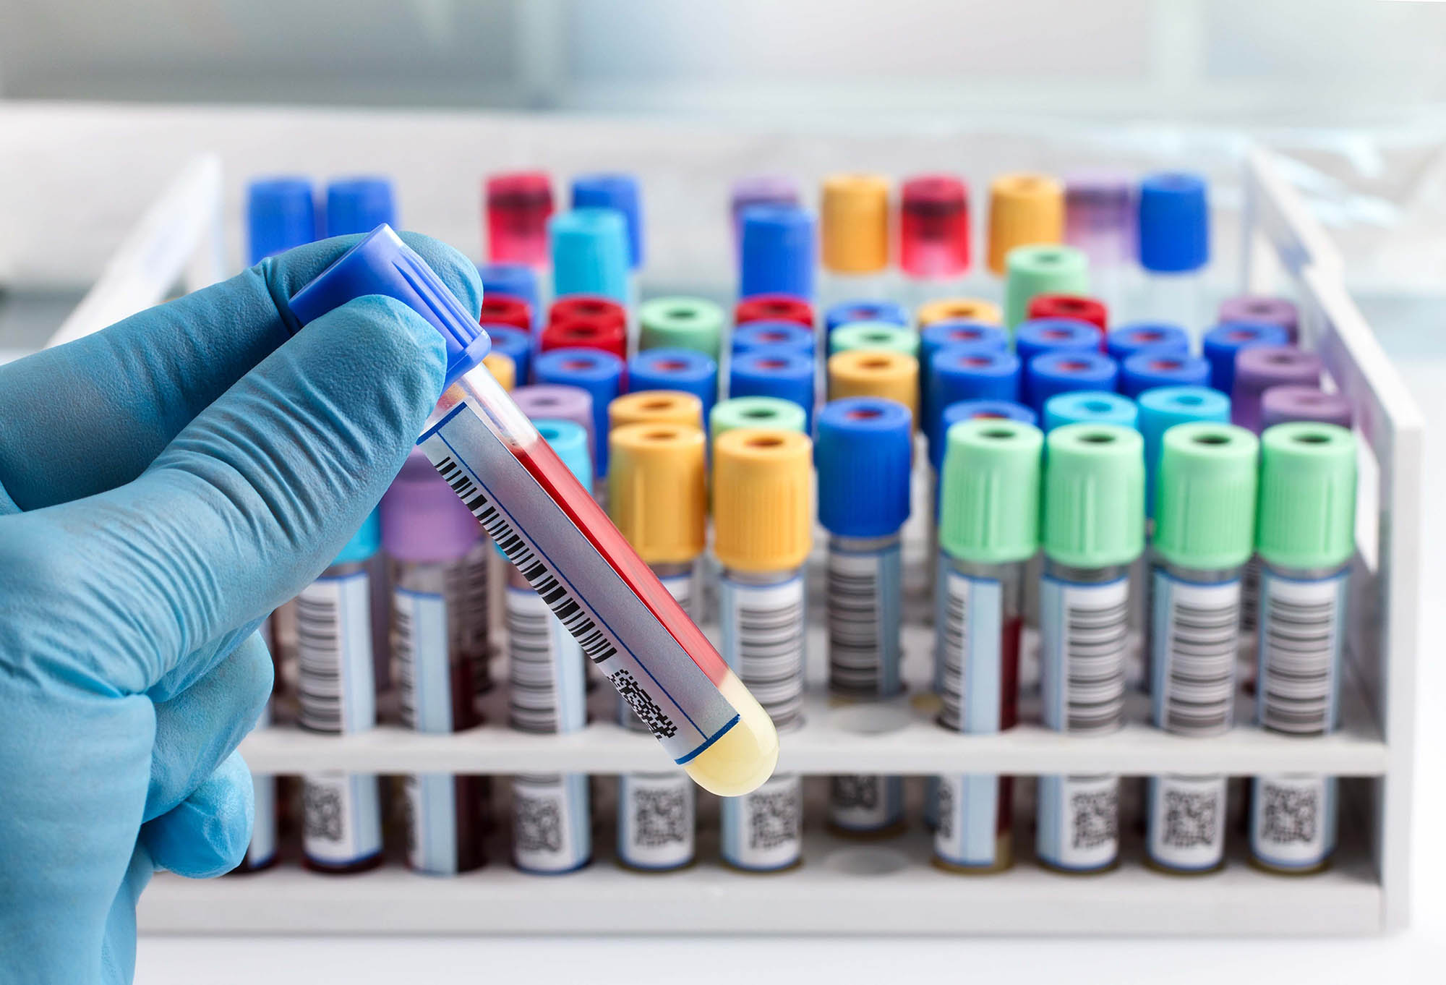
How to deny DVT?
Absence of venous clots on imaging
Negative
D-dimer test
Normal blood flow on imaging

Slide 16
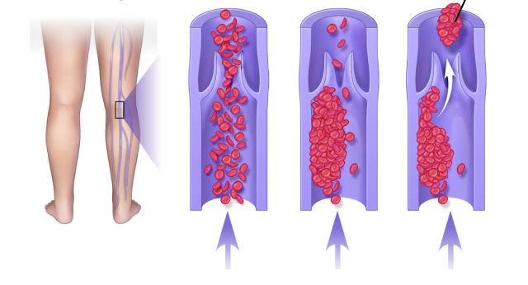
Determination the cause of DVT
Detailed anamnesis
If necessary, additional blood tests, imaging tests, genetic analysis

Slide 17
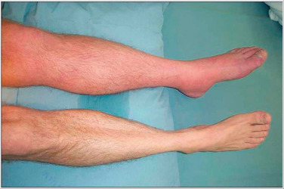
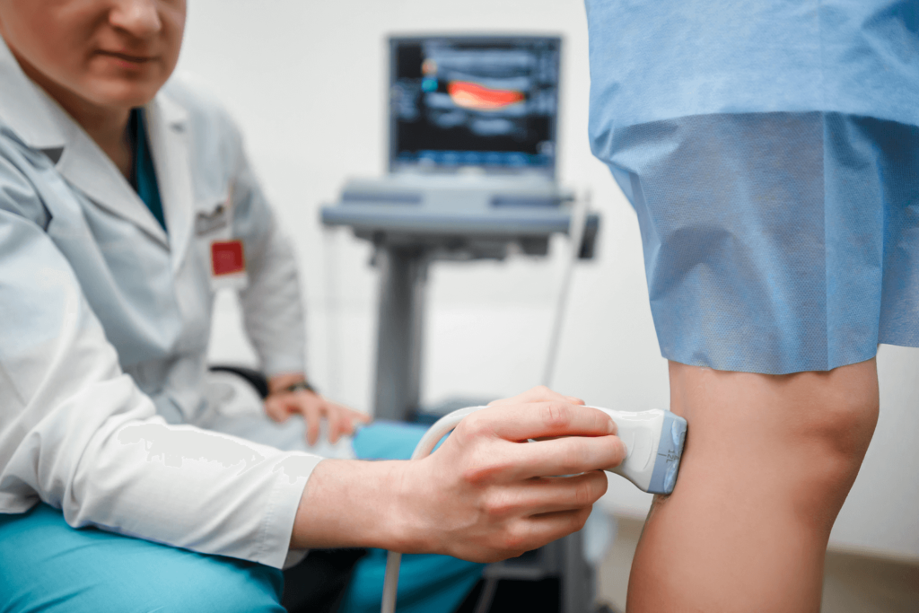
Determination the severity of DVT
Clinical signs
If necessary, check the proximal veins

Slide 18
Treatment principles of DVT
Acute DVT
Immediate treatment
Prevention of the progression of the thrombotic process
prevention and treatment of complications
Prevention of recurrences

Slide 19

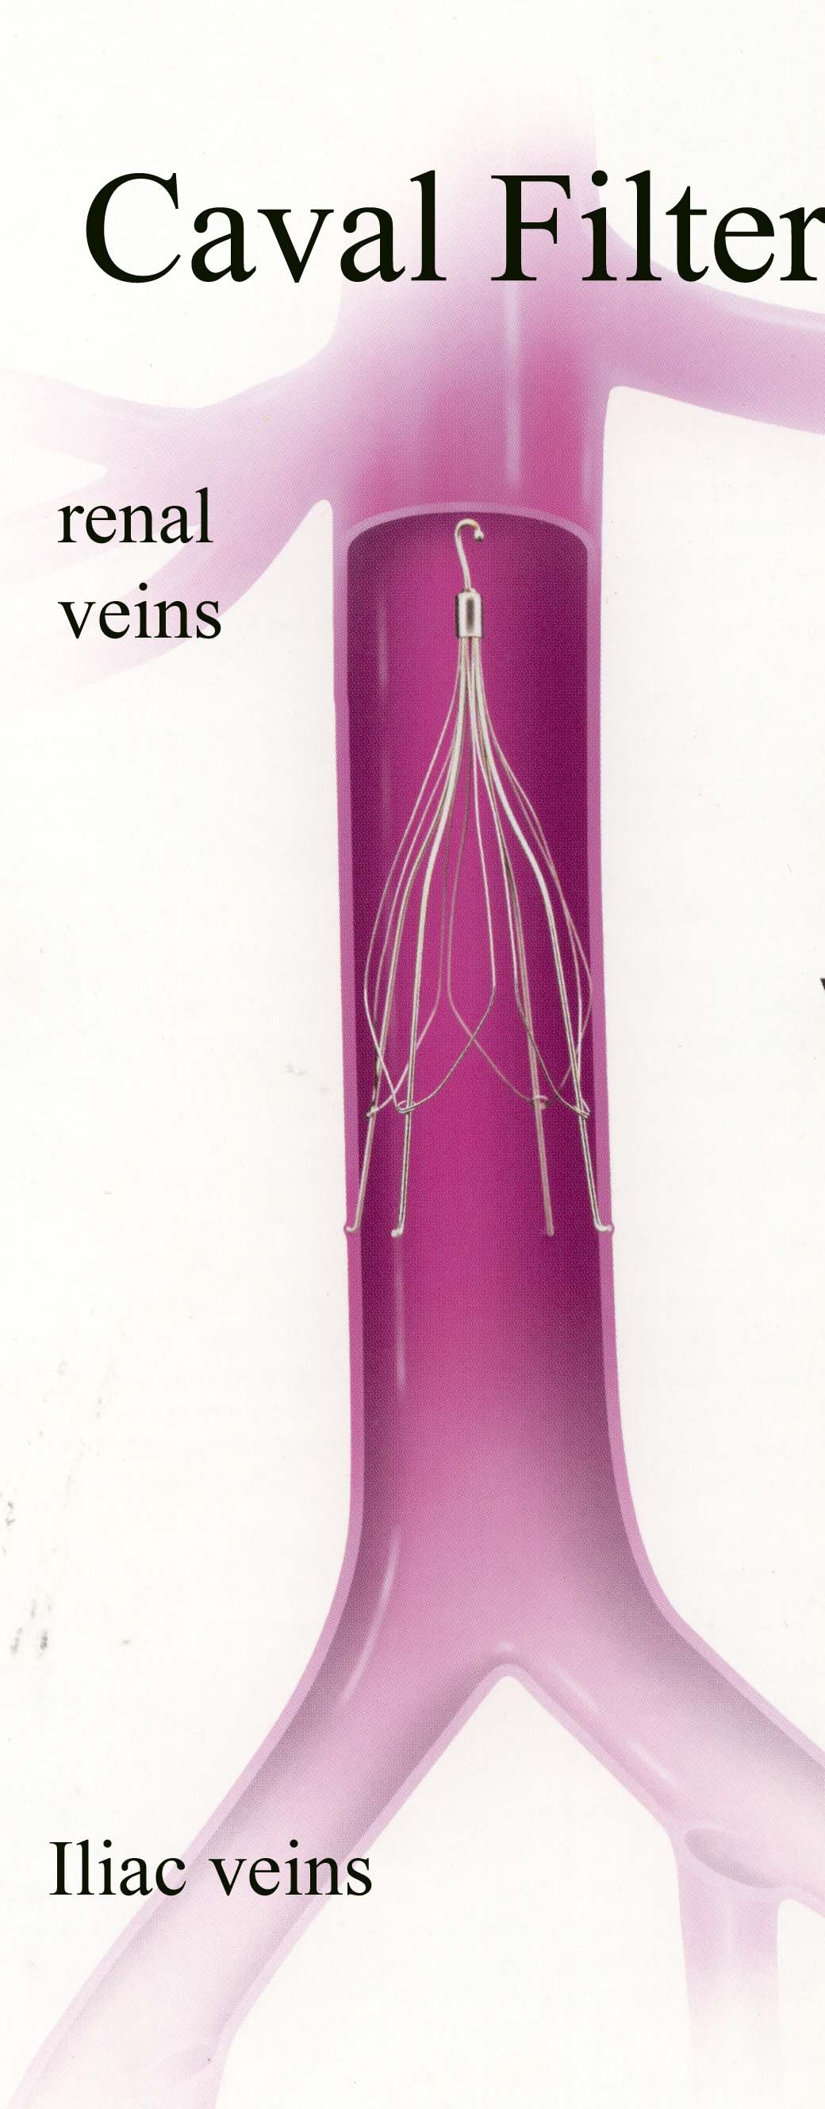

Treatment methods of DVT
Anticoagulant therapy
Vitamin K antagonist
Factor Xa inhibitors
Thrombin inhibitor
Heparin
Prevention and treatment of complications
Thrombolysis
Thrombectomy
Elastic socks
Filter in the inferior vena cava
Prevention of recurrences
Early activation

Slide 20
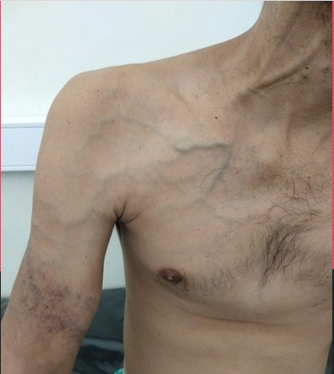
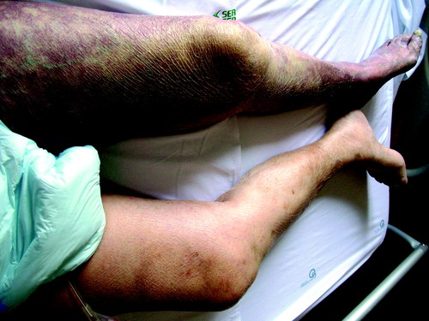
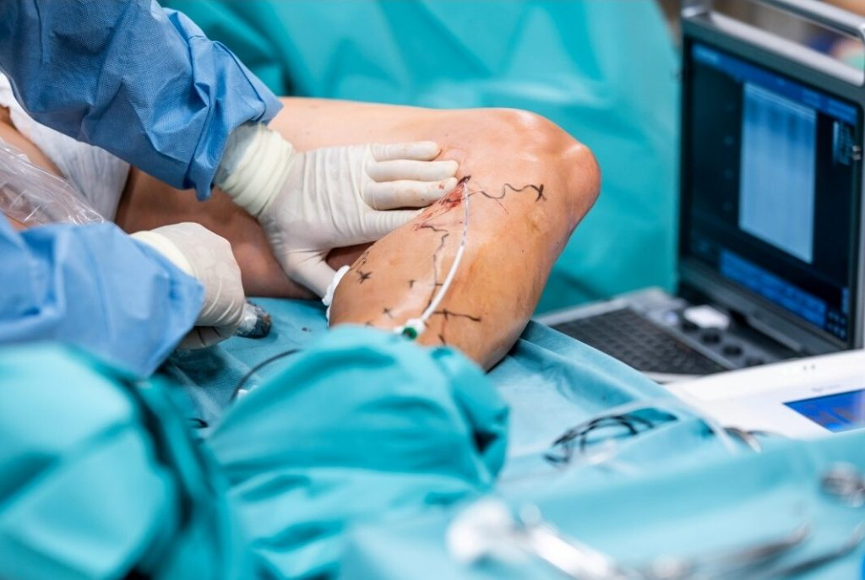
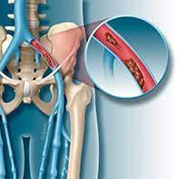

Indications for surgery
Thrombectomy
Phlegmasia Cerulea Dolens
Iliofemoral thrombosis
Unsuccessful anticoagulant therapy
Paget-Schroetter syndrome – rib resection

Slide 21
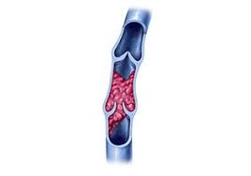
Contraindications for surgery
Acute lower extremity DVT

Slide 22
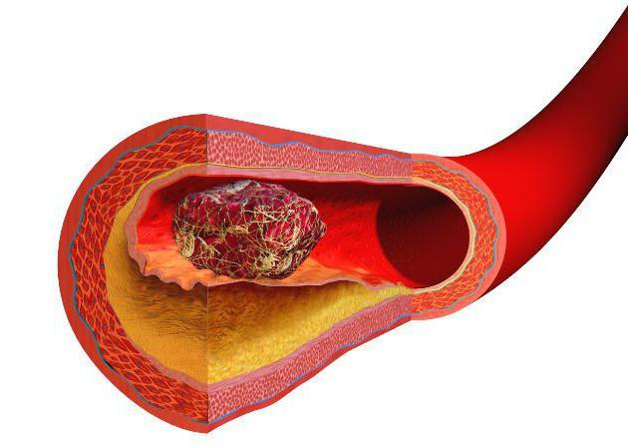
Treatment approach of DVT
Acute DVT
High risk of bleeding and thromboembolism
Low risk of bleeding and thromboembolism
High risk of bleeding and low risk of thromboembolism
- anticoagulant treatment is started and continued for 3-6 months, sometimes longer
- inferior vena cava filter is also placed to prevent embolism
- anticoagulants are not prescribed or given at very low doses
- monitoring
- non-anticoagulant therapy

Slide 23
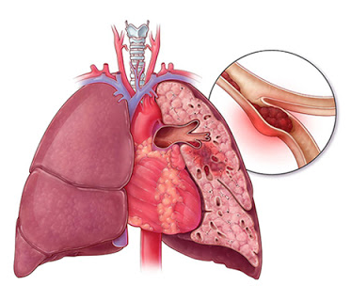
Prognosis of DVT
Proximal DVT
Pulmonary embolism
Post-thrombotic syndrome
- Cancer
- İdiopathic DVT
- Upper extremity localization
RECURRENCE

Slide 24
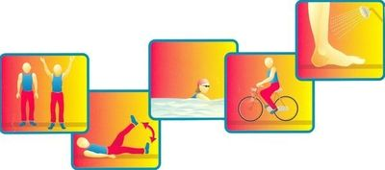
Prophylaxis of DVT
To reduce risk factors in the general population, it is recommended:
Reducing excess weight;
Active lifestyle;
A sufficient amount of liquid;
Do not sit in one place for a long time;
Do not cross your legs while sitting;
No smoking;
No drinking alcohol;
Elastic socks;
Be as mobile as possible on long trips.
For the prevention of thrombosis in patients undergoing surgery, it is necessary to follow the hospital protocol:
Early activation of patients;
Elastic socks;
Pharmacotherapy according to indications.

Slide 25
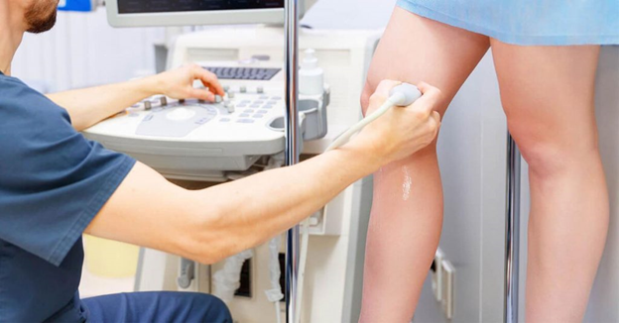
Screening of DVT
Doppler ultrasound

Slide 26
Follow up of DVT
D-dimer
DUS
Clinical signs

Slide 27
Rehabilitation after DVT
Regular walks
Raising the injured leg in a sitting position
Any flights or long trips should be postponed for at least 2 weeks after starting anticoagulants

Slide 28



Characteristics of DVT in special groups
4-5 times

Slide 29
Thanks for your attention!

