Slide 1
Aortic valve disease
Dr. Shukufa Musayeva
Department of 1st Surgical Disease

Slide 2
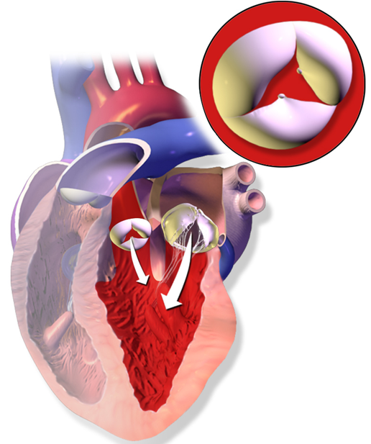
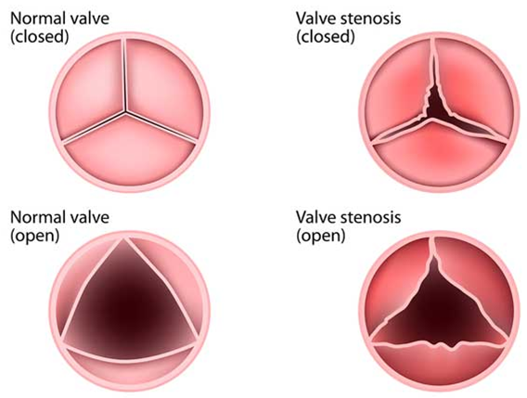
Definition
Aortic valve stenosis
Aoric valve regurgitation
Aortic valve stenosis is a disease in wich the aortic valve narrowed and blood flow from the left ventricle to the aorta is reduced or blocked. Also called aortic stenosis .
Aortic valve regurgitation is a condition that occurs when the heart's aortic valve doesn't close tightly and as a result, in diastole, some of the blood flows back from the aorta to the left ventricle (diastolic reflux, regurgitation).
In the literature, it is also known as aortic insufficiency.

Slide 3
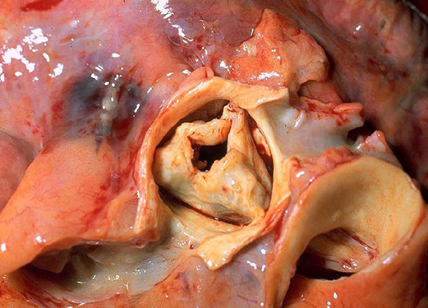
Classification
Aortic valve stenosis
According to the clinical stage
According to the severity of the stenosis
Stage A – asymptomatic, there is a risk of aortic stenosis (AS)
Stage B- asymptomatic, mild or moderate AS
Stage C- asymptomatic, severe AS
Stage D- symptomatic, usually with severe AS
Mild- aortic valve area (AVA) >1.5 cm2, peak aortic jet velocity 2.0 to 2.9 m/second,mean gradient <20 mmHg.),
Moderate- AVA 1-1.5 cm2, peak aortic jet velocity 3.0 to 3.9 m/second, mean gradient 20–40 mm Hg),
Severe- (AVA <1 cm2, peak aortic jet velocity > 4m/second , mean gradient >50 mm Hg

Slide 4
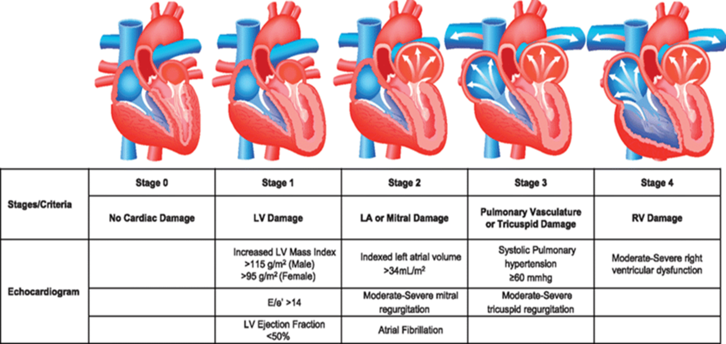
Classification
Aortic valve stenosis

Slide 5
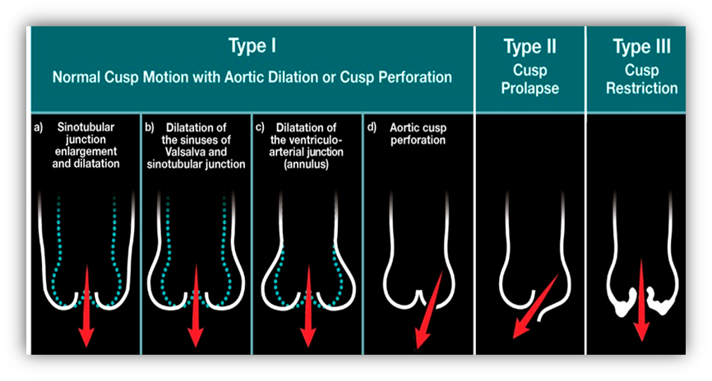
Classification
Aortic valve regurgitation
Classification by stages
(Modified American Heart Association)
According to clinical course
Compensated:
Stage A - asymptomatic, minimal regurgitation
Stage B - asymptomatic, moderate regurgitation, left ventricular ejection fraction and systolic measurements are normal.
Decompensated:
Stage C - asymptomatic, regurgitation, reduced left ventricular ejection fraction (less than 50%) or enlarged systolic volume (more than 50 mm)
Stage D- symptomatic
Acute
Chronic

Slide 6
Causes
Aortic valve stenosis
Aortic valve regurgitation
Congenital heart defects (bicuspid or unicuspid aortic valves)
Degenerative calcification aortic valves (hypertension, hypercholesterolemia, diabetes mellitus, smoking, etc. (relevant for degenerative diseases)
Rheumatism
Rheumatic disease
Endocarditis,
Aortic root dilatation,
Marfan syndrome
And other connective tissue diseases,
Calcific injury and trauma.
In developed countries, the most common causes are aortic root dilatation and congenital bicuspid valve,
in developing countries, rheumatism

Slide 7
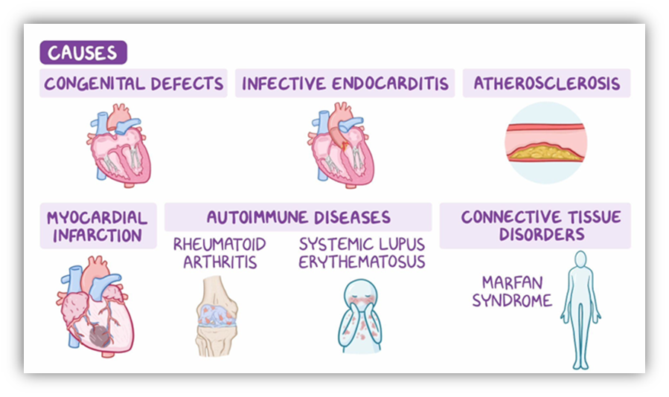
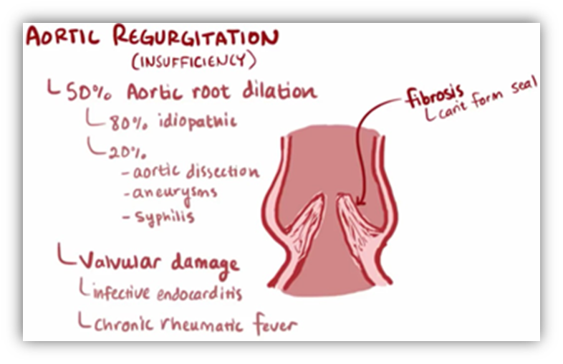
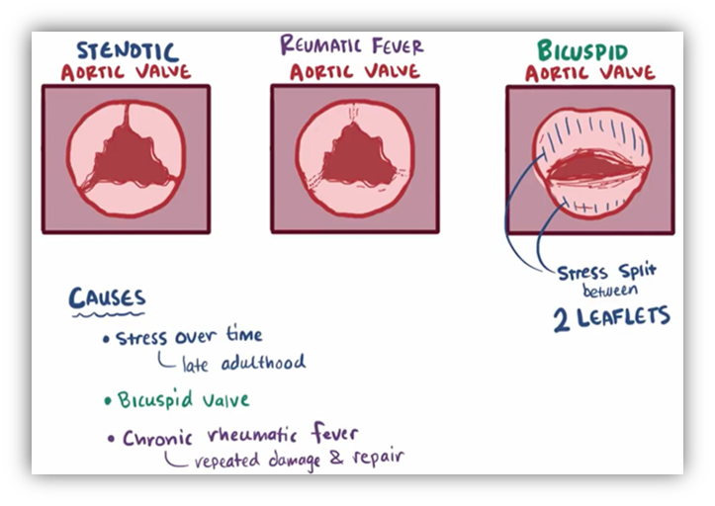
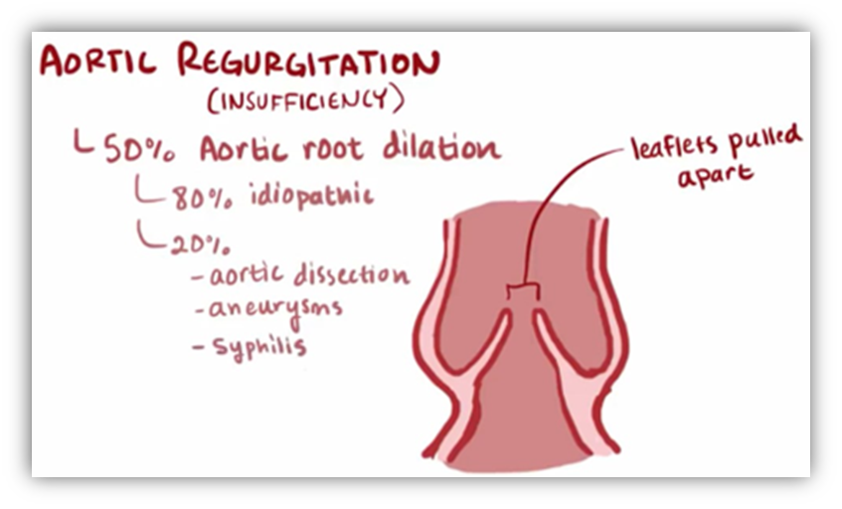

Slide 8
Pathogenetic mechanisms
Aortic valve stenosis
Stenosis of the aortic valve (less than 3 cm2)
An increase in the peak aortic jet velocity (more than 2 m/second)
An increase in the mean gradient (more than 20 mm Hg st)
Compensatory hypertrophy in the left atrium
The stenosis increases the preload on the left ventricle
Decompensation
Heart failure occured

Slide 9
Pathogenetic mechanisms
Aortic valve regurgitation
Injuring the aortic valves or dilating the aortic root
A defect in closure
Insufficient closing of the valves, during diastole
Regurgitation
Diastolic regurgitation causes left ventricular preload, hypertrophy, enlargement
Leads to an increase in stroke volume in each heartbeat.
In the chronic process, the left ventricle enlrged compensatory and hypertrophy occurs. As the process continues, the left ventricle decompensates - the ejection function decreases and signs of heart insufficiency appear.
In the acute process, signs of aortic insufficiency appear rapidly because the left ventricle cannot "find time" for compensation.

Slide 10
Clinical course
Aortic valve stenosis
Aortic valve stenosis is asymptomatic for a long time.
Usually, when stenosis becomes severe (AVA <1 cm2, peak aortic jet velocity >4 m/s, mean gradient greater than 40 mmHg.st), symptoms appear
The risk of lethality increases.

Slide 11
Clinical course
Aortic valve regurgitation
Chronic aortic valve regurgitation
Acute aortic valve regurgitation
Compensated stage:
no clinical signs
the function of the left ventricle is not disturbed
can last for years
the probability of decompensation is 1-6% per year
Decompensated stage:
left ventricular dysfunction occurs (stroke fraction decreases, ventricle expands)
symptoms and sings appear (shortness of breath at rest or during physical work, chest pain, etc.)
In this phase, the probability of heart failure and lethality increases (25%)
sudden onset of shortness of breath,
symptoms of heart failure
and chest pain,
almost fatal if left untreated.

Slide 12
Complications
Aortic valve stenosis
Aortic valve regurgitation
Heart failure
Pulmonary hypertension
Sudden death
Bleeding tendency
Heart failure is the most common complication.

Slide 13
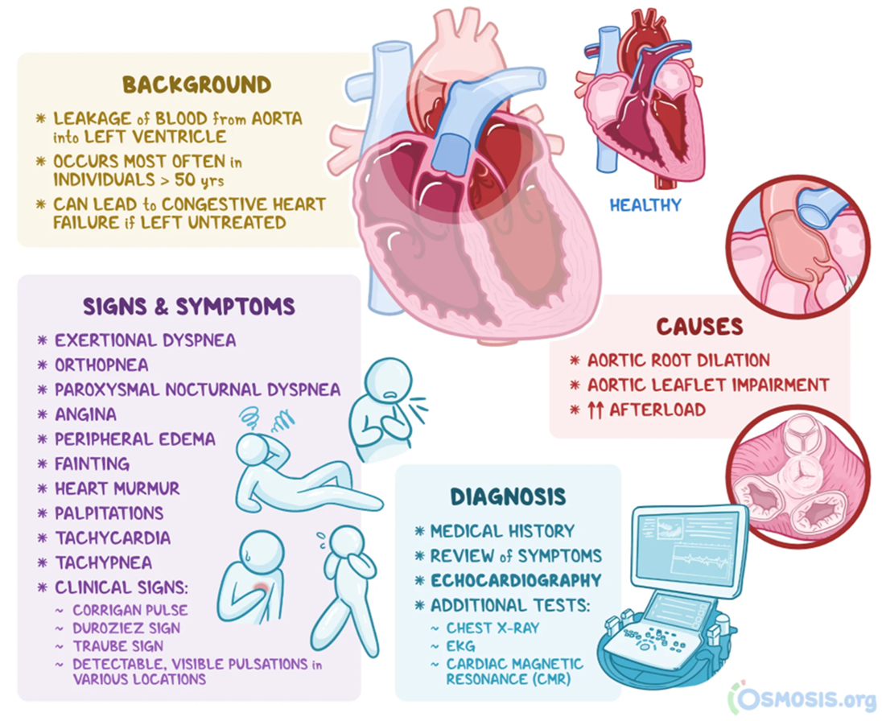
Clinical examinations
Aortic valve stenosis
Asymptomatic stenosis can be seen in echocardiography during routine examination.
Clinically, the triad of AS dyspnea, syncope, and angina, which begins after physical exertion, is characteristic
Sudden death can occur
A slow-rising and low-volume pulse
Heaving apex pulse
A systolic murmur are observed.
As the disease progresses, symptoms of heart failure develop.

Slide 14
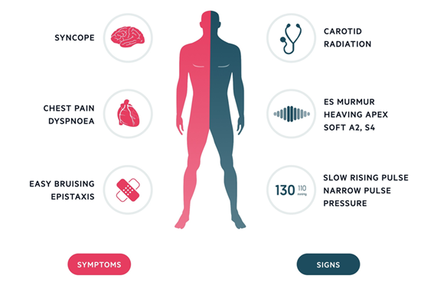
Clinical examination
Acute aortic valve regurgitation
Chronic aortic valve regurgitation
sudden onset of shortness of breath,
chest pain,
heart failure symptoms
Physical examination reveals tachycardia,
peripheral vasoconstriction,
cyanosis,
pulmonary edema.
Cardiogenic shock occurs in a very short period of time.
asymptomatic for a long time.
Symptoms begin with palpitations, shortness of breath, and chest pain.
Low diastolic blood pressure (below 60 mm Hg)
ncreased pulse pressure (systolic and diastolic pressure difference greater than 100 mm Hg)
Early diastolic murmur
Special symptoms - Becker's sign (presence of visible pulsation of retinal arteries),
Corrigan's pulse (abrupt distension and quick collapse of carotid arteries)
Musset's sign (visible nodding of the head in time with arterial pulsation),
Müller's sign (pulsation of the uvula during systole),
Traube's sign (a "pistol-shot" sound or loud systolic ana diastolic murmur over the femoral pulse during auscultation

Slide 15
Laboratory examination
Laboratory tests are usually needed to rule out endocarditis and rheumatic etiology.

Slide 16
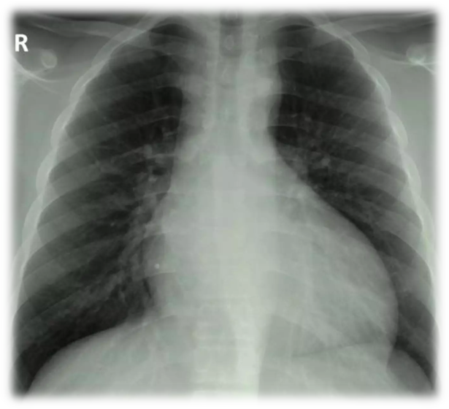
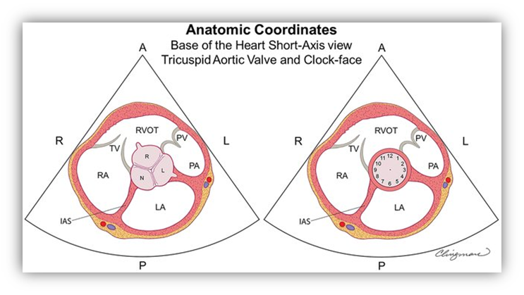
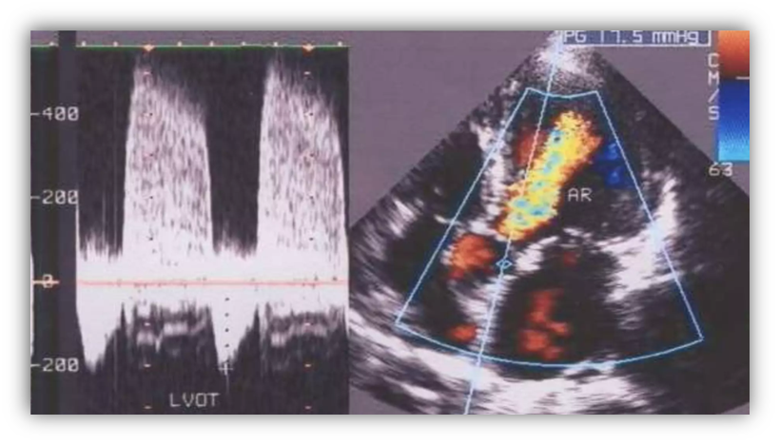
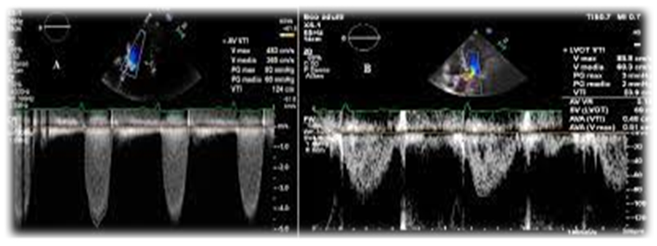
Imaging
Echocardiography is an important diagnostic test.
CT
X-ray
Angiography
Cardiac catheterization

Slide 17

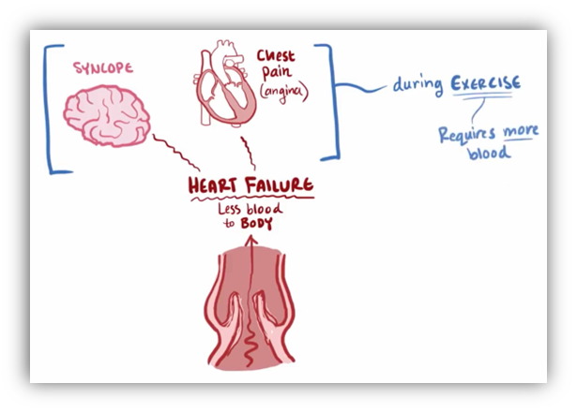
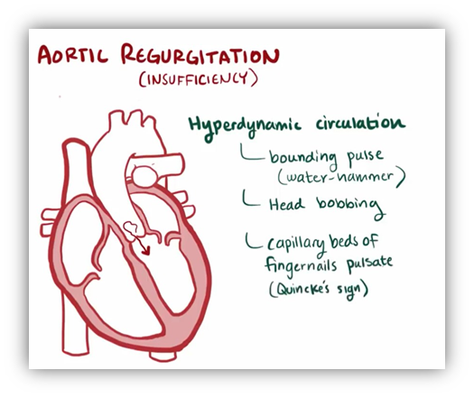
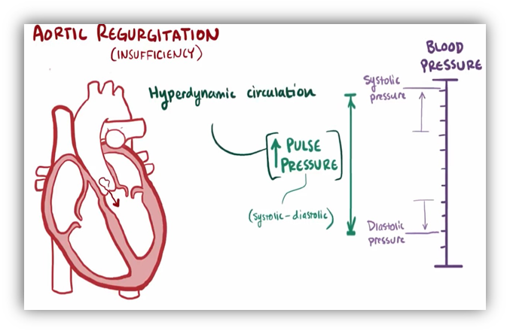
Suspiction
Aortic valve stenosis
Aortic valve regurgitation
dyspnea
angina
intolerance to physical exertion
Syncope
heart murmurs
heart failure
Heart murmurs
Increased pulse pressure
Dilation of the aorta
Bicuspid valve
Symptoms of heart failure

Slide 18
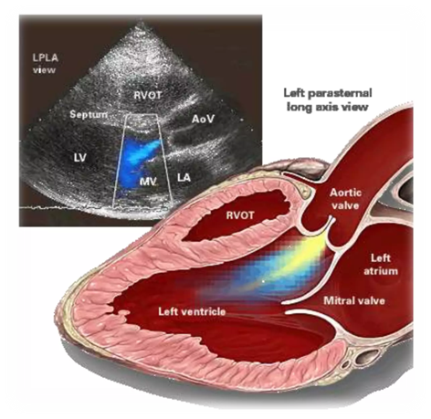
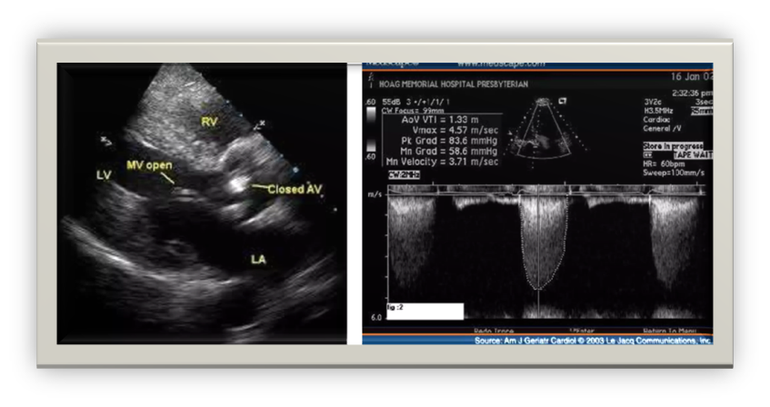
Confirmation of the diagnosis
Aortic valve stenosis
Aortic valve regurgitation
The gold standard for confirming the diagnosis of aortic insufficiency is echocardiography (90% sensitivity and specificity).
Cardiac MRI is used if echocardiography is suboptimal.
The appearance of regurgitation in these examinations is a characteristic sign.
The first choice is echocardiography
decreasing in AVA
increasing in aortic jet velocity

Slide 19
Differential diagnosis
Aortic valve stenosis
Aortic valve regurgitation
Acute coronary syndrome
Mitral stenosis
Mitral regurgitation
Aortic stenosis
Patent ductus arteriosus
Infective endocarditis
Tricuspid stenosis
Pulmonary valve regurgitation
Pregnancy
Thyrotoxicosis
Hyperthermia
Arteriovenous fistula
1. Acute coronary syndrome
2. Hypovolemic shock
3. Myocardial infarction
4. Other valve pathologies (mitral stenosis, mitral insufficiency)

Slide 20
Denial
Aortic valve stenosis
Aortic valve regurgitation
If the AVA is normal on echocardiography (3 cm2, aortic jet velocity less than 2 m/s)
The mean gradient on catheterization is less than 20 mm Hg st.
The diagnosis can be ruled out by the absence of regurgitation on imaging.

Slide 21
Determination of the cause
To determine the cause of aortic valve stenosis, the anamnesis and clinical examinations are usually sufficient.

Slide 22
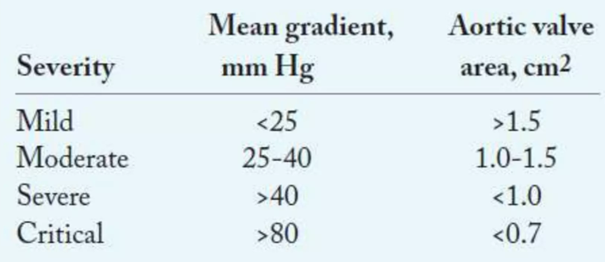
Severity and complications
Aortic valve stenosis
Aortic valve regurgitation
Compensated stage -
asymptomatic,
there is minimal regurgitation,
the left ventricular ejection function and systolic volume are normal
Decompensated stage -
asymptomatic, but there is left ventricular dysfunction (ejection fraction decreased and/or enlarged)
or symptomatic.
Clinical results
Anamnesis
Echocardiograpic results

Slide 23
Treatment principles
Aortic valve stenosis
Aortic valve regurgitation
Eliminating stenosis
Prevention
And treatment of complications
Eliminating regurgitation,
prevention and treatment of complications

Slide 24
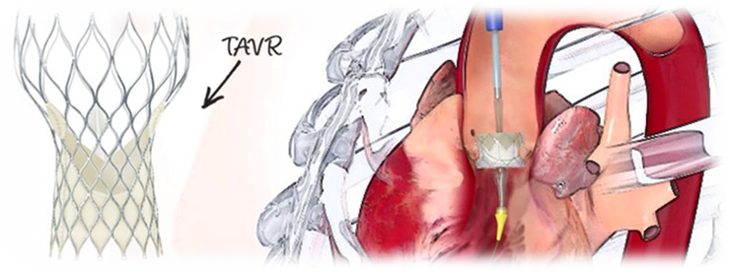
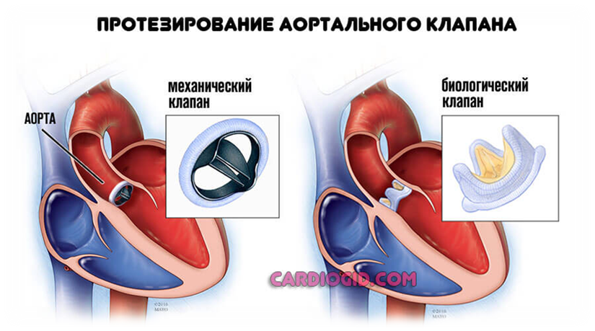
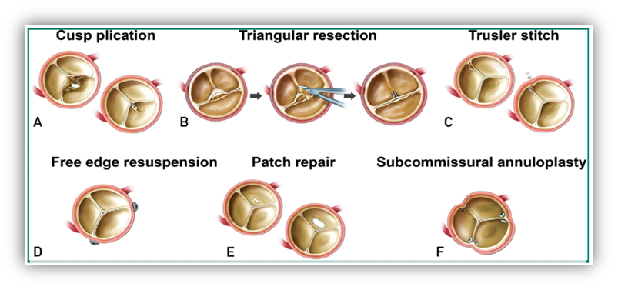
Treatment methods
Aortic valve stenosis
Aortic valve regurgitation
Surgical aortic valve replacement
Transcatheter aortic valve replacement
Medical treatment
Surgical intervention - valve replacement (the most effective method) or repair.
Percutaneous interventions - valve replacement.
Medical - prevention and treatment of complications

Slide 25
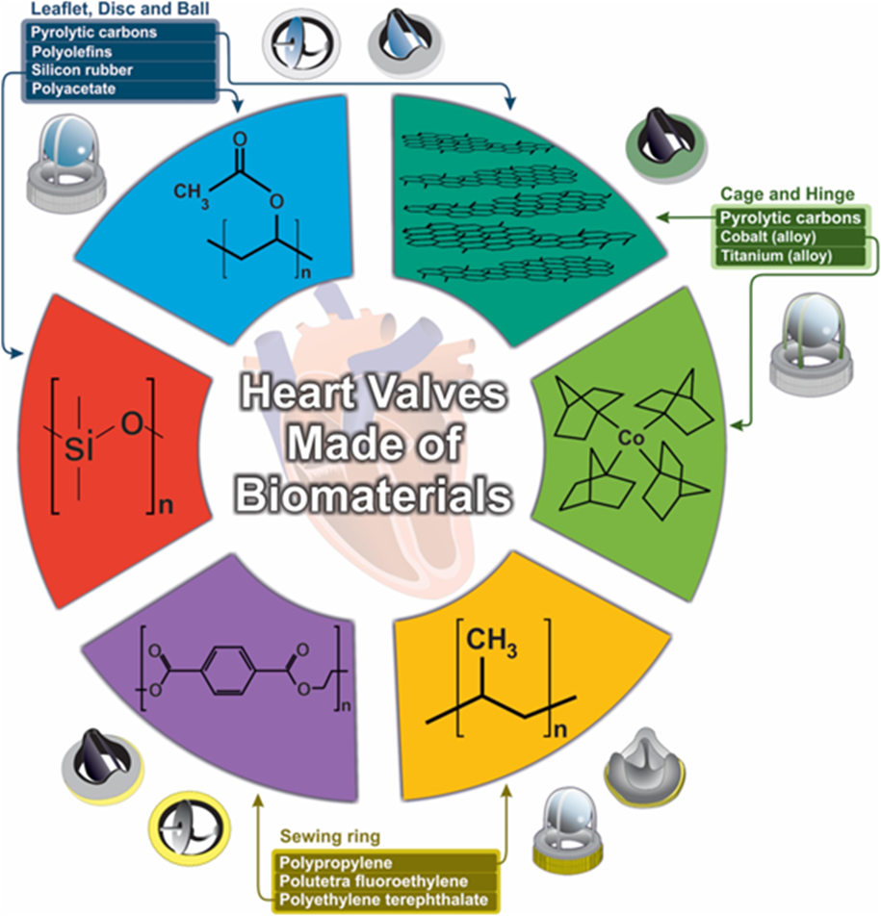
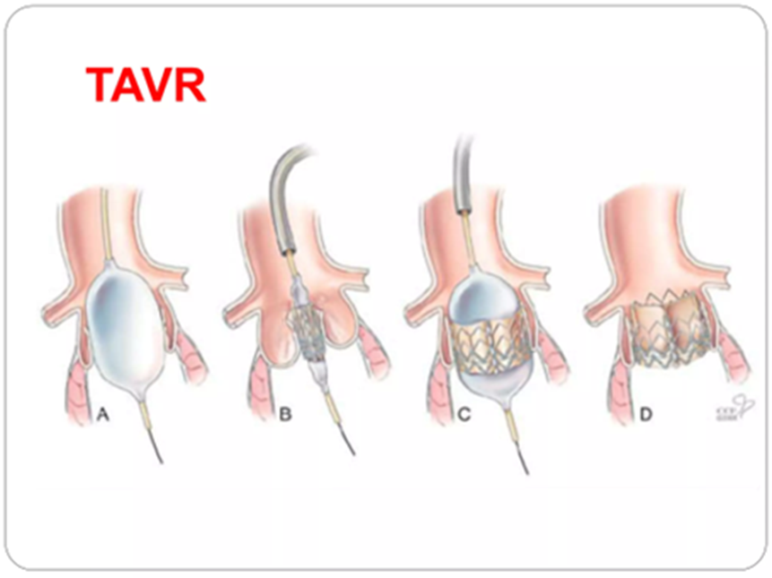
Choosing the valve replacement method (surgical and transcatheter), the risk of intervention and the individual characteristics of the patient are taken into account.

Slide 26

Indications for surgery
Aortic valve stenosis
Aortic valve regurgitation
Symptomatic, severe AS
Acute aortic insufficiency (especially due to infective endocarditis and aortic dissection
Decompensated chronic aortic insufficiency (symptomatic patients, reduced left ventricular ejection fraction (<50%), left ventricular dilatation - end-diastolic diameter > 70mm or end-systolic diameter > 50mm)
Concomitant heart disease that requires surgical intervention

Slide 27
Contraindications to the operation
Aortic valve stenosis
Aortic valve regurgitation
Asymptomatic
Mild AS patients
Asymptomatic
in cases where the left ventricular function is not disturbed

Slide 28
Treatment approach
Aortic valve stenosis
Asymptomatic
Mild stenosis
Moderate stenosis
follow-up and medical prevention of complications are reccomended.
Symptomatic patients
Severe stenosis
Surgical or transcatheter valve replacement is recommended

Slide 29
Treatment approach
Aortic valve regurgitation
In acute aortic valve regurgitation the first choice is surgical valve replacement.
In the compensatory stage of chronic valvular insufficiency monitoring and conservative treatments are carried out.
In the decompensation stage of chronic valve deficiency surgical valve replacement is the first choice.
Valve repair can be used in selected patients and percutaneous valve replacement in those with contraindications to surgery.

Slide 30
Prognosis
Aortic valve stenosis
Aortic valve regurgitation
In symptomatic and severe stenosis, if the valve is not replaced, the prognosis is poor and the mortality rate is high.
The average survival for patients with angina is 5 years,
with syncope, 3 years,
and with chronic heart failure, 2 years.
In acute aortic insufficiency, the prognosis is poorer
in chronic aortic insufficiency, the prognosis is good until heart failure occurs.

Slide 31
Profilaction
There is no specific primary prevention.

Slide 32
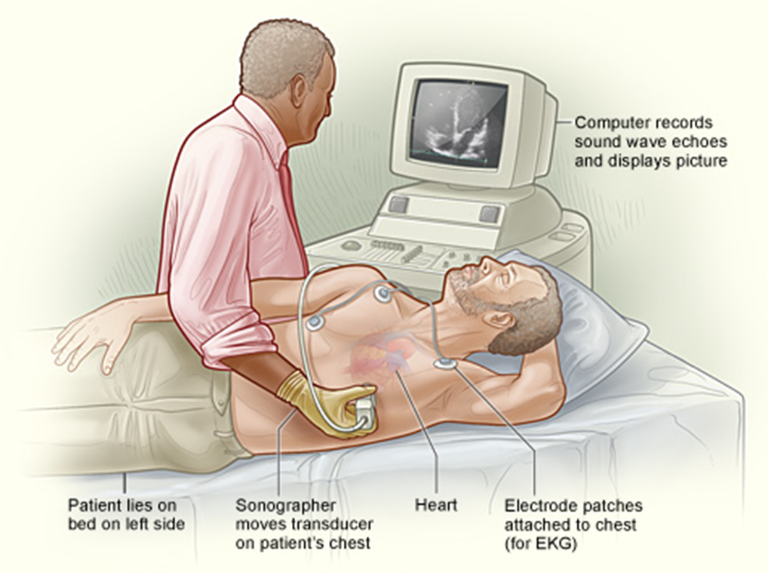
Screening
Screening is performed with echocardiography.

Slide 33
Follow up
Aortic valve stenosis
Aortic valve regurgitation
Clinical and echocardiographic examinations are recommended
annually for asymptomatic,mild and moderate AS,
and twice a year for severe stenosis.
In some cases, a stress test is also performed.
In patients with compensated aortic insufficiency and patients with the bicuspid aortic valve, the clinical and echocardiographic follow-up is recommended annually
in patients with decompensated aortic insufficiency follow-up every 3-6 months .

Slide 34
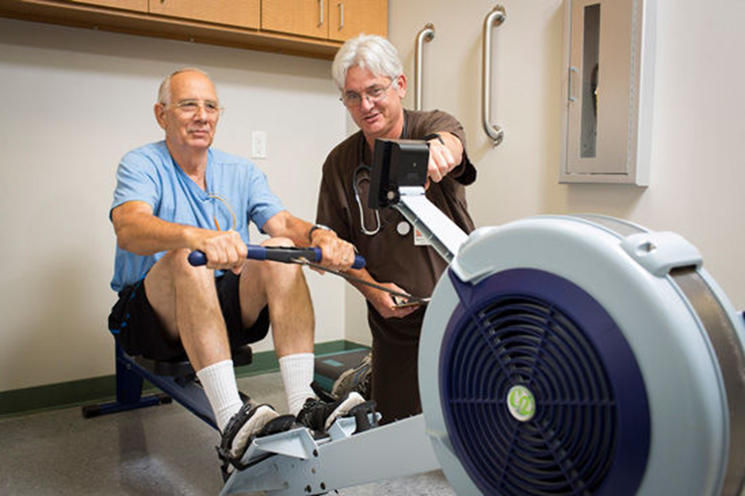
Rehabilitation
Rehabilitation is carried out in a general way

Slide 35
Thank you for attention.

