Slide 1
Congenital heart defects
Phd, Md Parvana Aydinova
Department of 1st Surgical Diseases

Slide 2
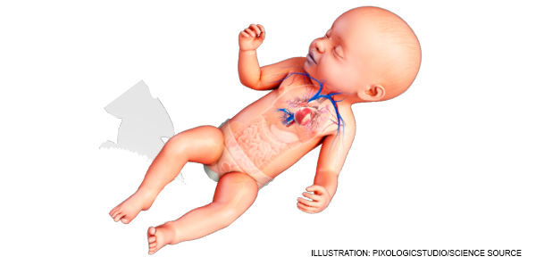
Definition
Congenital heart defects (CHD)
are structural abnormalities
of the heart valves,
heart wall, or heart vessels
that are present at birth.

Slide 3
Characteristic features
The most common birth defect in newborns and is one of the leading causes of neonatal deaths.
Depending on the type of defect, it can range from completely asymptomatic to life threatening.
Asymptomatic defects are usually detected incidentally during an examination.
Symptoms are variable and the main complaints are dyspnea, tachypnea, bluish discoloration of the skin and mucous membranes (cyanosis), inability to gain weight, frequent illness, and fatigue.
Echocardiography is mainly used to make the diagnosis. Treatments are minimally invasive interventions or surgery

Slide 4

Occurrence frequency
The most common type of birth defect, occurring in about 0.8-1% of newborns

Slide 5
Classification
According to the clinic
(cyanotic and non-cyanotic)
According to the treatment
(critical və non-critical)
Cyanotic defects
(right-to-left shunt)
Tetradology of Fallot
Truncus Arteriosus
Total anomalous pulmonary venous return
Tricuspid atresia
Transposition of the great arteries
Hypoplastic left heart syndrome
Ebstein's anomaly
Non - cyanotic defects
(left-to-right shunt)
Atrial septal defect
Ventricular septal defect
Atrioventricular septal defect
Patent ductus arteriosus (Ductus Botalli)
Malformations causing right-sided heart failure
Pulmonary valve stenosis
Malformations causing left-sided heart failure:
Aortic stenosis
Coarctation of the aorta
Coronary artery anomalies
Not requiring immediate
intervention defects
Requiring immediate intervention
(critical CHD)
Hypoplastic left heart syndrome
Tetradology of Fallot
Truncus Arteriosus
Total anomalous pulmonary venous return
Tricuspid atresia
Transposition of the great arteries
Patent ductus arteriosus (Ductus Botalli)
Ebstein's anomaly
Coarctation of the aorta
A single ventricle

Slide 6

Risk factors
The etiology of CHDs is unknown
Infectious diseases during pregnancy
Alcohol and tobacco
Some chromosomal and genetic causes
Taking certain medications
(15%) is considered to increase the risk of CHD.

Slide 7
The main pathogenetic mechanism
In cyanotic defects
Non cyanotic defects
In obstructive defects
A right-to-left transition occurs
Left-to-right shunting defect
There is no cyanosis at the beginning
Deoxygenated blood passes
into the general circulation
There is no cyanosis initially
Decompensation of the ventricle
As the disease progresses,
the lungs are overloaded
Heart failure
Cyanosis
pulmonary hypertension
right-to-left shunting
Cyanosis

Slide 8
Clinical course
Cyanotic defects
usually presents with cyanosis from birth and is diagnosed earlier.
Non cyanotic defects
depending on the size of the defect, the symptoms can vary from asymptomatic to severe heart failure symptoms.
Small defects are often asymptomatic or mildly symptomatic at an early age
In the case of large defects, it is related to the loading of the lungs
dyspnea
don't get tired easily
sweating
retardation of physical development
not gaining weight
manifests itself with symptoms such as

Slide 9
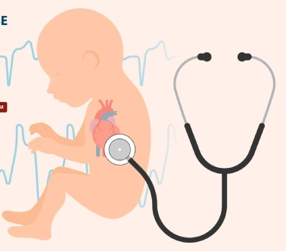
The most common complications
Heart failure
Pulmonary hypertension
Liver failure
Concomitant infectious diseases
Sudden cardiac arrest

Slide 10
Clinical exam
Depending on the type, it can show different symptoms and complaints
In symptomatic forms
cyanosis
heart murmurs on auscultation
inability to gain weight
poor physical growth
frequent infection
sweating when feeding

Slide 11
Laboratory test
Hemoqlobin
Hematocrit compensator
Blood viscosity increases
In blood in cyanotic CHDs

Slide 12
Imaging and other examinations
Most patients can be diagnosed with prenatal screening USM during pregnancy.
In the diagnosis of CHDs
Exocardiography (ExoCQ) plays an important role.
CT
MRI
Angiography
Electrocardiogram (ECG) – usually not a specific test for CHDs, it is used mostly to diagnose arrhythmias in children
Cardiac catheterization is performed as indicated and for pressure measurements.

Slide 13
Suspection
Heart murmurs on auscultation
Pressure and saturation difference in hand and foot
Sweating, dispnea when feeding
Getting frequent infections
Inability to gain weight
Poor physical growth
A bluish color to the skin or mucous membrane
Clubbed Fingers

Slide 14
Clarifying the diagnosis
ExoCQ is the main examination method in the diagnosis of many CHD.
Sometimes other examination methods (CT, MRI, angiography and cardiac catheterization) are used to clarify the diagnosis and get additional information.

Slide 15
Differential diagnosis
CHDs primarily with each other
With acquired cardiac diseases
And sometimes with pulmonary diseases

Slide 16
Diagnostic criteria
Defects in the interatrial and interventricular septum
Stenosis or atresia of the valves
Stenosis of blood vessels
Transposition of arteries
Patent ductus arteriosus (Ductus Botalli)
Enlarged heart chambers

Slide 17

How to rule this out?
Mainly on by echocardiography
Transesophageal ExoQQ (TEE) if needed
Or (CT, MRI) can be denied.

Slide 18

Determination of the cause
There is usually no need to determine the cause
.

Slide 19
Determination of severity
Clinical symptoms
A liver panel
Hemogram
Echocardiogram
Cardiac catheterization

Slide 20
Treatment principles
Defect elimination
Prevention and treatment of complications

Slide 21
Treatment methods
Surgery
Minimally invasive
Medical

Slide 22
Basic instructions for the operation
Tetradology of Fallot
Transposition of the great arteries
Atrial septal defect (ASD)
Ventricular septal defect (VSD)
However, in general, early intervention for the majority of CHD is recommended.

Slide 23
Contraindications to the operation
Severe active infection
Irreversible pulmonary hypertension
.

Slide 24
Treatment approach
Minor and asymptomatic defects can be tracked
Depending on the type of defect, surgical or minimally invasive methods are chosen.
Symptomatic and complicated defects, as well as serious CHDs, are corrected in early by surgical intervention (or invasive methods).

Slide 25

The prognosis
The prognosis of many CHDs
is good if treated in time.

Slide 26

Profilaction
There is no specific primary prevention.

Slide 27
Scrining
Also, pulse oximetry is performed on newborns
A doppler ultrasound examination is performed during pregnancy.

Slide 28

Follow up
Asymptomatic patients are monitored by a pediatric cardiologist for 3-6 months or yearly, depending
on the type of defect.

Slide 29

Rehabilitation
It is carried out in a general manner

Slide 30
Features in special groups
Asymptomatic defects may become symptomatic during pregnancy
When some defects are accompanied by genetic diseases (for example, Down's syndrome), more severe, pulmonary hypertension may occur earlier

Slide 31
Thank you for your attention.

