Slide 1
Acute mesenteric arterial occlusion
Acute mesenteric arterial occlusion
Prof. Dr. Nuru Bayramov
Dr. Farah Gahramanova

Slide 2
Acute mesenteric arterial occlusion
Acute mesenteric arterial occlusion
acute ischemic injury caused by thromboembolism or thrombosis of intestinal arteries
can be complicated by necrosis and perforation of intestines, and acute peritonitis
The most common type of acute ischemic disease of the small intestine
In more than half of patients, the definitive diagnosis is made at the time of surgery
Sudden onset of severe abdominal pain out of proportion to the physical examination, and severe progressive course
No specific clinical, laboratory and standard imaging
High mortality despite treatment (50-90%)

Slide 3
Classification
Acute mesenteric arterial occlusion
The most common type of acute ischemic disease of the small intestine (60-70%)
Intestinal ischemia is classified into four types:
1. Acute arterial occlusion (60-70%)
2. Acute non-occlusive ischemia (20-30%)
3. Acute venous thrombosis (5%)
4. Chronic arterial ischemia
cause:
thromboembolism
thrombosis
localisation:
small intestine
colon
magistral vessels
seqmental vessels
stage:
ischemia
necrosis
peritonitis

Slide 4
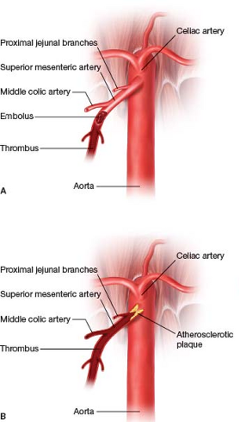
Etiology
Acute mesenteric arterial occlusion
Acute mesenteric arterial occlusion
Embolism
50%
Thrombosis
25%
Acute myocardial infarction
Atrial fibrillation
Arrhythmia
Valvular diseases
Cardiac aneurysm
Iatrogenic
Atherosclerosis
Rarely
Vasculitis
Hypercoagulable states
Traumas

Slide 5
Pathogenetic mechanism
Acute mesenteric arterial occlusion
Arterial occlusion
Activation of collaterals
İnsufficient perfusion
Sufficient perfusion
Complete or incomplete restoration
İschemia-reperfusion injury
DAMPs are released from damaged cells and activate the Toll-like reseptors
Asepric inflammation
Necrosis
Infection develops
Gangrene
Bacterial translocation
Perforation
Peritonitis
Sepsis
MODS

Slide 6
Clinical course
Acute mesenteric arterial occlusion
ischemia
necrosis
Pain decreases
peritonitis
Perforation
Sudden onset severe abdominal pain
3-6 hours
Inrestinal bleeding may occur
Peritonitis
Abdominal compartment
MODS

Slide 7
Clinical examination
Acute mesenteric arterial occlusion
Sudden onset severe abdominal pain – most common symptom
A discrepancy between the severity of the abdominal pain and minimal findings (or lack of findings) (“pain out of proportion to the physical examination”)
Bloody stool
Rapid deterioration
Signs of acute peritonitis and abdominal compartment syndrome within hours

Slide 8
Laboratory examination
Acute mesenteric arterial occlusion
There is no spesific laboratory findings.
Leukocytosis
Acidosis
Crp ↑
Lactate ↑
İntestine-related creatine kinase (CK-BB) ↑

Slide 9
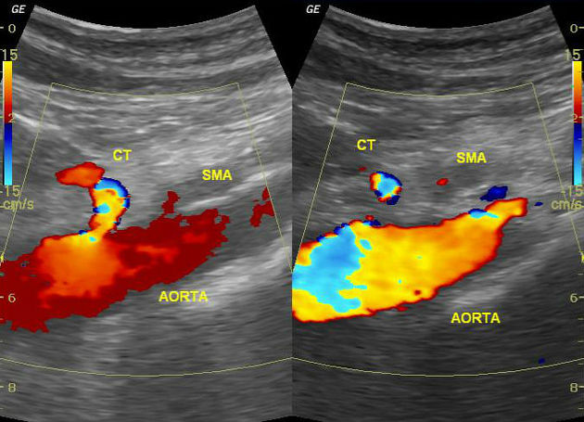
Imaging methods
Acute mesenteric arterial occlusion
Preoperative examinations, including CT-angiography, have 60-70% diagnostic accuracy
Doppler US – arterial occlusion
KT-angioqrafiya – the first choice of imaging technique
Endoscopy – not specific (severe mucosal pallor and necrotic areas may be shown)
Prof. Dr. NYBay, Dr. Farah Gahramanova

Slide 10
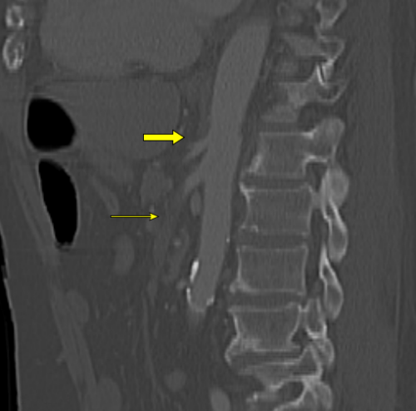
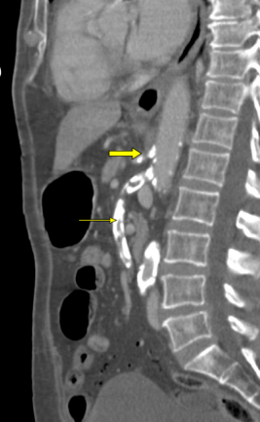
Acute mesenteric arterial occlusion
CT-angiography
Mesenteric arterial occlusion,
Focal or segmental bowel wall thickening
Intestinal pneumatosis with portal vein gas
Bowel dilation
Mesenteric stranding (edema)
Portomesenteric thrombosis
Free air in abdominal cavity (perforation)
Solid organ infarction
SMA embolic occlusion
Intestinal pneumatosis
Pneumoperitoneum (perforation)
Gas in portal vein
SMA thrombotic occlusion

Slide 11
Suspicion
Acute mesenteric arterial occlusion
Sudden onset severe abdominal pain
Pain out of proportion to the physical examination
Bloody stool
Progressive deterioration
Peritonitis
Abdominal compartment syndrome
Continuous acidosis, intestine-related creatine kinase (CK-BB)↑

Slide 12
Confirmation of diagnosis
Acute mesenteric arterial occlusion
There are no specific clinical, laboratory and standard imaging signs.
Suspicion and differentiation
CT-angiography
diagnostic laparotomy (laparoscopy)
In more than half of patients, the definitive diagnosis is made at the time of surgery
Early stages - pallor of the intestinal wall and lack of pulsation
Late stages – focal or extended gangrene, perforation, peritonitis

Slide 13
Differential diagnosis
Acute mesenteric arterial occlusion
It is necessary to distinguish from the diseases that cause severe abdominal pain:
Abdominal aortic aneurysm rupture
Acute pancreatitis
Strangulated bowel obstruction
Acute inflammatory diseases and perforation of hollow organs

Slide 14
Diagnostic criteria
Acute mesenteric arterial occlusion
Laparotomy/laparoscopy:
intestinal ischemia and necrosis
Clinical sign and symptoms
sudden onset severe, and continues pain for hours
progressive deterioration – shock, sepsis and organ failure (multiorgan)
KT- angiography:
Mesenteric arterial occlusion
focal or segmental bowel wall thickening
intestinal pneumatosis with portal vein gas
bowel dilation
mesenteric stranding (edema)
portomesenteric thrombosis
free air in abdominal cavity (perforation)
solid organ infarction

Slide 15
Exclusion of diagnosis
Acute mesenteric arterial occlusion
Normal blood flow in angiography and normal endoscopic appearance of intestinal mucosa can rule out the diagnosis

Slide 16
Determination of the cause
Acute mesenteric arterial occlusion
Clinical and laboratory studies (thrombophilia) are helpful to reveal the cause.

Slide 17
Determination of the severity
Acute mesenteric arterial occlusion
  general condition of patients
  hemodynamic parameters
  laboratory and CT-angiography
  diagnostic laparotomy

Slide 18
Treatment principles
Acute mesenteric arterial occlusion
İmmediate treatment
Revascularization
Resection
Prevention and treatment of complications

Slide 19
Treatment methods
Acute mesenteric arterial occlusion
SURGICAL
embolectomy
bypass
stenting
resection
ENDOVASCULAR
embolectomy
angioplasty
stenting
CONSERVATİVE
antikcoagulants
antibiotics
supportive therapy

Slide 20
Surgical treatment
Acute mesenteric arterial occlusion
stenting
bypass
resection
embolectomy

Slide 21
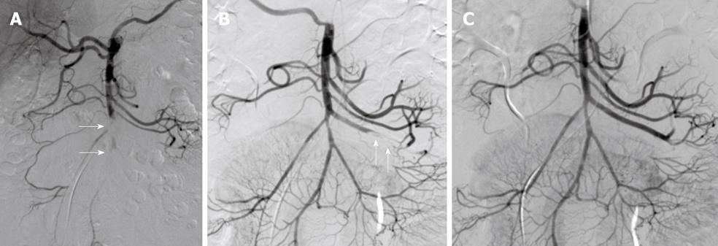
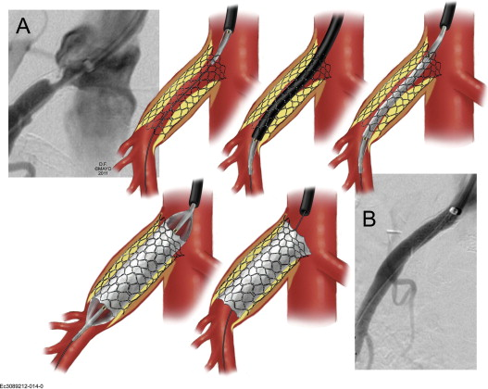
Endovascular treatment
Acute mesenteric arterial occlusion
ENDOVASCULAR
embolectomy
angioplasty
stenting

Slide 22
Indications for surgery
Acute mesenteric arterial occlusion
Acute peritonitis or perforation, hemodynamic instability are indications for emergency surgery.

Slide 23
Contraindications for surgery
Acute mesenteric arterial occlusion
Agonal state

Slide 24
Treatment approach
Acute mesenteric arterial occlusion
Intestinal necrosis
no
revascularization
yes
Resection ±revascularization
And second-look operation

Slide 25
Prognosis
Acute mesenteric arterial occlusion
Mortality 50-90%
Advanced mesenteric ischemia requiring bowel resection is associated with a 15-fold increase in mortality
Poor prognostic factors
Older age
Chronic kidney disease
Diabetes
Arrhythmia
Heart failure
Hypotension
Small and large bowel involvement
İncreased lactate
Delay to surgery

Slide 26
Prophylaxis
Acute mesenteric arterial occlusion
Primary prophylaxis Treatment of cardiovascular diseases
Secondary prophylaxis Anticoagulants and antiaggregants

Slide 27
Screening
Acute mesenteric arterial occlusion
no standard screening method

Slide 28
Follow-up
Acute mesenteric arterial occlusion
Following mesenteric revascularization, it is recommended to follow up patients with Doppler US or CT angiography at 1, 6, 12 months and then once a year thereafter

Slide 29
Rehabilitation
Acute mesenteric arterial occlusion
Rehabilitation is carried out in a general way.

Slide 30
Characteristics in special groups
Acute mesenteric arterial occlusion
More severe course in patients with older age, chronic renal failure and diabetes

Slide 31
Acute mesenteric arterial occlusion
Thank you for your attention.

