Slide 1
Diabetic foot
Ph.dr. Azer Hummatov
I department of surgical diseases,
Azerbaijan Medical University

Slide 2
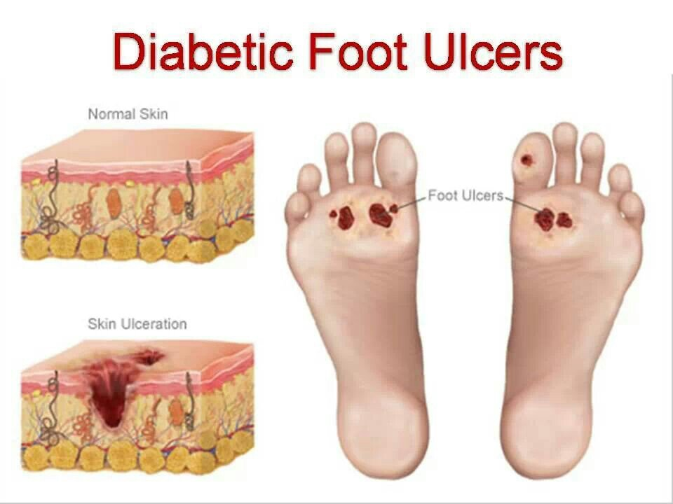
How is it defined?
Diabetic foot
Diabetic foot ulcers are an injury to all layers of skin and even deep tissues (bones, tendons), purulent-necrosis or gangrene that usually occur on the soles of the feet, as a result of peripheral neuropathy or peripheral arterial disease in diabetes mellitus (DM) patients.
Ph.dr.Azer Hummatov

Slide 3
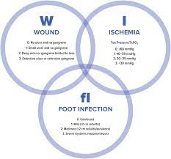
WIFI classification for the assessment of diabetic foot ulcers
What is the most commonly used classification?
Diabetic foot
0 . Noninfected and no symptoms
1. Presence of local edema or infiltration, 0.5-2 cm erythema around the wound, local tension or pain, local hyperthermia, purulent discharge (at least two of the listed signs must be present to include patients in this grade).
2. Presence of local infection, transmission of infection to deeper layers (osteomyelitis, arthritis, fasciitis), lack of signs of systemic inflammation.
3. Signs of local inflammation + signs of systemic responce.
Grade | Ankle-brachial index | Ankle systolic pressure (mmHg) | Toe pressure or tcpO2 (mmHg)
0 | ≥ 0.80 | > 100 | ≥ 60
1 | 0.60 – 0.79 | 70 – 100 | 40 – 59
2 | 0.40 – 0.59 | 50 – 70 | 30 – 39
3 | ≤ 0.39 | < 50 | < 30
Azer Hummatov

Slide 4

What are the main causes and risk factors?
Diabetic foot
ill-fitting footwear,
poor glycemic control,
calluses,
foot deformities,
improper foot care,
underlying peripheral neuropathy
and poor circulation,
dry skin
Azer Hummatov

Slide 5
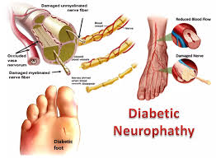

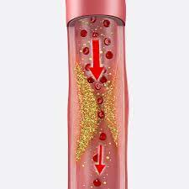
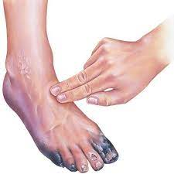
What are the main causes and risk factors?
Diabetic foot
The main cause is neuropathy and angiopathy caused by impaired glucose tolerance.
Patients with diabetes without paraesthesia, peripheral artery diseases, and foot complications are included in the low-risk group.
Azer Hummatov

Slide 6
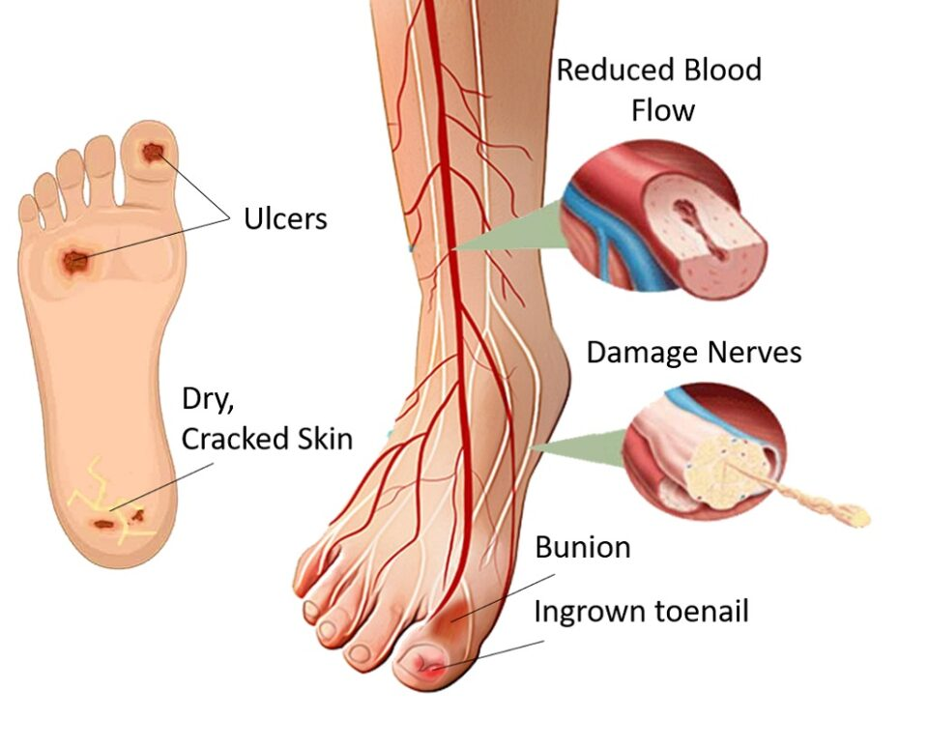
What is the main pathogenetic mechanism?
Diabetic foot
The four main branches of pathophysiology include neuropathy, ischemia, nutritional dysfunction, and infection.
A well-perfused foot is more resistant to ulceration and infection than one that is suffering from peripheral vascular disease
Azer Hummatov

Slide 7
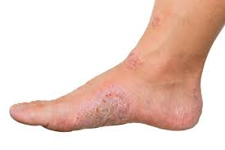

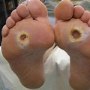
What is natural history? (clinical course)
Diabetic foot
neuropathy
amputation
gangrene
phlegmon
infection
Loss of tactile and temperature sensation
recover
Azer Hummatov

Slide 8
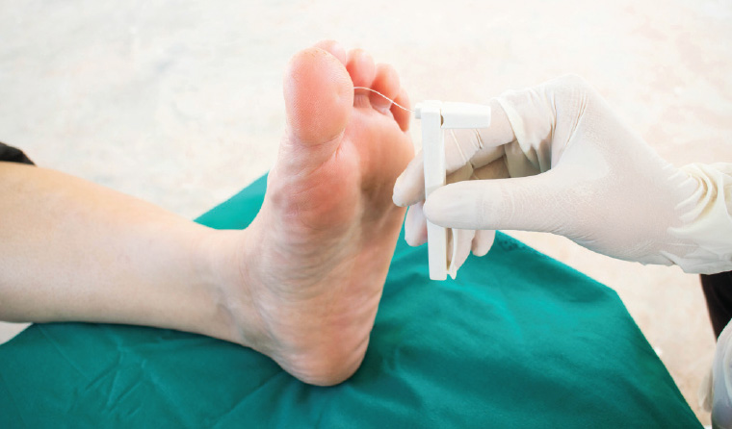
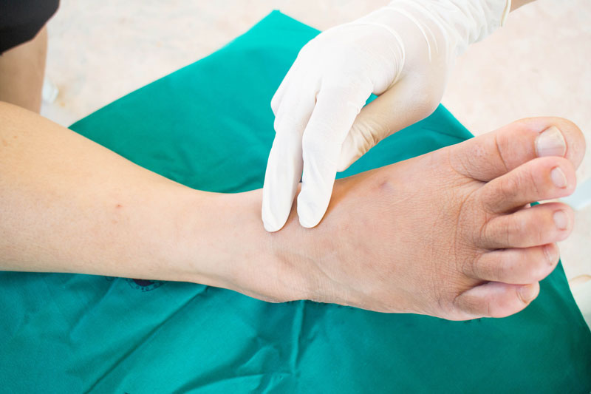
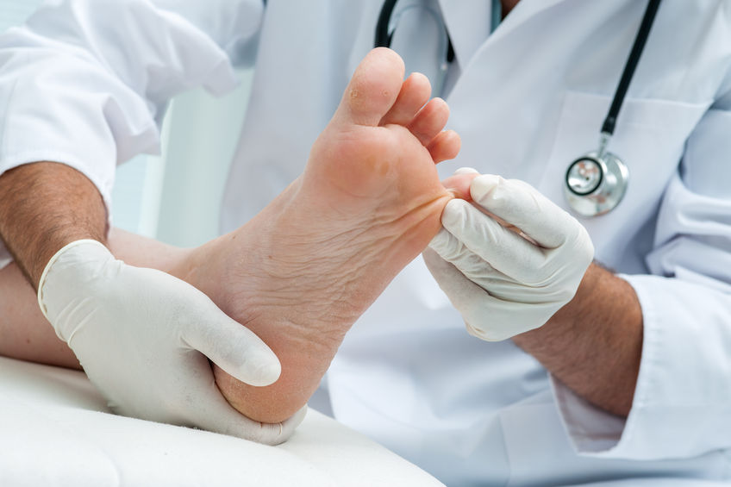
Clinical examination
Diabetic foot
Tingling, burning, or pain in your feet.
Loss of sense of touch or ability to feel heat or cold very well.
Loss of hair on your toes, feet, and lower legs.
Dry, cracked skin on your feet.
A change in the color and temperature of your feet.
Thickened, yellow toenails.
Fungus infections such as athlete’s foot between your toes.
A blister, sore, ulcer, infected corn, or ingrown toenail
.
Azer Hummatov

Slide 9
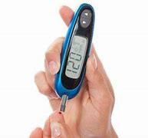
Laboratory examination
Diabetic foot
.
DF does not have specific laboratory findings
an erythrocyte sedimentation rate (ESR) of 70 mm/h raises suspicion of osteomyelitis
Sugar elevation, leukocytosis, CRP increase are noted during complications
Azer Hummatov

Slide 10

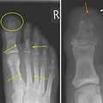
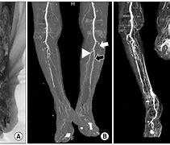
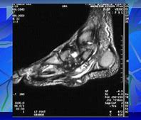
Imaging
Diabetic foot
.
State of blood circulation by Doppler angioscanning
destructions observed in bones by X-ray
extent of damage by contrast angiography
Status of the fistula path and deep tissues by MRI
Azer Hummatov

Slide 11
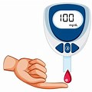
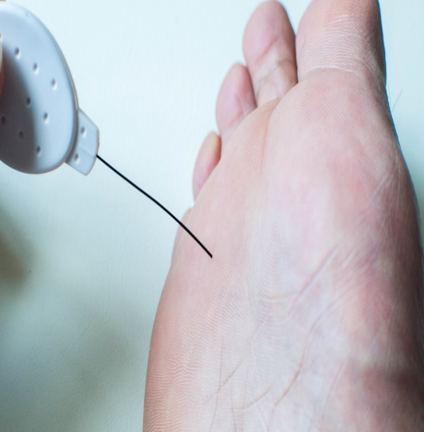
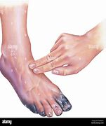

In what cases should be suspected?
Diabetic foot
long-term diabetes,
sensory and blood circulation disorders,
skin thickening (callus),
redness,
wound defect, gangrene (dry and wet).
.
Azer Hummatov

Slide 12
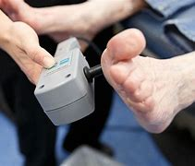
How is the diagnosis confirmed?
Diabetic foot
Diagnosis is based on clinical signs and examination
doppler
angiography
The diagnosis is clarified
X-ray
mrt
Azer Hummatov

Slide 13
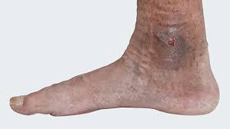
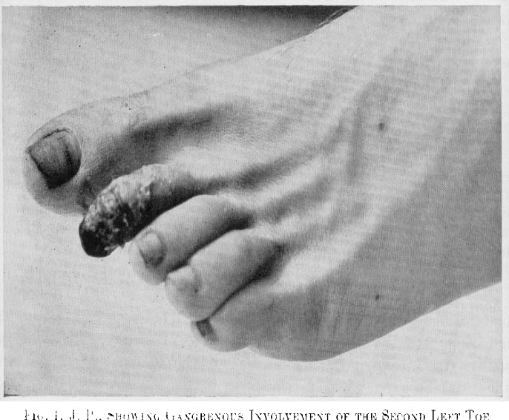
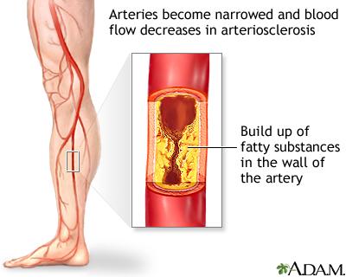
Differential diagnosis?
Diabetic foot
venous trophic ulcers are usually formed on the inner
surface of the calf, and patients have obvious varicose veins
obliterative endoarthritis usually occurs in both legs,
most patients have a history of smoking,
vascular symptoms are more pronounced
Atherosclerosis of large vessels usually begins with vascular symptoms,
and diabetic foot with neuropathy symptoms
Hümmətov Azər

Slide 14
Diagnostic criteria?
Diabetic foot
Clinical Signs
On imaging or functional examinations
.
paresthesia,
wound defect,
signs of ischemia
disruption of blood circulation
in doppler
functional, angiographic examination
loss of sensation in functional
examination
Azer Hummatov

Slide 15
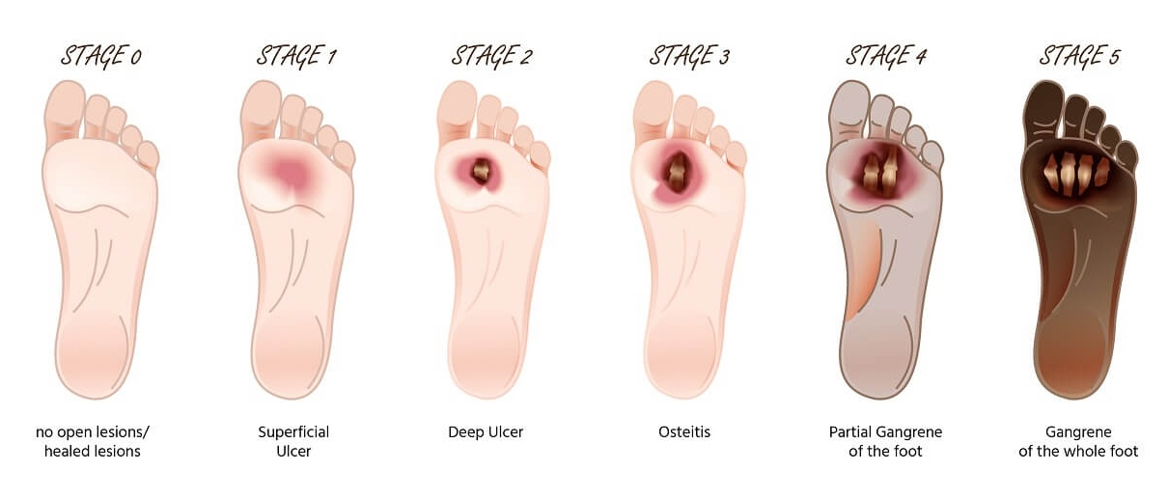
How to deny it?
Diabetic foot
It is possible to rule out DF with imaging examinations
it is possible to rule out DF with functional examinations
bone biopsy is sometimes used to rule out osteomyelitis.
Azer Hummatov

Slide 16
How to determine the cause?
Diabetic foot
Examination of blood sugar,
hemoglobin A1c,
neuropathy and angiopathy is sufficient.
allow the diagnosis to be excluded.
Azer Hummatov

Slide 17
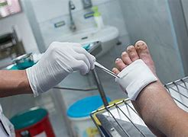
What are the treatment principles?
Diabetic foot
The treatment of diabetic foot ulcer is based on the following principles:
epithelialization
regulation of blood sugar
cleansing of the wound from necrosis and pus
treatment of neuropathy and vascular disorders
Azer Hummatov

Slide 18

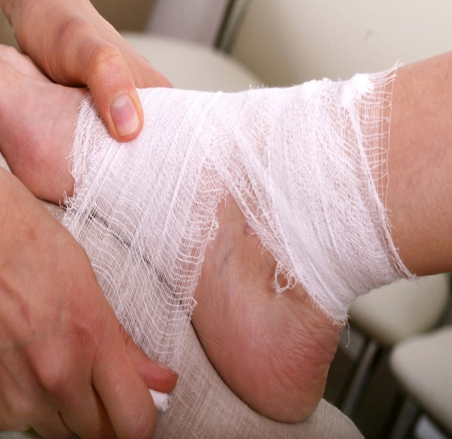
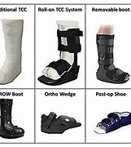
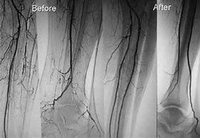
Treatment methods
Diabetic foot
Conservative treatments:
medical treatment,
weight-reducing measures,
selection of dressing materials,
antibiotics,
stem cell transplantation and other
Surgery - necroctomy (debridement, amputation), revascularization
Endovascular- stent, angioplasty
Ph.dr.Azər Hümmətov

Slide 19
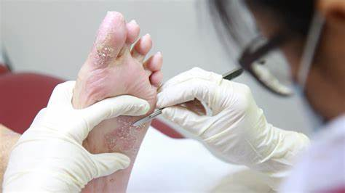
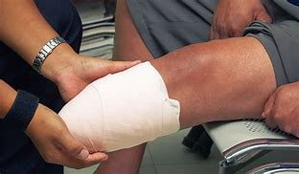
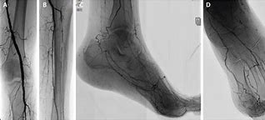
Treatment methods
Diabetic foot
What are the indications for surgery?
Surgical interventions such as debridement, amputations and revascularizations are performed in diabetic foot ulcers.
Debridement is performed in uncomplicated banal leg wounds,
amputations in dry and wet gangrenes
endovascular and open surgery in various degrees of vascular stenosis (occlusions).
Ph.dr. Azər Hümmətov

Slide 20
Contraindications to the operation?
Diabetic foot
older age group,
comorbidities,
heart and kidney failure,
shorter life expectancy,
lack of confidence that revascularization will give a positive result.
Ph.dr.Azər Hümmətov

Slide 21
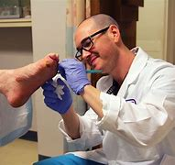
Treatment approach
Diabetic foot
The location and degree of necrosis, infection, and ischemia are taken into account in the choice of treatment.
The golden rule for healing a diabetic wound is as follows
Multidisciplinary approach - diabetic foot patients should be treated together with surgeon, endocrinologist, neurologist, invasive radiologist
Step-by-step treatment - cleaning of the wound from necrosis and pus (surgically and medication)
development of granulation tissue (medication)
.
epithelialization (medication) and revascularization as indicated.
Ph.dr.Azər Hümmətov

Slide 22
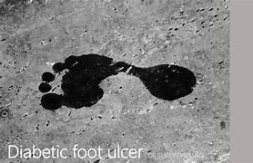
Prognosis
Diabetic foot
A revascularized diabetic foot ulcer heals, but recurrence is possible.
The recurrence probability of a healed diabetic ulcer is 42% in 1 year, and 65% within 5 years.
In 17% of these patients, the ulcer recurs at the site of the previous wound, and in 48%, it recurs in other areas of the leg (contourlateral).
The high probability of relapse requires consistent monitoring of this patients.
Ph.dr.Azər Hümmətov

Slide 23
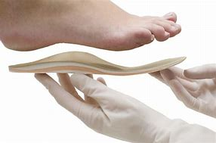
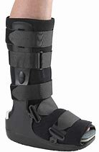
Prophylaxis
diabetic foot
It refers to specific primary prophylaxis:
Regulation of blood sugar,
elimination of symptoms of neuropathy and angiopathy,
active lifestyle,
reduction of pressure on feet,
hygienic care are considered important.
Ph.dr.Azər Hümmətov

Slide 24

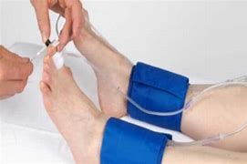
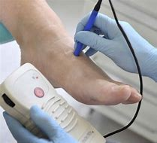
Screening
Diabetic foot
A visual examination of the legs
functional tests
doppler angioscanning should be applied
Ph.dr.Azər Hümmətov

Slide 25
Follow up
Diabetic foot
For diabetic patients without neuropathy, atherosclerosis, or deformity, it is recommended to have a check-up once a year.
For those with neuropathy or atherosclerosis but without foot deformity, it is recommended to have a check-up every 6-12 months.
Patients with neuropathy, atherosclerosis, and foot deformity should have a check-up every 3-6 months.
Patients with neuropathy, atherosclerosis, deformation, ulcer, or amputation should be under specialist control every 1-3 months.
Ph.dr.Azər Hümmətov

Slide 26
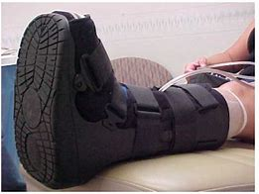
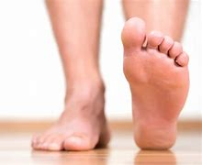
Rehabilitation
Diabetic foot
Rehabilitation is performed by special institutions and groups.
Reducing the pressure on the feet and using pressure-reducing shoes is considered essential.
Ph.dr.Azər Hümmətov

Slide 27

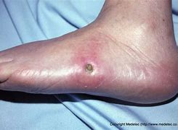
Characteristics in special groups
Diabetic foot
Pregnant women
a gynecologist should be included in the multidisciplinary team.
Revascularization (endovascular, surgical method) can be performed in patients of the older age group according to a special instruction.
Ph.dr.Azər Hümmətov

Slide 28
Diabetic foot
Thank you for your attention.
Ph.dr.Azər Hümmətov

