Slide 1
Chronic venous diseases and insufficiency
Prof. Dr. Mamed Kərimov.,
Dr. Nuranə Süleymanova
1-st Department of Surgery, Azerbaijan Medical University

Slide 2
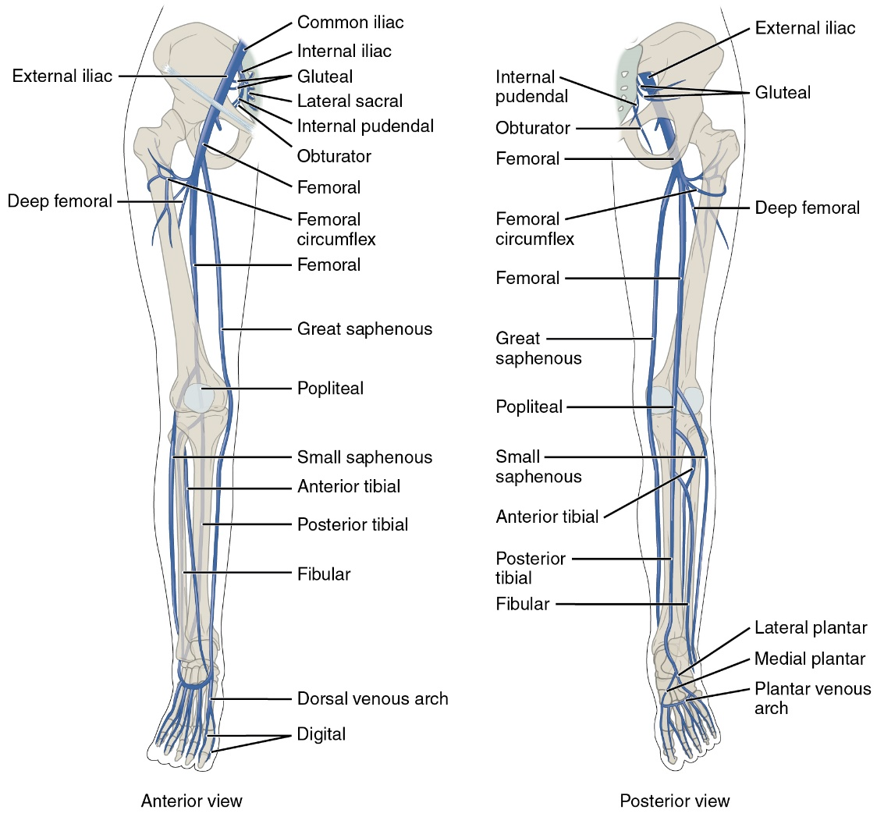
How is it defined?
Chronic venous diseases
Pathologies that cause long-term stasis in the vessels are gathered under a common name and named as follows:
Chronic venous disorders
Chronic venous diseases (chronic diseases of the veins)
Chronic venous insufficiency

Slide 3
What is the most commonly used classification?
Chronic venous diseases
(CEAP- Clinical -Etiology-Anatomy-Pathophysiology)
Clinical manifestations (C):
C0 - no visible or palpable signs of venous disease
C1 – telangiectasias or reticular vessels
C2 – Varicose veins; diameter > 3mm
C2r – Recurrence of varicose veins
C3 – edema
C4 – secondary skin and subcutaneous tissue changes:
C4a - pigmentation or eczema
C4b- lipodermatosclerosis or white scars (atrophy blanche)
C4c- phlebectatic crown
C5 – Healed venous ulcer
C6 – Active venous ulcer
C6r – Recurrent (recurrent) venous ulcer
Pathophysiological mechanism (P)
Pr - reflux
Po – occlusion
Pr,o – reflux and occlusion
Pn – it is not possible to determine the pathophysiological changes in the venous system.
Etiological (E):
Ep - primary disease
Es - secondary (postthrombotic, trauma)
Esi - secondary intravenous disease
Ese - secondary extravenous disease
Ec- is a congenital disease
En -it is not possible to determine the etiological factor.
Anatomical region (A):
As- superficial veins
Ad -deep veins
Ap- perforating veins
An – it is impossible to determine the localization of changes in the venous system.

Slide 4
What are the main causes and risk factors?
Chronic venous diseases
Advanced age,
Female gender,
Family history of venous disease,
Connective tissue weakness,
Prolonged standing,
Obesity,
Smoking,
Trauma,
Deep vein thrombosis,
High estrogen levels,
Multiple births and some congenital conditions are the main risk factors.

Slide 5
What is the main pathogenetic mechanism?
Chronic venous diseases
Valve insufficiency and reflux.
Vascular occlusion (DVT, tumors).
Dysfunction of the calf muscle venous pump (muscle dysfunction, valve failure, prolonged immobility, trauma, etc.)
Non-obstructive central hypertension (obesity, pregnancy, etc.)
Venous ischemia,
Edema,
İnflammation,
Extravasation (transendothelial infiltration of protein and other blood components),
İnduration,
Pigmentation,
Fibrosis and sclerosis,
Ulceration
Macrovascular venous stasis (venous hypertension)
Microvascular venous damage

Slide 6
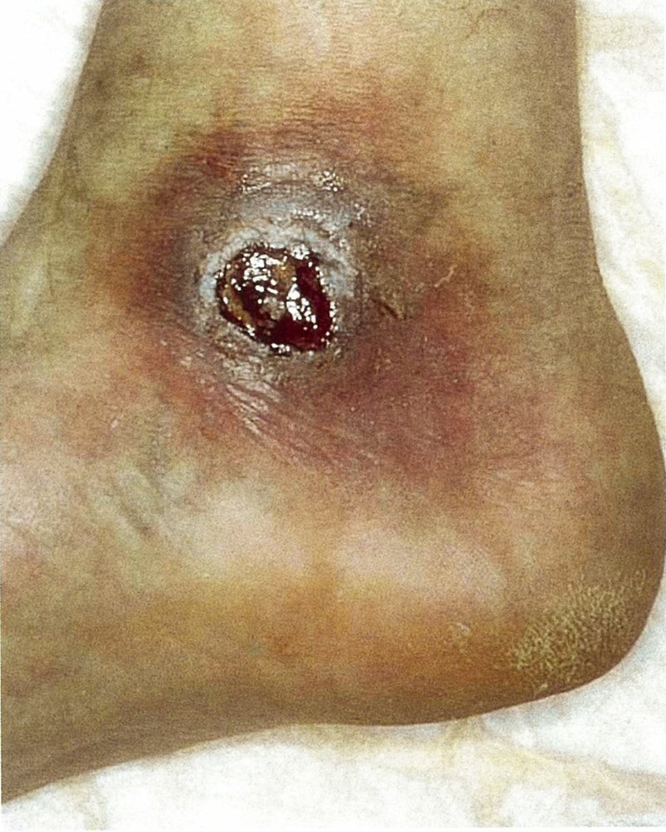
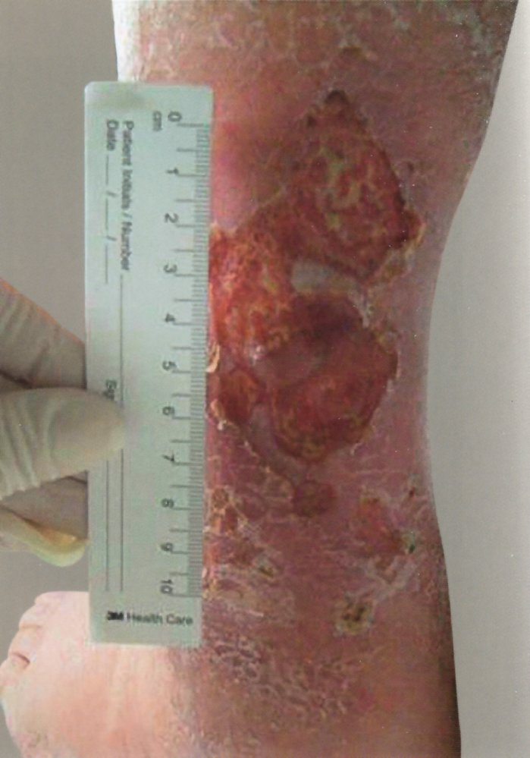
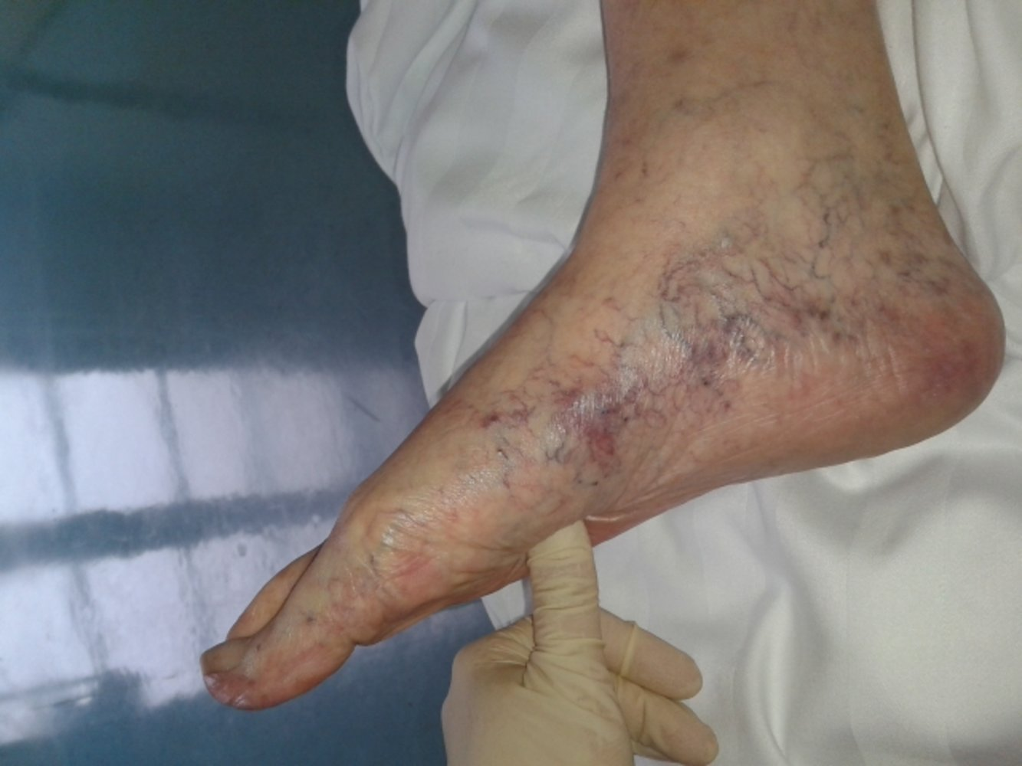
What is natural history? (clinical course)
Chronic venous diseases
Usually begins asymptomatically
It is progressive in half of the patients.
Stage 1 - reversible edema
Venous insufficiency in 3/1
(edema, skin changes and ulcers)
Ulcers tend to recur in 70% of patients
Stage 2 – persistent edema
Stage 3 – ulcer formation
and are difficult to heal in 50%.

Slide 7
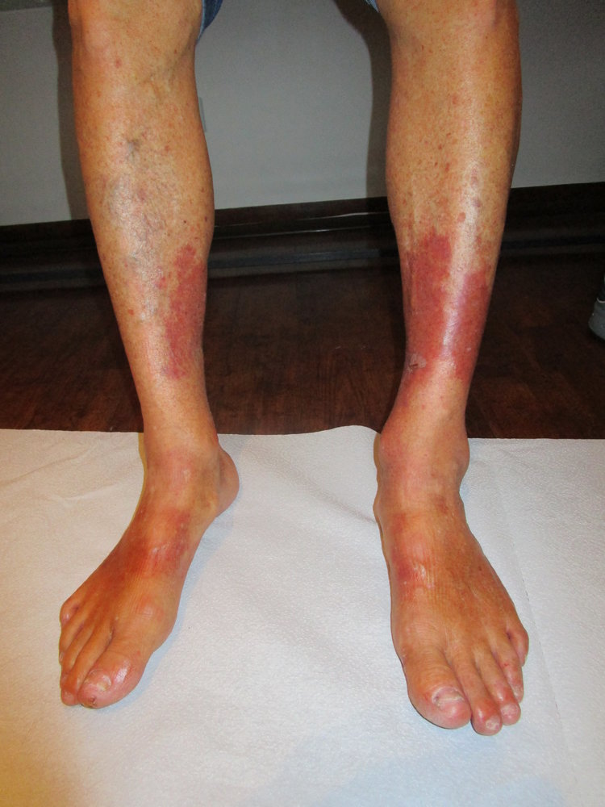
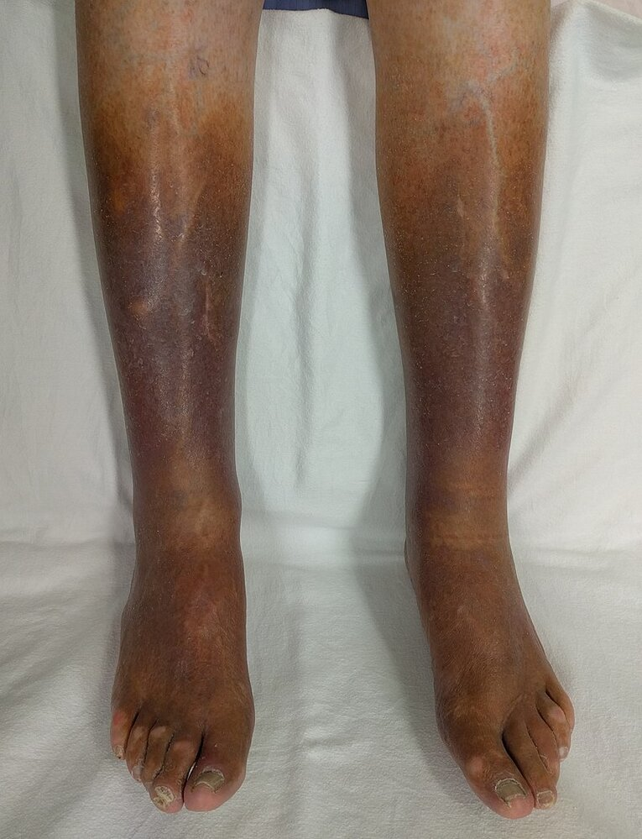
Clinical examination
Chronic venous diseases
Symptoms
Leg fatigue,
Burning,
Aching,
Convulsions,
Sometimes venous laxity
Sings
telangiectoses,
reticular
veins,
varicose veins,
edema,
pigmentation,
eczema,
lipodermatosclerosis,
phlebectatic crown,
ulcers

Slide 8
Laboratory examination
Chronic venous diseases
CVD does not have specific laboratory findings,
when complicated with thrombosis, the amount of D-dimer in the blood increases.

Slide 9
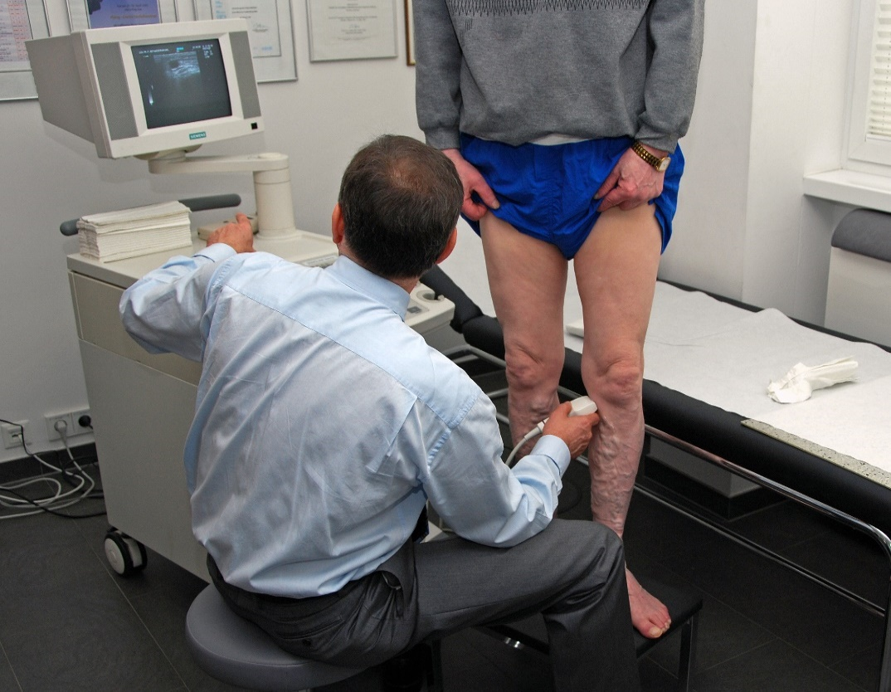
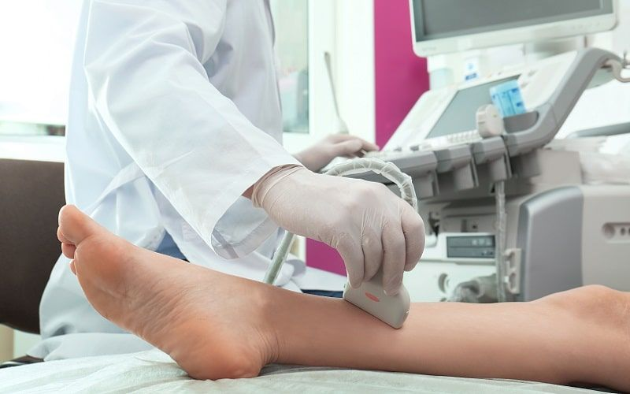
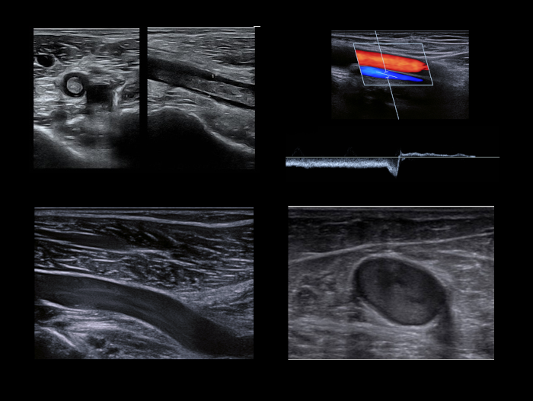
Imaging
Chronic venous diseases
Duplex USM (DUS) is the standard examination and reflux, dilatation, and narrowing of the lumen are characteristic signs of CVD.
CT venography,
MR-venography
Phlebography
İntravenous ultrasound - the use of intravenous ultrasound examination is gradually increasing.

Slide 10
In what cases should be suspected?
Chronic venous diseases
Leg pain,
Fatigue,
Convulsions,
Telangiectasia,
Vascular network,
Varicose veins,
Edema,
Pigmentation,
And ulcers in the extremities.
Symptoms such as changes in complaints and edema depending on the situation (increased in the evening, decreased while lying down, increased when standing and sitting for a long time), depression when pressing on the edema, vein diseases in the anamnesis, and hard and pigmented skin increase suspicion.

Slide 11
How is the diagnosis confirmed?
DUS is the first examination to confirm the diagnosis of CVD.
CT venography, MR venography and plethysmography are used when DUS result is doubtful and inguinal occlusion is suspected.

Slide 12
Differential diagnosis?
Chronic venous diseases
Kidney failure
Heart failure
Cirrhosis
lymphedema
Arterial ulcers
Diabetic foot
Pyoderma
Scleroderma

Slide 13
Diagnostic criteria?
Chronic venous diseases
Characteristic complaints, telangiectasia, reticular varicose veins,
edema,
eczema,
pigmentation, lipodermatosclerosis, ulcers, etc.
On imaging or functional examinations
Signs of venous pathology (reflux, dilatation, narrowing of the lumen, changes in the wall, etc.)
Clinical Signs

Slide 14
How to deny it?
Chronic venous diseases
The absence of venous pathology on imaging
And the absence of a problem with venous flow on functional examination
allow the diagnosis to be excluded.

Slide 15
How to determine the severity and complications?
Chronic venous diseases
Clinical Signs
(CEAP- Clinical -Etiology-Anatomy-Pathophysiology)
Laboratory
when complicated with thrombosis, the amount of D-dimer in the blood increases.
DUS
reflux, dilatation, narrowing of the lumen, changes in the wall,
Various clinical scales are available to determine the degree of severity.

Slide 16
What are the treatment principles?
Chronic venous diseases
Elimination of venous stasis,
Prevention of its progression,
Prevention and treatment of complications

Slide 17
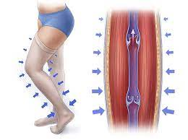
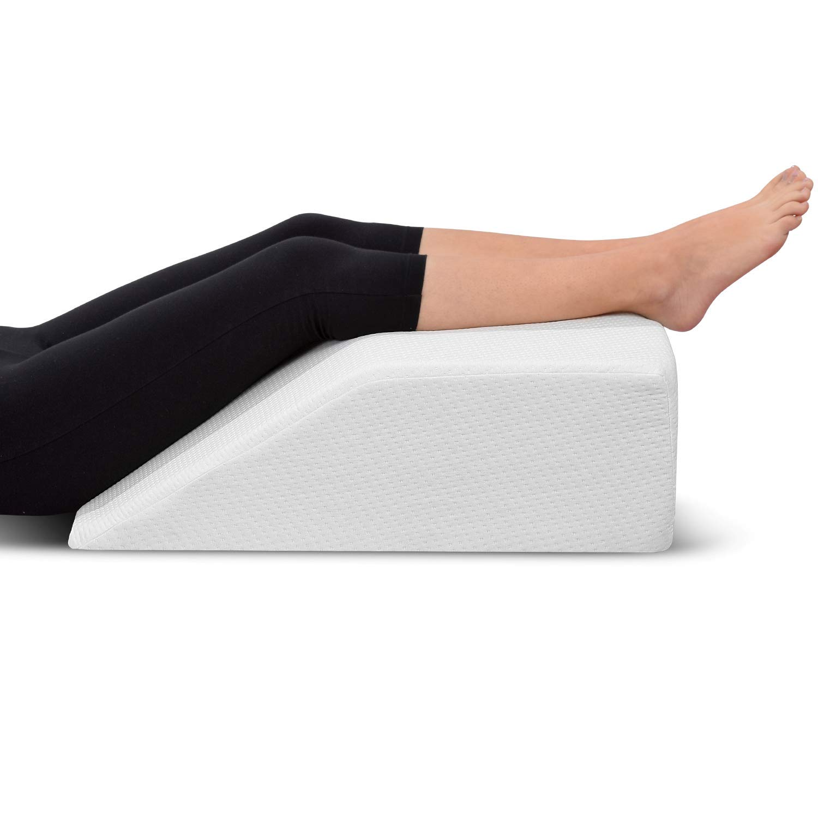
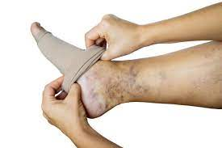
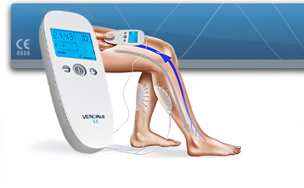
Treatment methods
Chronic venous diseases
Conservative treatments:
Physical methods – periodic leg elevation, compression (with and without pressure), walking, neuromuscular electrostimulation, etc.
Venoactive drugs - natural (ruscus extract, micronized refined flavonoids, horse chestnut extract, red grape leaf extract) and synthetic (calcium dobesilate, hydroxy-ethyl-rutoside, sulodexide, etc.)
Skin emollients
Anti-edema drugs
Ulcer treatments (antibiotics, ointments, regeneratives, stem cells, exosomes, etc.)
Lose weight

Slide 18
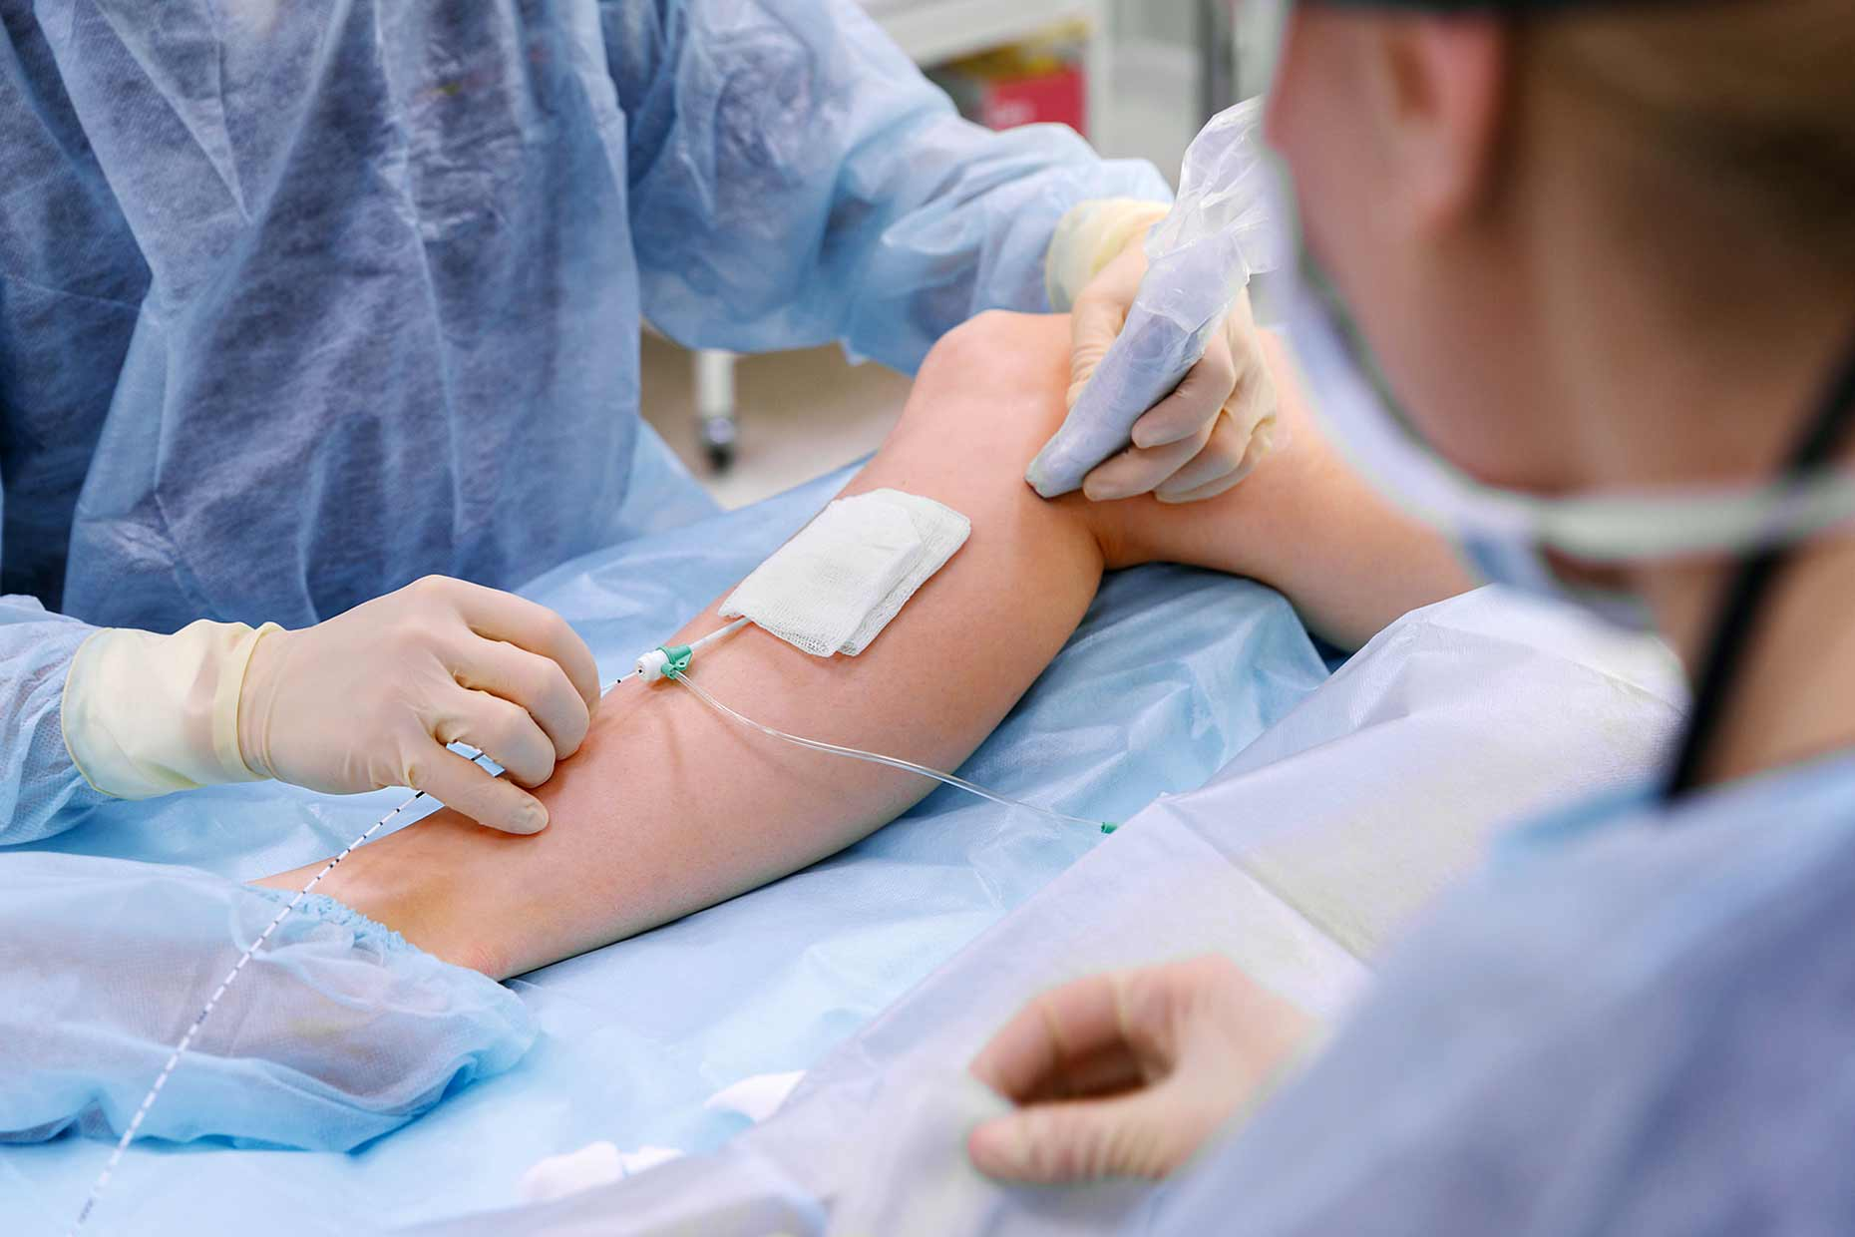
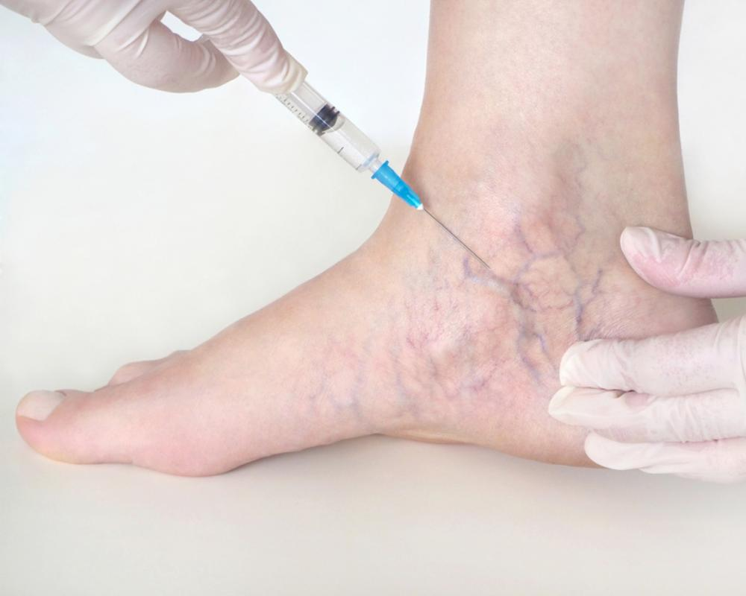
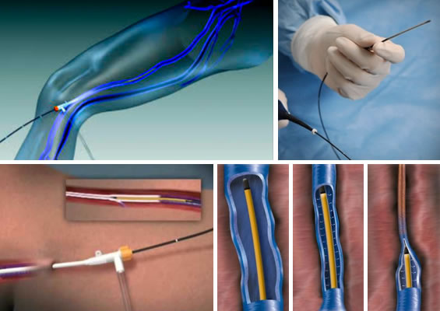
Treatment methods
Chronic venous diseases
Endovenous interventions:
Endovenous laser ablation (EVLA) - laser obliteration or ablation of a vessel or vessel segment
Mechano-chemical ablation - obliteration or ablation of a vessel or vessel section by mechanochemical means
Radiofrequency ablation (RFA) - the destruction or ablation of a vessel or part of a vessel with radiofrequency energy
Cyanoacrylate embolization - obliteration of a vessel or portion of a vessel by injection of cyanoacrylate
Sclerotherapy (liquid or foam) - destruction of a vein or part of a vein with a chemical (liquid or foam)

Slide 19
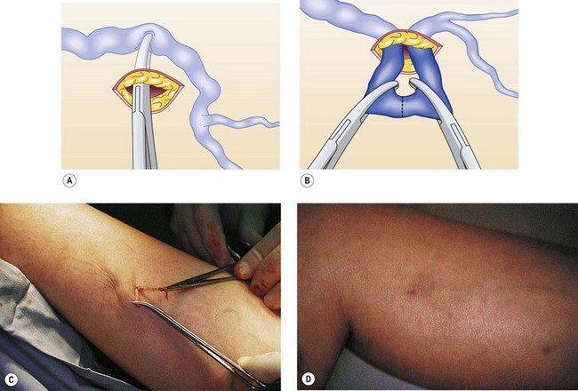
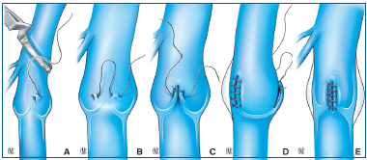
Treatment methods
Chronic venous diseases
Surgical interventions:
High ligation - insertion and cutting of the ligature at the junction of the femoral vein of the great Saphenous vein, the junction of the knee vein of the small Saphenous vein, including the closure and cutting of branches.
Phlebectomy - removal of a long section of a vein, usually large and small subcutaneous veins
Miniphlebectomy - removal of a segment of a vessel from small skin incisions
Cryostripping - inserting a rigid cryoprobe into a vein, freezing it with liquid nitrous oxide, and then removing it with the probe.
Subfascial closure of perforators (open or endoscopic)
Valvuloplasty
Reconstruction
Vascular transplantation
Surgical treatment of ulcer, skin transplant (dermatome or small piece free skin transplant);

Slide 20
Indications for surgery
Chronic venous diseases
Symptomatic diseases,
In cases where endovenous methods are not helpful,
In non-healing ulcers
And for cosmetic purposes.

Slide 21
Contraindications to the operation?
Chronic venous diseases
Interventions on compensatory dilated superficial veins are contraindicated in deep vein occlusions.

Slide 22
Treatment approach
Chronic venous diseases
Conservative
Asymptomatic patients
Symptomatic patients
are treated conservatively,
ablation can be applied for cosmetic purposes
usually started with a conservative method
subsequent treatments are selected according to the reflux site.
when ineffective.
Endovenous
Surgery
If the ulcer defects are not closed, skin plastic is applied.

Slide 23
Prognosis
Chronic venous diseases
If left untreated, the deficiency becomes progressive.
Venous ulcers recur in 70% of cases and are difficult to heal in 50% of cases.
Results are good if treatment is done early.

Slide 24
Prophylaxis
Chronic venous diseases
It refers to specific primary prophylaxis:
Proper regulation of life and work style,
Avoiding prolonged standing or sitting,
Using compression stockings,
Preferring plant-based foods,
Eliminating constipation,
Wearing pregnancy stockings,
Doing sports (walking, swimming, etc.),
In heredity, being under the supervision of a phlebologist, etc., especially if both parents have varicose veins.

Slide 25
Screening
Chronic venous diseases
DUS is used for scanning.

Slide 26
Follow up
Chronic venous diseases
Clinical examination and DUS are performed every 6 months for follow-up purposes.

Slide 27
Rehabilitation
Chronic venous diseases
Rehabilitation is carried out in a general way.

Slide 28
Characteristics in special groups
Chronic venous diseases
Pregnant women
Follow-up is necessary in pregnant women, the risk of complications is the same as in non-pregnant women.

Slide 29
Chronic venous diseases
Thank you for your attention.

