Slide 1
Acute pulmonary embolism
Dr. Musayeva Shukufa
Department of 1st Surgical Diseases

Slide 2
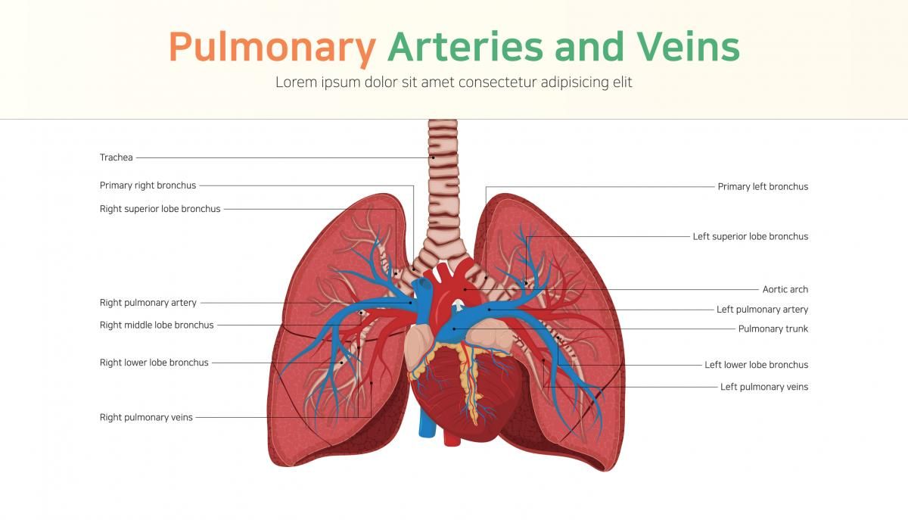
Definition
Pulmonary embolism is a blockage of a pulmonary artery or its branches by a substance (such as a thrombus, tumor, air and fat embolism) that has moved from elsewhere in the body through the bloodstream. In the literature, it is also called pulmonary artery embolism (PE) or pulmonary thromboembolism (PTE).

Slide 3
Epidemiology
The overall incidence is higher in males compared with females (56 vs. 48 per 100,000 respectively).
It is one of the most common causes of death in surgical patients.

Slide 4
Classification
Acute – clinical signs appear immediately after occlusion
According to the duration to symptom onset
Subacute – clinical signs appear days or weeks after embolism
Chronic – symptoms slowly develop over many years
According to the hemodinamics
Stable – normal BP
Unstable – hypotension(SBP <90 mmHg) >15 minutes
According to symptoms
Symptomatic
Asymptomatic
Saddle
According to the location of the blockage
Lobar
Segmental
Subsegmental

Slide 5
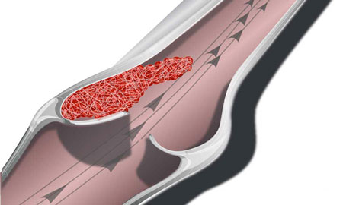
Causes and risk factors
The most common cause of PE is venous thromboembolism.
The main etiological factors of PE :
  Factors that contribute to venous thrombosis and thromboembolism (thrombophilia, venostasis, and vascular damage).
  The most common sites of thrombus are the proximal veins of the lower extremities (iliac, femoral, and popliteal), the inferior vena cava and its branches.

Slide 6
Pathogenesis
Peripheral thrombosis
Rupture of thrombus (embolus) and completely or partial blockage of pulmonary arteries
The occurrence of complications
Pulmonary and hemodynamic changes
heart attack
gas exchange impairment and hypoxia
pulmonary hypertension
right ventricular failure

Slide 7
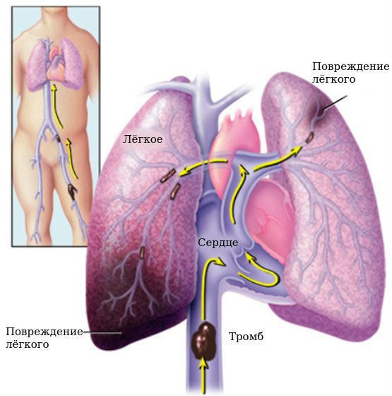

Slide 8
Characteristic pathology
  Pulmonary artery thrombosis
  Embolism
  Pulmonary infarction
  Inflammation and pleural effusion

Slide 9
Clinical course
The clinical course of PE is variable, mainly depending on the location of the blockage, its degree, and the body's reactivity.
PE can frequently recur.

Slide 10
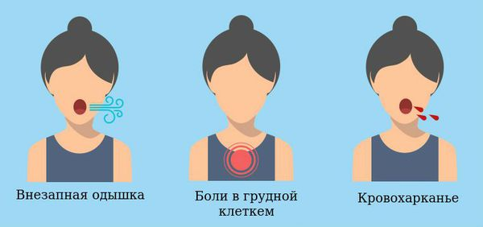
Clinical course
Acute form
Shock begins immediately after blockage
Rapidly progresses
Can lead to death (30%)
In some cases, it may start with shortness of breath, chest pain, and cough, then progress or regress.
Subacute form
Usually begins with shortness of breath and cough after a certain period of time obstruction, the clinical course can be different.
Chronic form
Usually asymptomatic or begins with mild symptoms, followed by pulmonary hypertension and right heart failure.

Slide 11
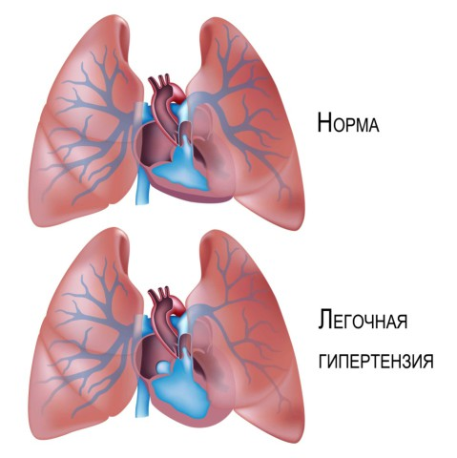
Complications
Cardiopulmonary failure
Cardiogenic shock
Death
Pulmonary hypertension.

Slide 12
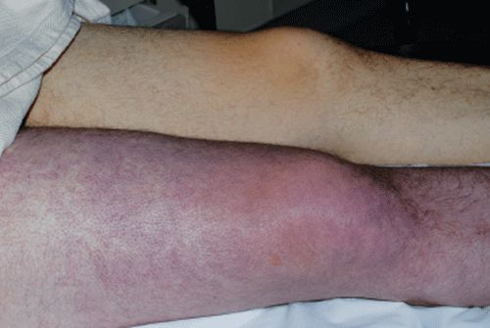
Clinical examination
• Dyspnea
• Pleuritic chest pain (increased pain during inspiration)
• Cough
• Tachypnoea
• Hypotension
• Symptoms of peripheral thrombosis

Slide 13
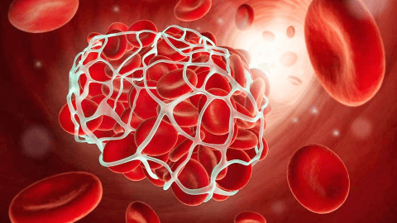
Laboratory examination
Increased levels of D-dimer

Slide 14
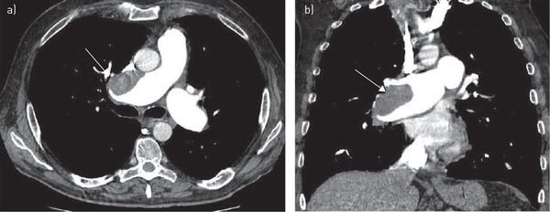
Instrumental examinations
CT pulmonary angiography is the most important examination in diagnosis.
Biopsy is not a standard examination.
In patients in whom CT-angiography is contraindicated, echocardiography or venous Doppler exam of the lower limbs can be used.
Post-mortem examination shows thrombus and embolus in the vein, pulmonary infarction and inflammation.

Slide 15
Diaqnostik yanaşma prinsipi
PE klinik olaraq şübhələnilir, KT angioqrafiya ilə dəqiqləşdirlir.

Slide 16
Suspision
PE should be suspected in patients with shortness of breath, tachypnea, and cough.
The presence of the following clinical signs in the patient (Wells criteria) increases the suspicion:
  Clinical signs and symptoms of DVT
  If PE is the only suspected disease
  Tachycardia
  Immobilization (surgery, trauma, etc.)
  Previous, objectively diagnosed PE or DVT
  Hemoptysis
  Malignancy

Slide 17
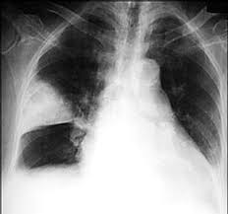
Confirmation of the diagnosis
The standard examination to confirm the diagnosis of PE is CT angiography. Pulmonary artery filling defect is characteristic.
When CT angiography is contraindicated, a D-dimer test, echocardiography, and sometimes ventilation-perfusion scintigraphy can be done.
In angiography, filling defects and ventilation-perfusion defects are the main diagnostic criteria.

Slide 18
Differential diagnosis
It is necessary to differentiate PE from most pathologies that cause shortness of breath, hypotension, heart failure, and first of all from the following diseases:
    Heart failure
    Pneumonia
    Myocardial infarction
    Pericarditis
    Pneumothorax
    Cardiac tamponade
    Shock

Slide 19
Denial
A negative D-dimer result in low and intermediate-risk PE patients is a reason to completely rule out PE.
In high-risk PE patients, the diagnosis must be confirmed or rule-out by an imaging method (CT-angiography).

Slide 20
Determination of the cause
The main cause can be clarified through a number of clinical examinations (echocardiography, venous doppler, etc.), laboratory and genetic tests.

Slide 21
Treatment principles
PE is a severe and potentially fatal illness that requires prompt diagnosis and treatment.
Main measures:
  Stabilization
  Timely prevention of progression of thrombosis
  Prophylaxis, and treatment of complications

Slide 22
Treatment
Stabilization - oxygenation, ABCDE
Prevention of thrombosis - anticoagulant treatment:
  Heparin (low molecular weight heparin, fondaparinux and unfractionated heparin).
  Vitamin K antagonist (warfarin);
  Factor Xa inhibitors (rivaroxaban, apixaban, edoxaban);
  • Thrombin inhibitor (dabigatran);
Prevention and treatment of complications of thrombosis:
  Thrombolysis (tPA, streptokinase, etc.);
  Thrombectomy (surgical and mechanical);
  Inferior vena cava filter;
  Relapse prevention;

Slide 23
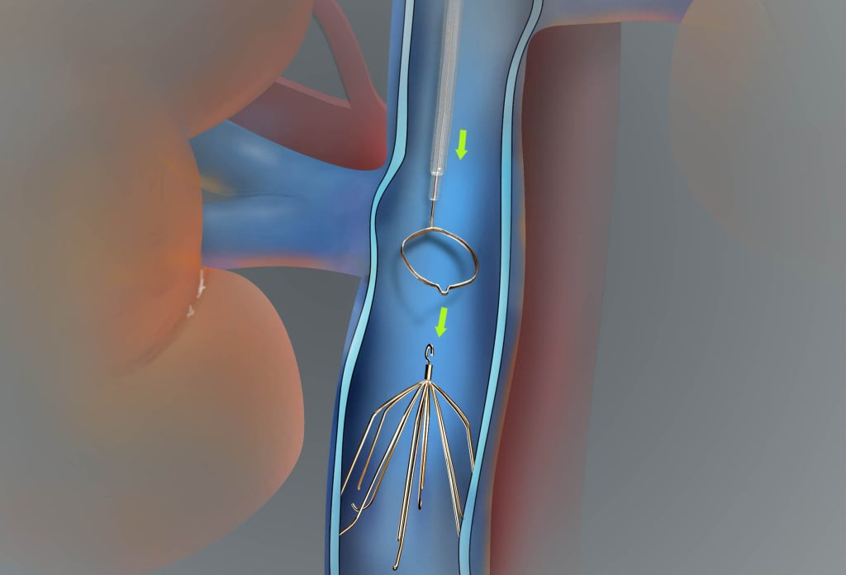
Indications for surgery
Patients with life-threatening PE may require additional treatment methods, such as thrombolysis, use of inferior vena cava filters, and embolectomy, in addition to anticoagulant therapy.

Slide 24
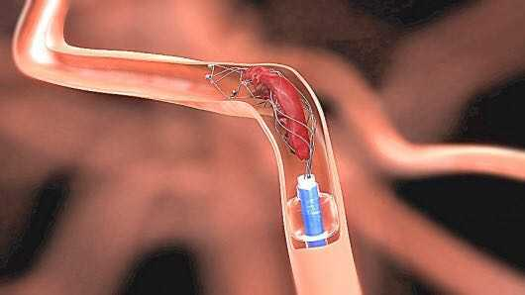
Indications for surgery
Selected groups of patients requiring specific anticoagulation or alternative treatment strategies include:
  • Cancer patients
  • Pregnant
  • Heparin-related thrombocytopenia.
  • Contraindication to the use of anticoagulant
  • Patients who are hemodynamically unstable despite the use of anticoagulants

Slide 25
Contraindications
Patients who recover with conservative treatment do not need surgery.

Slide 26
Treatment approach
Thrombolysis
Stabilisation
Anticoagulant treatment
Inferior vena cava filters
Embolectomy
May be used as alternative treatments when anticoagulation is contraindicated or ineffective.

Slide 27
Prognosis
PE is one of the most common causes of death in surgical patients
untreated PE has a mortality rate of 30%
Many prognostic models exist for PE.

Slide 28
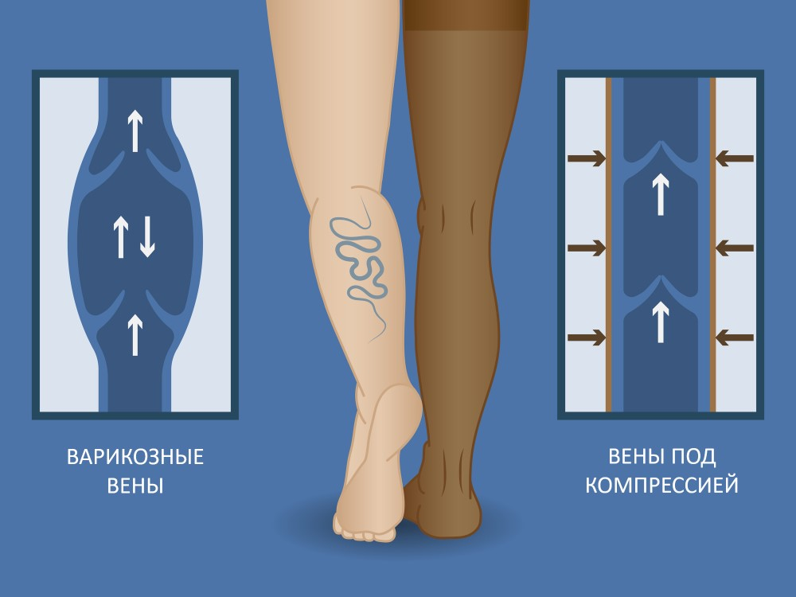
Profilaction
Prevention of peripheral vein thrombosis plays an important role in the prevention of PE.
Following the hospital's protocol for thrombosis prevention in patients who have undergone surgery:
  Early activation;
  Elastic socks;
  Pharmacological therapy according to the indication.

Slide 29
Screening and follow up
Clinical examination
D-Dimer testing
Patients with pulmonary embolism are closely monitored in the intensive care unit in the early stage, lungs, hemodynamics, coagulation, and fibrinolysis (D-dimer) are observed.
In the late stage, the pulmonary pressure, right ventricle, and lung parenchyma are monitored.

Slide 30
Rehabilitation
No specific rehabilitation program.

Slide 31
Thank you for your attention!

