Slide 1
Cardiogenic shock
Dr. Shukufa Musayeva
Department of 1st Surgical Diseases

Slide 2
Definition of shock
Fundamental point of view
shock is cellular and tissue hypoxia caused by a decrease in oxygen delivery and uptake, oxygen overuse, or a combination thereof.
Practical point of view
shock is hypoperfusion, that is, hypoxia occurring in cells and tissues due to insufficient blood circulation.
It is clinically manifested by hemodynamic disturbances and organ dysfunctions.

Slide 3
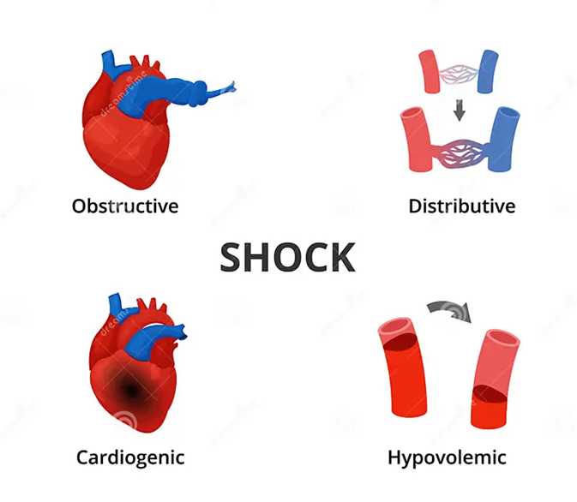
Classification
Mechanism
Hypovolemic
Cardiogenic
Obstructive
Distributive or vasomotor
Stages
Compensated
Decompensated
Refractory (Irreversible)

Slide 4
Causes and risk factors
Shock
Hypovolemia
Vasodilatation
Cardiogenic
Obstructive
Bleeding
Dehydration
Diarrhea
Burns
Pancreatitis
Intestinal obstruction
Sepsis
SIRS-sepsis
Neurogenic
Endocrine (adrenal, thyrotoxic, etc.)
Liver failure
Myocardial infarction
Heart failure
Valve ruptures
Paroxysmal tachycardia
Tension pneumothorax
Cardiac tamponade
Pulmonary embolism

Slide 5
Pathogenetic mechanism
Cardiogenic
Myocardial infarction
Heart failure
Valve ruptures
Paroxysmal tachycardia
Obstruction
Tension pneumothorax
Cardiac tamponade
Pulmonary embolism
Vasodilatation
    SIRS-sepsis
    Neurogenic
    Endocrine
    Liver failure
Hypovolemia
  Bleeding
  Plasma loss
Hypoperfusion
Hypoxia
Cellular dysfunction
dysfunction of membrane pumps
mitochondrial dysfunction
disruption of cellular homeostasis and functions
Cellular damage
edema, acidosis, destruction, inflammation
Systemic dysfunction and damage
SIRS, sepsis, primary and secondary multiple organ dysfunction

Slide 6
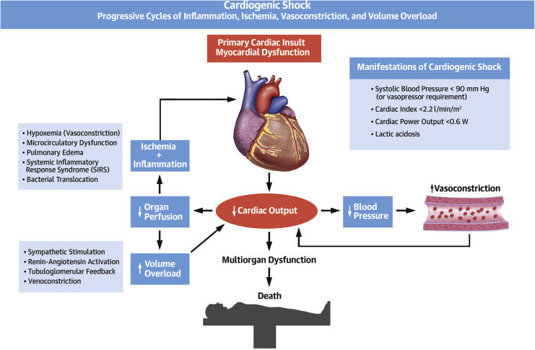

Slide 7
Clinical course
HYPOPERFUSION
COMPENSATION
DECOMPENSATION
REFRACTORY
Centralization
  Tachycardia
  Peripheral vasoconstriction
Blood pressure normal
Peripheral hypoperfusion
Vasodilatation
İschemic parts reperfusion
Hypotension
General hypoperfusion
SİRS
Refacter hypotension and hypoperfusion
Multiorgan failure
TREATMENT
TREATMENT
Inef fective
Recentralization
Normalization of BP
Ischemia-reperfusion injury
Rehabilitation
SİRS elimination
Interstitial spase fluid releasing
SİRS
Sequestration –edema

Slide 8
Clinical examination
Hemodynamic changes:
Tachycardia
Orthostatic collapse or hypotension
Decreased systolic pressure and pulse pressure
Hypoperfusion signs:
Cold and clammy skin (in some cases hyperthermic skin)
Slow capillary filling
Oliguria
Decrease of consciousness

Slide 9
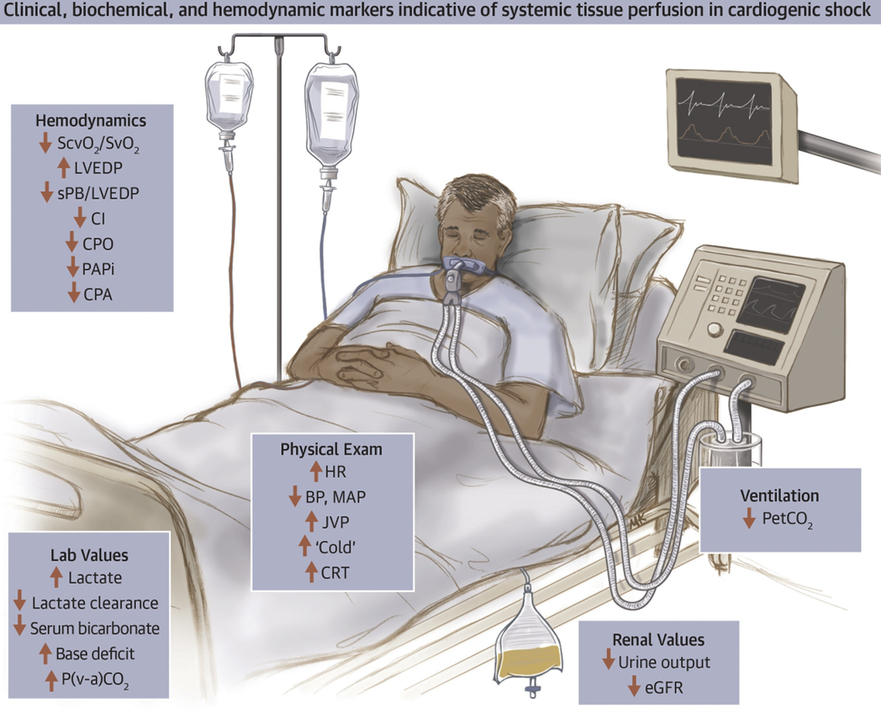
Laboratory examination
Hypoperfusion signs:
Blood lactate
Blood pH
Organ dysfunction signs:
There are no specific laboratory markers of shock!

Slide 10
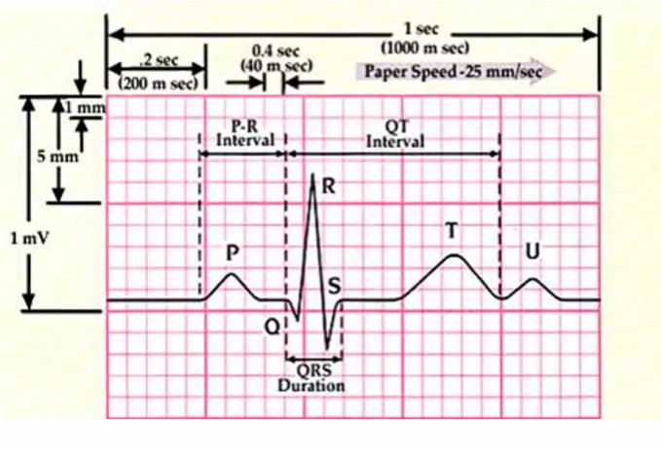
İmaging and other examinations
Stabilization stage
USG – determines hemorrhagic (internal bleeding) and cardiogenic shock
EKQ – determines MI and arrhythmia
X-ray – determines lung and bones injuries
After stabilization
CT
Endoscopy
Pulmonary arterial catheterization
Other

Slide 11
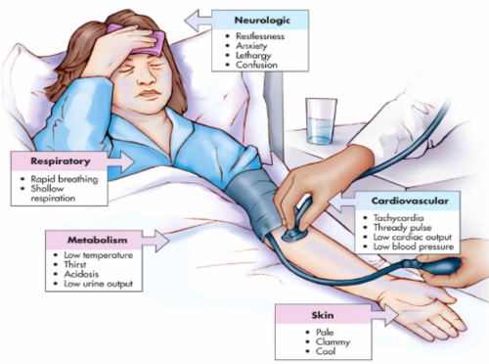
Shock suspection
Tachycardia
Tachypnea
Hypotension
Cold or hyperthermic skin
Disturbance of consciousness
Oliguria

Slide 12
Confirmation of diagnosis
The diagnosis of shock is based on clinical examination.
Important studies are checking hemodynamics and organ perfusion.

Slide 13
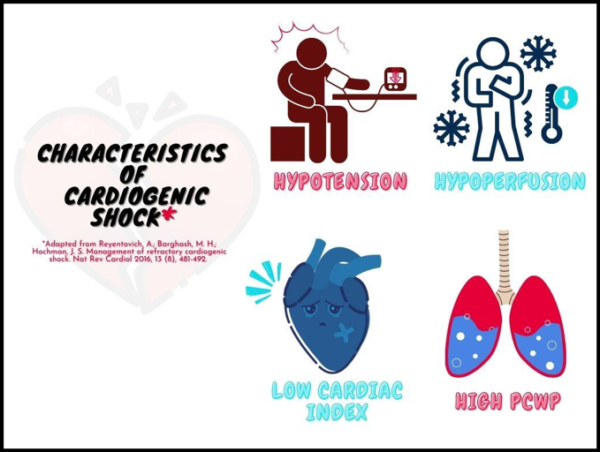
Differential diagnosis
Syncope
Orthostatic collapse
Pulmonary insufficiency
Coma

Slide 14
Diagnostic criteries
1
2
3
Causing factors
  Trauma
  Ilness
Hemodynamic signs
  tachycardia (>90)
  hypotension (<90 mm Hg)
  orthostatic collapse
Signs of hypoperfusion and disfunction
  Cold skin
  oliguria
  Delayed capillary refill
  Tachypnea
  Loss of consciousness
  Metabolic acidosis
  Increased lactate

Slide 15
Denial of shock
Shock can be ruled out if hemodynamic parameters are stable and perfusion and organ function are normal.

Slide 16
Determination of causes
Shock or shock suspection
Hemorrhagic shock
Obstruktive shock
Cardiogenic shock
Neurogenic shock
Septic shock
Was there an injury or surgery?
Yes
No
Is there dehydration?
(vomiting, diarrhea, polyuria, excessive sweating)
Hypovolemic shock
Hemorrhagic shock
Yes
No
Are there signs of sepsis?
(fever, hypothermia, immunosuppression)
Yes
Septic shock
No
Search other causes and examinations
Is there a cardiological problem?
Yes
Cardiogenic shock
No
No
Is there an allergy to something?
Yes
Anaflaktic shock

Slide 17
Severity and stages of shock
Compensatory
  Normal BP (>90 mm Hg)
  tachycardia
  hypoperfusion
Decompensatory
  hypotension
  hypoperfusion
Refractory
  infusion-refractory hypotension
  hypoperfusion
  organ and systemic failure

Slide 18
Treatment principals
Emergency
Stabilization
Immediately elimination of the cause
Supportive treatments

Slide 19
Treatment methods
1
2
3
Stabilization
Airway managment
Ventilation
Oxygenation
İnfusion therapy
Hemotrasfusion
Immediately elimination of the cause
Control of bleeding (surgical, percutaneous, endoscopical, medics)
Treatment of obstruction (surgical, percutaneous, medics)
Vasopressors
Steroids
Antiallergic medicines
Elimination of the septic source (surgical, percutaneous drainage, and antibiotics)
Supportive treatments for organ and system dysfunctions

Slide 20
Indications for surgery
• Surgical bleeding - traumatic, postoperative, etc.
• Obstructive causes - tension pneumothorax, cardiac tamponade
• Sepsis - peritonitis, infectious pancreatitis, abscess, etc.
• Heart valve rupture
• Aortic aneurysm rupture

Slide 21
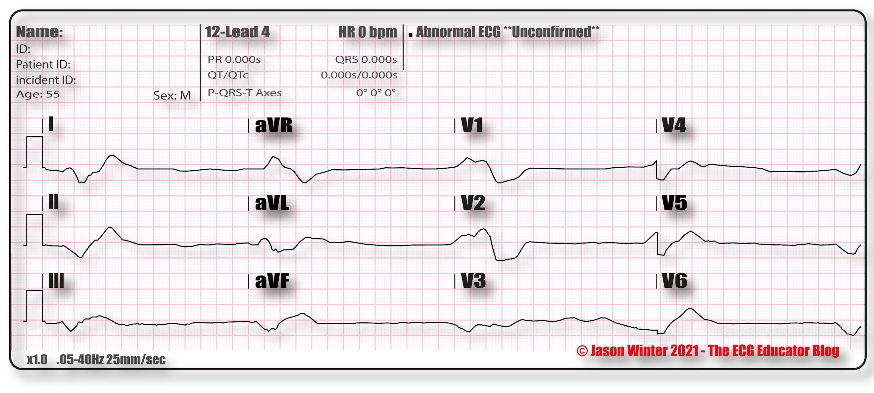
Contraindications
AGONY

Slide 22
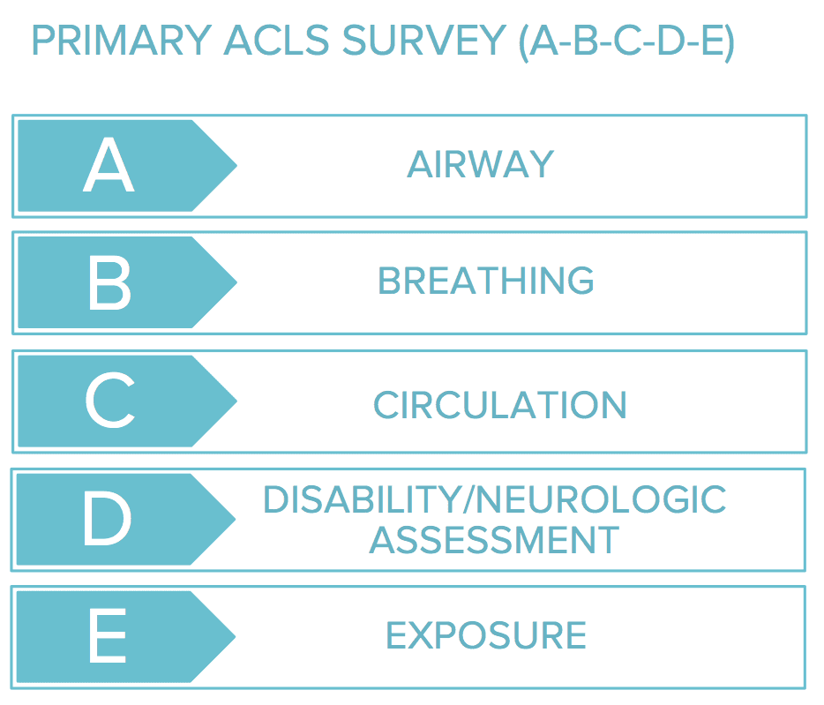
Treatment approach
Shock/Shock suspiction
The ABCDE primary survey and stabilisation
Airway and ventilation
Oxygen supply, infusion
Take analysis, ECG and USG
Life-saving interventions
No need
Need
Emergency first aid and hospitalization :
Bleeding - surgery, percutaneous, endoscopic hemostasis.
Tension pneumothorax - thoracic drainage.
Cardiac tamponade - pericardial drainage.
Embolism - thrombolytic interventions.
Sepsis- surgery, percutaneous, endoscopic drainage, and intravenous antibiotics.
Anaphylaxis - intravenous adrenaline.
An adrenal crisis - intravenous steroids.
Myocardial infarction - revascularization.
Rupture of the heart valve - emergency surgical care.
Arrhythmias - Cardioversion.
Examinations for searching reasons and treatment
Yes
Stabilised?
NO
Continue stabilization and searching reasons

Slide 23
Prognosis
Mortality 50% .
Negative prognostic factors
Late treatment
Refractory stage
Failure to eliminate the cause
Low reserves

Slide 24
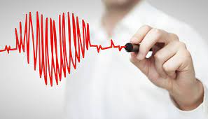
Profilaction
Early diagnosis and treatment of shock-causing factors is effective in preventing shock.

Slide 25
Screening
severe trauma patients
critically ill patients
postoperative patients
hospitalized patients

Slide 26
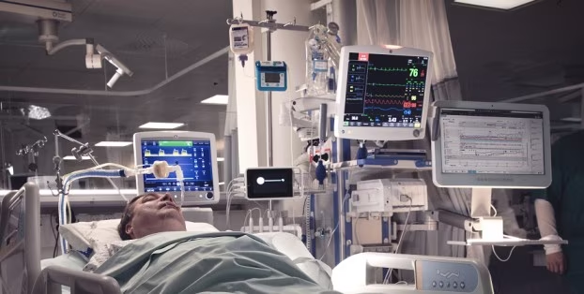
Follow up
intensive care unit and involves
monitoring hemodynamics
perfusion and organ functions
Stabilisation signs
Mean arterial pressure >65 mmHg or pulsation in the perineal artery
urine output > 0.5 ml/kg/h
blood pH - 7.4
blood lactate (less than 1.5 mmol/l)

Slide 27

Rehabilitation
Rehabilitation of patients with shock is carried out in a general way.

Slide 28
The characteristics in special groups
Children
Hemodynamics may be stable in the early stages of shock, and decompensation may occur suddenly.
Pregnant women
If there is a lot of blood loss in the early stage, hemodynamics can change little, but fetal hypoxia may occur.
Elder people
a small amount of blood and plasma loss can cause hypotension.

Slide 29

Thank you for attention!

