Slide 1
Cardiac tamponade
Dr. Shukufa Musayeva
Department of 1st Surgical Diseases

Slide 2
Definition
Cardiac tamponade
Cardiac tamponade is a life-threatening complication and one of the pericardial compression syndromes in which an abnormal amount of fluid accumulates in the pericardial sac, compressing cardiac chambers, and causing decreased cardiac pump function.
In other words "tamponade = pericardial fluid + heart dysfunction"

Slide 3
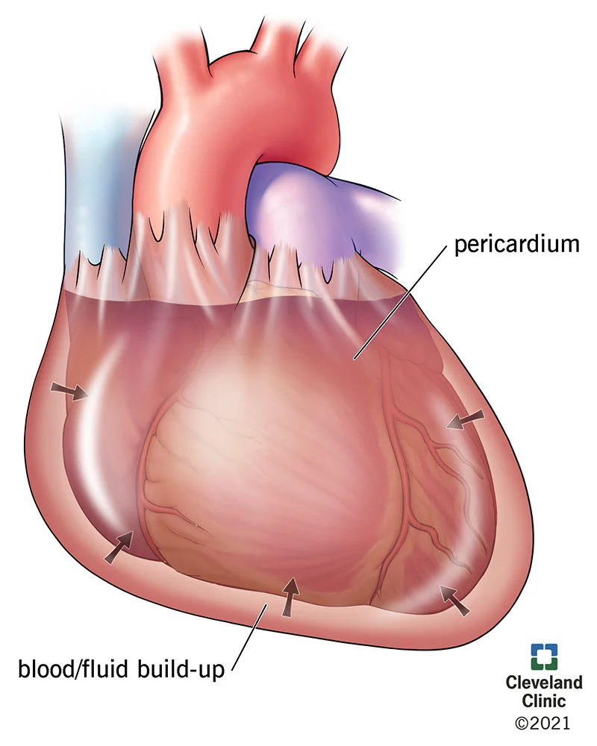
Classification
Cardiac tamponade
There are 4 clinical forms of cardiac tamponade
acute
subacute
low-pressure
local cardiac tamponade

Slide 4
Causes and risk factors
Cardiac tamponade
Causes of exudative or hemorrhagic pericarditis:
• Infection -viral-adenovirus, CMV, bacterial-tuberculous bacilli, staphylococcal, streptococcal, fungal-histoplasma, candida, parasitic-echinococcus, amoeba),
• Autoimmune diseases (lupus erythematosus, rheumatoid arthritis),
• Neoplasms (primary and metastatic)
• Drugs (procainamide, isoniazid)
• Metabolic disorders (hypothyroidism, uremia)
• Heart diseases (heart attack, pericarditis, myocarditis, etc.)
Trauma to the chest (hemopericardium as a result of blunt and open traumas to the chest)
Iatrogenic (during placement of catheters and implantation of pacemakers, after cardiopulmonary resuscitation and chest surgery)

Slide 5
Pathogenetic mechanism
Cardiac tamponade
Fluid accumulation
Increasing intrapericardial pressure
Heart compression
Beck's triad:
Jugular venous distention,
Inaudible heart sounds
Pulsus paradoxus
preventing the ventricles and atria from expanding and filling with blood during diastole
Heart failure
Shock
dyspnoea, tachycardia, hypotension, cold skin,
decrease of consciousness, decreased diuresis

Slide 6
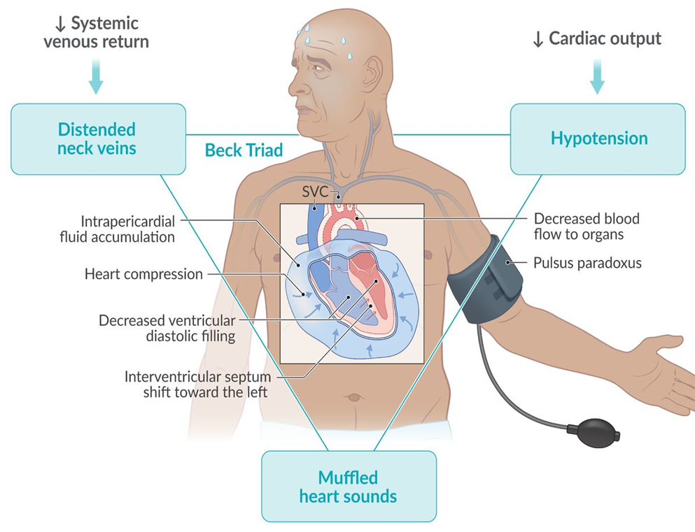

Slide 7
Clinical course
Cardiac tamponade
Acute cardiac tamponade
Subacute cardiac tamponade
Fluid accumulates in the pericardial space for a short period of time (seconds, minutes)
Fluid accumulates in the pericardial space gradually - over days or weeks
If emergency first aid not performed
asymptomatic in the early phase but, when the the occurrence of compression as a result of an increase in the amount of fluid (sometimes up to 2 liters) reveals
Dyspnea
venous distension at the neck and head
poorly heard or inaudibile heart sounds
arterial hypotension
decreased pulse pressure
Tachycardia
cold extremities
peripheral cyanosis
decreased urine output
DEATH
Dispnoea
Chest discomfort
Peripheral oedema
Fatigue
Arterial hypotension
Decreased pulse pressure
After timely decompression, heart activity is restored.

Slide 8
Clinical examination
Cardiac tamponade
Acute cardiac tamponade
Subacute cardiac tamponade
Along with complaints corresponding to the underlying disease:
Chest pain
Loss of consciousness
tachypnea
arterial hypotension
tachycardia
Peripheral edema
jugular venous distention
Paradoxical pulse
Usually has a history of trauma or interventions.
Clinical examination:
shock
Pericardial compression
The charachteristic Beck’s triad
Paradoxical pulse

Slide 9
Laboratory examination
Cardiac tamponade
There are no specific laboratory indicators of cardiac tamponade!

Slide 10
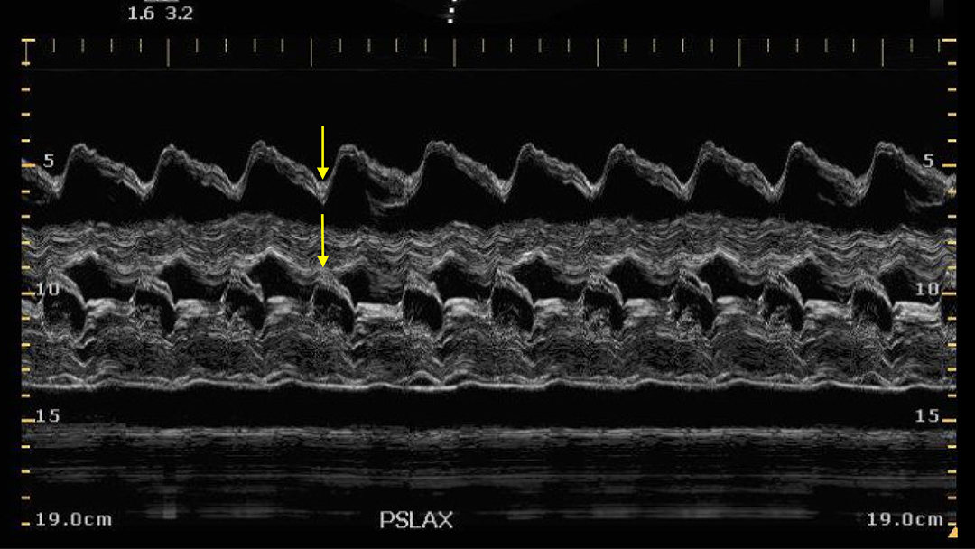
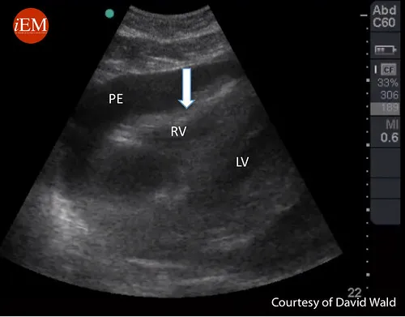
Imaging and other examinations
Cardiac tamponade
Echocardiography
Chest X-ray
CT
MRI
In cases of subacute cardiac tamponade, thoracoscopy is usually used as an approach to open the pericardial window rather than as an examination.

Slide 11
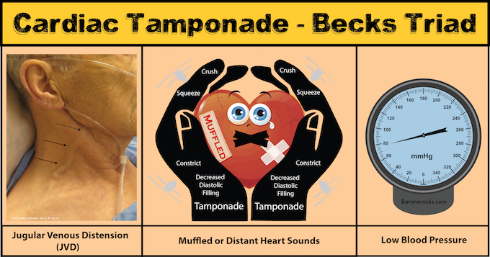
Suspiction
Cardiac tamponade
Shock
Trauma
Heart failure
Chest pain
Shortness of breath
Weak or inaudible heart sounds
Peripheral edema
Jugular venous distension
Parodoxical pulse

Slide 12
Confirmation of diagnosis
Cardiac tamponade
Heart dysfunction
The presence of diffuse or local fluid in the pericardium
Echocardiogram is the test of choice
Fluid in the pericardium
Fluid not found
Suspicion to the carciac tamponade
Look for other causes
Urgent decompression (drenage)
cardiac dysfunction improves
dysfunction does not disappear
look for other causes
  Cardiomiopatia
  Myocardial infarction
  Cirrhosis
  Nephrotic syndrome
  Hypothyroidism
  Collagen disease
Cardiac tamponade

Slide 13
Confirmation of the diagnosis
Cardiac tamponade
Imaging examinations (USG, tomography) are performed, for the presence of diffuse or local fluid in the pericardium
The result of decompression are reviewed.
Echocardiogram is the test of choice to help make the diagnosis and ultrasound guided percutaneous drainage is often the first choice for decompression.

Slide 14
Differential diagnosis
Cardiac tamponade
Acute myocardial infarction (especially right ventricular localization)
Aortic dissection
Pulmonary embolism
Constrictive pericarditis
Heart failure
Cirrhosis

Slide 15
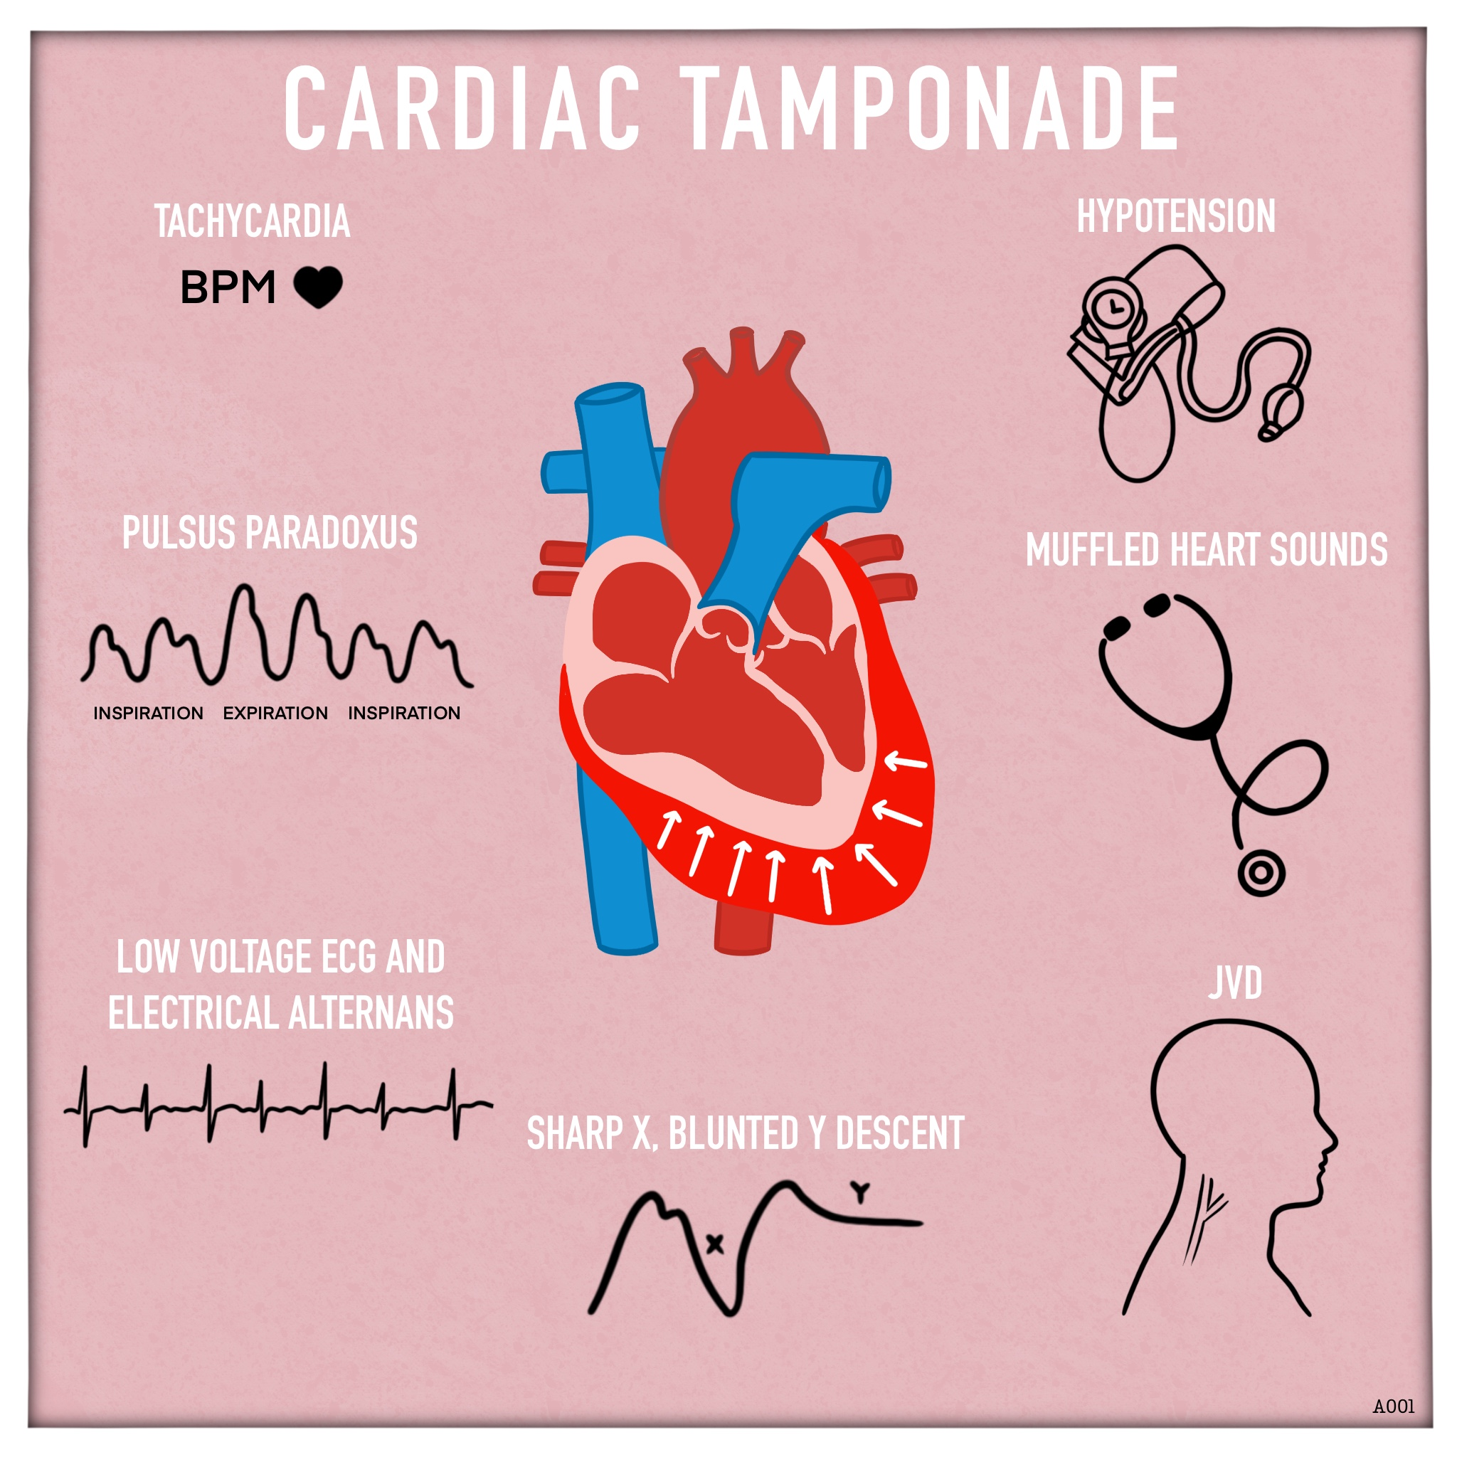
Diagnostic criteria
Cardiac tamponade
Diffuse or local pericardial fluid on imaging
Symptoms of cardiac dysfunction - dyspnea, tachycardia, shock, arterial hypotension, edema, venous distension at the neck, paradoxical pulse, etc.
Improvement after decompression

Slide 16
Denial of cardiac tamponade
Cardiac tamponade
Cardiac tamponade can be ruled out if any of the following diagnostic criteria are absent:
No fluid in the pericardium
No signs of cardiac dysfunctionn
If cardiac function does not recover after decompression

Slide 17
Determination of cause
Cardiac tamponade
The cause of tamponade is determined by clinical, imaging, functional and other tests.

Slide 18
Severity and stages of shock
Cardiac tamponade
Cardiac tamponade
Diffuse fluid in the pericardium
Localised fluid in the pericardium
cardiac dysfunction occurs within minutes
cardiac dysfunction appears over days or weeks
Acute tamponade
Subacute tamponade
Lokalised/regional tamponade

Slide 19
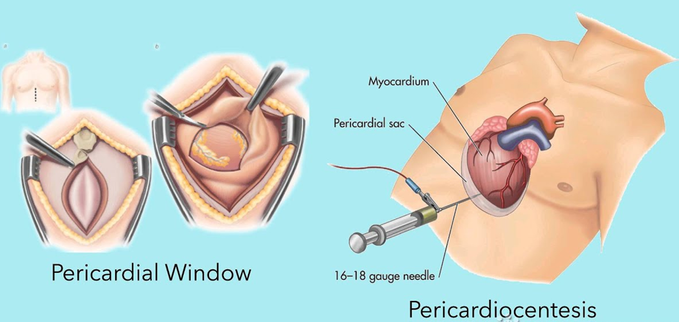
Treatment principles
Cardiac tamponade
Cardiac tamponade is a life-threatening condition, requires urgent treatment!
Decompression (drainage - removal of pericardial fluid) is the main principle of tamponade treatment.

Slide 20
Treatment methods
Cardiac tamponade
Treatment
Surgical drainage
Open
Thoracoscopic
Percutaneous drainage
puncture
Catheter
Conservative
Diuretic
Colchicine
Anti-inflammatory
Etiotropic

Slide 21
Indications for surgery
Cardiac tamponade
Traumatic hemopericardium
Hemopericardium due to aortic dissection
Myocardial rupture after myocardial infarction
Purulent pericarditis
Recurrent pericardial effusion after percutaneous pericardiocentesis
For biopsy

Slide 22
Contraindications
Cardiac tamponade
Contraindications to percutaneous drainage:
coagulopathy
cardiac tamponade due to aortic dissection
pulmonary hypertension
If tamponade can be controlled percutaneously, surgical drainage is a contraindication

Slide 23
Treatment approach
Cardiac tamponade
Cardiac tamponade
Acute
Subacute
Lokalised
Contraindications for a transcutaneous method
Coagulopathy
Pulmonary hyperthension
Aortic dissection
Indications for a surgical method
Traumatic hemopericardium
Hemopericardium due to aortic dissection
Myocardial rupture after myocardial infarction
Purulent pericarditis
Recurrent pericardial effusion after percutaneous pericardiocentesis
For biopsy
the absence of indications for a surgical method
the absence of contraindications for a transcutaneous method
Conservative
Urgent percutaneous drenage
Fail
Urgent surgical (percutaneous) drainage
Can be performed before anesthesia

Slide 24
Prognosis
Cardiac tamponade
Cardiac tamponade is fatal without treatment, and most patients recover with early interventions.
Time to intervention and cause are major factors affecting prognosis.
Patients with tamponade caused by malignant disease have death rates exceeding 75% within 12 months.

Slide 25
Profilaction
Cardiac tamponade
Echocardiography and regular hemodynamic monitoring are useful for early diagnosis and prevention of cardiac tamponde.

Slide 26
Screening
Cardiac tamponade
Echocardiography and hemodynamic monitoring are necessary.

Slide 27
Follow up
Cardiac tamponade
Periodic echocardiography (usually every 2-3 days, more often if necessary) and continuous hemodynamic monitoring are performed for follow-up after treatments

Slide 28
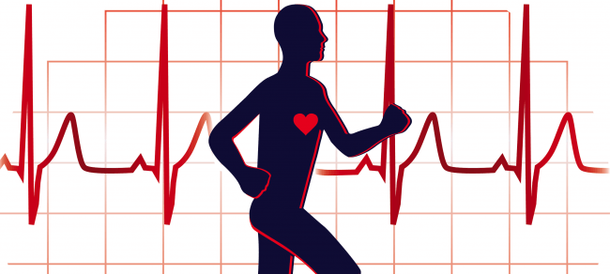
Rehabilitation
Cardiac tamponade
Rehabilitation of patients is carried out in a general way

Slide 29

Thank you for attention!
Cardiac tamponade

