Slide 1
Mitral valve disease
Dr. Aliya Seyidova
Department of 1st Surgical Diseases

Slide 2
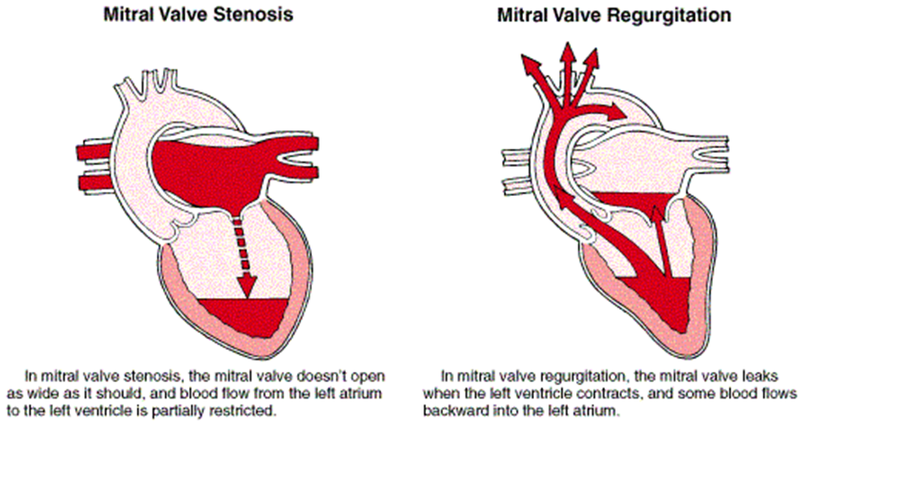
Classification
Mitral valve stenosis
Mitral valve insufficiency
Mitral stenosis (MS) is a disease caused by the difficulty of blood flow from the left atrium to the left ventricle as a result of the narrowing of the mitral valve.
Mitral valve insufficiency– is a disease caused by backflow of blood from the left ventricle to the left atrium as a result of incomplete closure of the mitral valve leaflets.

Slide 3
Classification
Mitral valve
According to the degree of stenosis (according to the mitral valve area):
According to the clinical manifestation
Asymptomatic
Symptomatic
Mild – mitral valve area greater than 1.5 cm2
Moderate - mitral valve area 1.5-1 cm2
Severe – mitral valve area less than 1 cm2

Slide 4
Classification
Mitral valve insufficiency
According to the etiology
According to the clinical form
Primary- due to the disruption of at least one of the valvular structures (annulus, leaflets, chordae tendineae, papillary muscles, left atrium and left ventricle) as a result of any of the following:
inflammatory diseases, degenerative diseases, infective endocarditis, mitral annular calcification, traumas, neoplasms, congenital anomalies
Secondary- it originates from nearby structures:
ischemic cardiomyopathy
dilated cardiomyopathy
hypertrophic obstructive cardiomyopathy
neoplasms
systemic diseases (sarcoidosis, amyloidosis)
endomyocardial fibrosis
Acute mitral insufficiency
Chronic compensated mitral insufficiency
Chronic decompensated mitral valve insufficiency

Slide 5
Causes
Mitral stenosis
Mitral valve insufficiency
Rheumatic.
Non-rheumatic
The most common causes of mitral insufficiency include myxomatous degenerative valve diseas.
Ischemic heart disease,
Dilated cardiomyopathy,
Rheumatic valve disease,
Infective endocarditis,
Mitral annular calcification,
Fibroelastic deficiency,
Rndomyocardial fibrosis,
Some systemic diseases, etc. reasons can also be mentioned.
Rheumatic fever is the most common cause.
Non-rheumatic causes include
Mitral annular calcification,
Congenital mitral valve anomalies some malignant and benign tumors,
Carcinoid syndrome,
Some systemic diseases,
Endocarditis,
Left atrial thrombus,and previous mitral valve surgery.

Slide 6
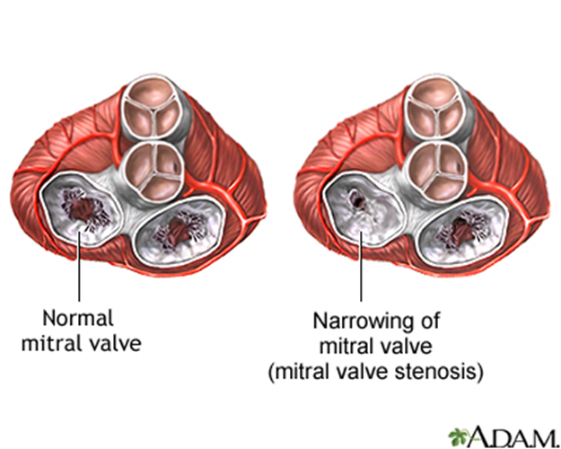
Pathogenetic mechanism
Mitral stenosis
Mitral valve insufficiency
Mechanisms are valve narrowing
Left atrial hypertension.
During systole, part of the blood that should be ejected into the aorta returns to the left atrium through the valve defect (regurgitation).
Regurgitation causes volume overload of the left atrium, the regurgitated blood enters the left ventricle again and causes volume overload of the ventricle.
The atrium, and ventricle compensate for this additional volume overload for a certain period, at this stage, symptoms are absent or weak.

Slide 7
Clinical course
Asymptomatic
If the stenosis is mild and the atrium compensates.
Sometimes this process takes 10-30 years.
As the stenosis increases and the atrium decompensates, symptoms begin to appear.
Other symptoms of heart failure develop.
Dyspnea and orthopnea are the first symptoms.
In the later stages, weakness, palpitations, nocturnal dyspnoea.
Mitral stenosis

Slide 8
Clinical course
Acute mitral valve insufficiency
Left atrial pressure increases greatly, resulting in acute pulmonary edema
During acute mitral insufficiency, sudden left atrial and ventricular volume overload occurs. Due to this, congestion and acute pulmonary edema develop in the lungs.
Chronic mitral valve insufficiency
usually remains asymptomatic for many years.
In the later stages, get tired easily, weakness, palpitations, nocturnal dyspnoea, and other symptoms of heart failure develop. If pulmonary hypertension and right heart failure occur, relevant symptoms annd sings starts.
For this reason, sudden dyspnea and orthopnea occur in patients. In many cases, cardiogenic shock develops.
Most deaths are related to heart failure and ventricular arrhythmias

Slide 9
Complications
Mitral stenosis
Mitral valve insufficiency
Paroxysmal arrhythmia
Thrombosis
Pulmonary hypertension,
Right ventricular enlargement or dysfunction
Heart failure
Pulmonary hypertension
Arrhythmias (atrial fibrillation, etc.)
Infectious diseases
Pulmonary edema
Cardiac arrest

Slide 10
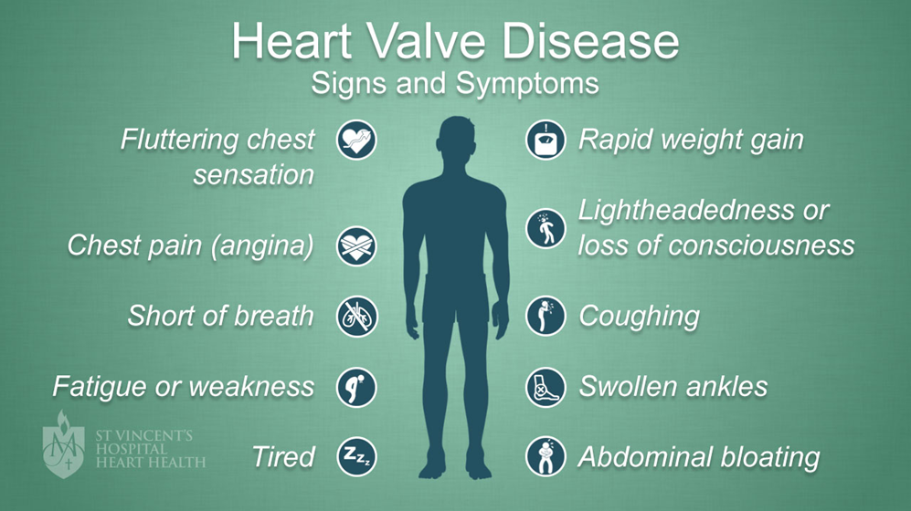
Сlinical examination
Mitral stenosis
Sudden breathlessness
Orthopnea
Get tired easily
Fatigue
Palpitations
Nocturnal dyspnoea
Symptoms of heart failure
Hemoptysis
Opening snap,
Presystolic and mid-diastolic murmur

Slide 11
Сlinical examination
Acute Mitral valve insufficiency
Chronic Mitral valve insufficiency
Dyspnea,
Orthopnea,
and in many cases cardiogenic shock
In the later stages,
rapid heartbeat,
weakness,
palpitations,
nocturnal dyspnoea and other symptoms of heart failure develop.
If pulmonary hypertension and right-sided heart failure occur, the relevant symptoms are added to the clinic.

Slide 12
Laboratory examination
There are no specific laboratory signs in mitral valve insufficiency, usually the laboratory parameters are normal.

Slide 13
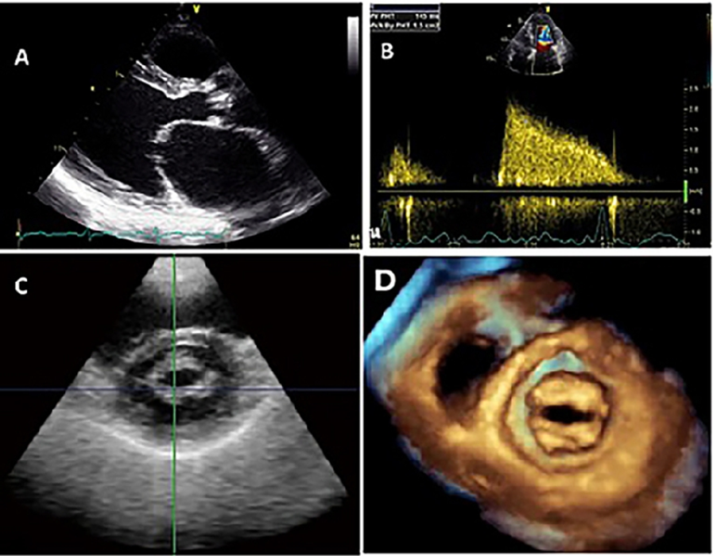
Imaging and other examinations
Echocardiography plays an important role in the diagnosis of mitral valve diseases
CT
Radiography
Angiography are widely used in the diagnosis of some defects

Slide 14
Suspection
Mitral stenosis
Mitral valve insufficiency
Mitral stenosis may be suspected in patients with a heart murmur and dyspnea,
Especially those with a history of rheumatic fever
Mitral insufficiency may be suspected in those with the following symptoms:
Dyspnea on exertion.
Get tired easily
Fatigue
Palpitations
Nocturnal dyspnea
Holosystolic apical murmur

Slide 15
Confirmation of the diagnosis
Mitral valve insufficiency
Mitral stenosis
Echocardiogram
the characteristic signs are the reduction of the AVA
the increase of the atrioventricular pressure gradient
Echocardiography
regurgitation
valvular defect

Slide 16
Differential diagnosis
Mitral valve insufficiency
Mitral stenosis
Mitral regurgitation
Ischemic heart disease
Aortic valve diseases
Cardiomyopathies
Ischemic heart disease
Aortic valve insufficiency
Mitral stenosis
Congenital defects
Other diseases that cause heart failure

Slide 17
Denial
Mitral valve insufficiency
Mitral stenosis
The diagnosis can be ruled out using mainly transthoracic (TTE)
transesophageal echocardiography (TEE).
It can be ruled out mainly by echocardiography,
if necessary using transesophageal echocardiography (TEE).

Slide 18
Determine the cause
Mitral valve insufficiency
Mitral stenosis
Clinical
Anamnestic data allow determining the cause in most cases.
Angiography is needed to confirm ischemic MI
and blood culture and echocardiography are needed to diagnose infective endocarditis.

Slide 19
Determine the severity
Mitral stenosis
Mitral valve insufficiency
In order to determine the clinical form, degree of severity and complications,
echocardiography
and pressure measurements are performed along with the clinical examination.
Clinically, in the acute form, pulmonary edema is at the forefront.
Chronic form can be asymptomatic or symptomatic.

Slide 20
Treatment principles
Mitral valve insufficiency
Mitral stenosis
Elimination of stenosis,
prevention and treatment of complications
are the main principles of mitral stenosis treatment.
Untreated, mitral insufficiency leads to acute and chronic heart failure
pulmonary hypertension.

Slide 21
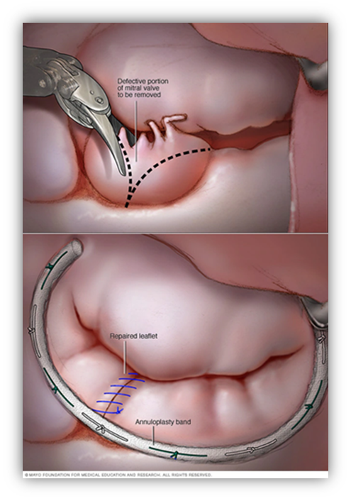
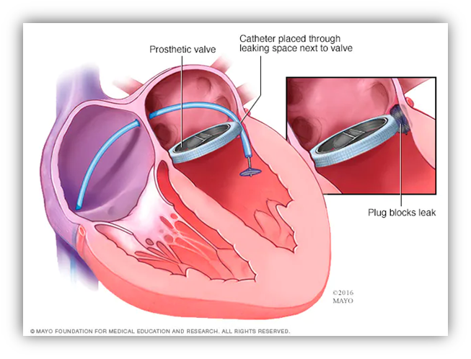
Treatment methods
Mitral stenosis
Mitral valve insufficiency
Treatments for mitral valve stenosis include :
Commissurotomy - percutaneous and surgical
Valve replacement (mechanical and biologic prostheses)
Prevention and treatment of complications:
To reduce the symptoms of heart failure - beta-blockers, cardiotonics, diuretics
Antiarrhythmics
Antithrombotics
Mitral valve disease is treated by three methods:
medical
percutaneous
surgery.

Slide 22
Indications for surgery
Mitral valve insufficiency
Mitral stenosis
The following cases are considered an indication for surgery in mitral stenosis:
In addition to mitral stenosis, if there is another heart disease that is an indication for surgery (valvular insufficiency, coronary disease, aneurysm, etc.).
When percutaneous balloon mitral commissurotomy is contraindicated in symptomatic severe-moderate stenosis (MVA <1.5 cm²).
Indications for surgery in case of mitral valve failure are as follows:
• Acute mitral regurgitation
• In chronic mitral regurgitation, if: an ejection fraction >30% - ≤60%, left ventricular end-systolic size ≥ 45 mm, new-onset atrial fibrillation (AF), pulmonary hypertension > 50 mm Hg, and unresponsive to drug therapy.

Slide 23
Contraindications to the operation
Mitral insufficiency
Mitral stenosis
Surgical treatment is generally not advised for asymptomatic patients without coexisting surgical heart conditions,
those who are eligible for percutaneous commissurotomy
those with severe heart failure
Severe heart failure
and severe pulmonary hypertension
contraindications to the operation.

Slide 24
Treatment approach
Mitral stenosis
In severe and moderate stenoses (valve area ≤1.5 cm²):
surgical intervention is selected if there is coexisting surgical heart disease.
percutaneous treatments are the first choice if there is no coexisting surgical disease.
if there are contraindications to percutaneous treatment (thrombus, anatomical incompatibility, regurgitation, etc.), surgical treatment is the first choice in symptomatic patients, and conservative treatment in asymptomatic patients.
Patients with mild stenosis (valve area > 1.5 cm²) if they are:
if symptomatic, and there is valve insufficiency - surgical treatment .
is symptomatic, have no valve regurgitation, but have high pulmonary pressure or pressure gradient should be treated percutaneously.
if symptomatic, have valve regurgitation, and pulmonary and gradient pressures are not high should be treated conservatively.
If asymptomatic, conservative treatment is selected.

Slide 25
Treatment approach
Mitral insufficiency
The treatment strategy for mitral valve insufficiency is based on surgical intervention, and the treatment approach is selected according to its clinical form:
In acute mitral regurgitation, an urgent surgical intervention is indicated.
In the case of chronic mitral insufficiency, medical treatment is initially started.
If there is no improvement with treatment, if clinical symptoms increase, or if arrhythmia is observed, surgical intervention is performed.

Slide 26
Prognosis
Mitral stenosis
Mitral insufficiency
The 10-year survival rate for asymptomatic and mildly symptomatic patients is 80%.
However, in severely symptomatic patients, this indicator drops to 10-15%.
The average life expectancy for patients with severe pulmonary hypertension is less than 3 years.
The 10-year survival rate for asymptomatic and mildly symptomatic patients is 80%.
However, in severely symptomatic patients, this indicator drops to 10-15%.
The average life expectancy for patients with severe pulmonary hypertension is less than 3 years.

Slide 27
Profilaction
Prevention of
infective endocarditis,
prevention and treatment of rheumatic diseases,
prevention of ischemic diseases are important measures.

Slide 28
Screening
Screening is performed with echocardiography.

Slide 29
Follow-up
Asymptomatic patients should undergo echocardiography twice a year.

Slide 30
Rehabilitation
Rehabilitation is carried out in a general way

Slide 31
Thank you for attention.

