Slide 1
Coronary artery disease
Dr. Shukufa Musayeva
Department of 1st Surgical Diseases

Slide 2
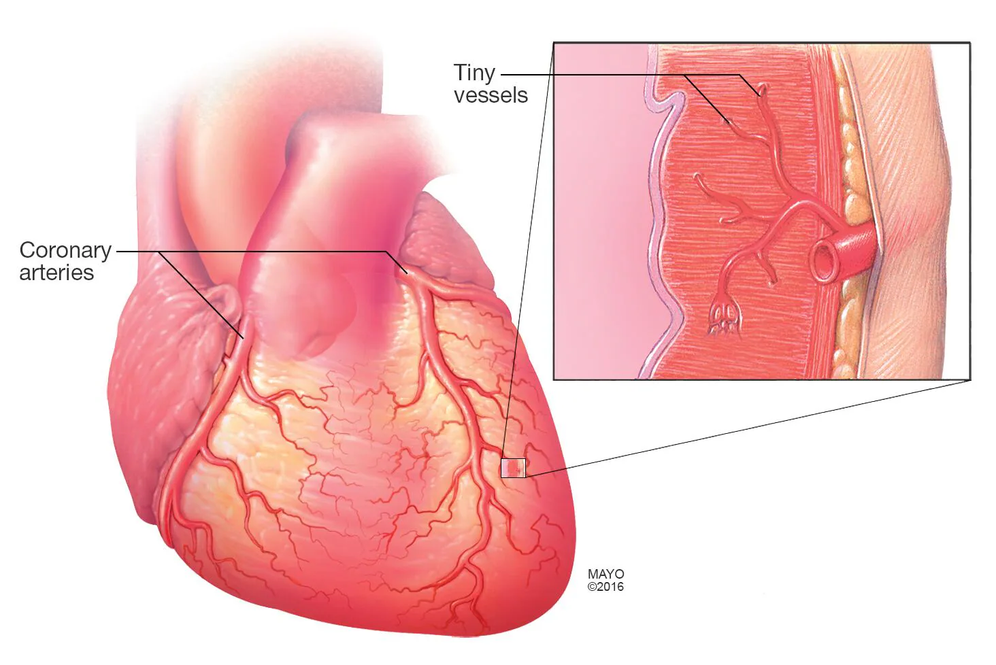
Definition
Coronary artery disease is called ischemia of the myocardium caused by narrowing or blockage of the coronary arteries that supply the myocardium.
It’s also called,
Coronary heart disease
Ischemic heart disease
Coronary syndrome

Slide 3
Classification
In clinical practice, the following classification is mostly used:
Acute coronary artery disease (acute coronary syndrome)
ST-elevation myocardial infarction
Non-ST-elevation myocardial infarction
Unstable angina
Chronic coronary artery disease (chronic coronary syndrome, stable angina pectoris)

Slide 4
Causes and risc factors
Atherosclerosis
Non-atherosclerotic
Non-modifiable
Modifiable
Vaskulitis (Takayusu disease, Kawasaki syndrome, Rheumatoid arthritis)
Diseases that cause artery intimal proliferation (Fabry disease, amyloidosis, Hurler disease)
Trauma
Spasm
Coronary artery dissection
Aortic dissection
Thromboembolic events (infective endocarditis, heart defects)
Congenital anomalies
Age
Gender
Heredity
Smoking
Hypercholesterolemia
Hypertension
Diabetes
Sedentary lifestyle
Stress
Depression
Alcohol
Obesity
Most seen cause is atherosclerosis
Acute coronary syndrome occurs in 1-2% of cases even without stenosis of the coronary arteries

Slide 5
Patogenetic mechanism
Narrowing or obstruction of the artery
ischemia and infarction
Narrowings chronic coronary syndrome
Acute occlusion acute coronary syndrome

Slide 6
Clinical course
Usually asymptomatic for a long time
stenosis
collaterals
Stenosis progression
İschemic cardiomiopathy
Acute coronary syndrome
Cardiogenic shock
Sudden death
Postinfarction cardiosclerosis
Heart aneurysm
Acute coronary syndrome
Acute pain
Arrhythmia
Extracardiac symptoms

Slide 7
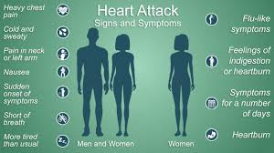
Clinical examination
Chronic coronary syndrome is characterized by chest pain that appears during physical exertion and is relieved by rest or nitroglycerin.
Acute coronary syndrome is characterized by severe chest pain and clinical deterioration.
As well as
Dyspnea
Nausea and vomiting
Fear of death
Arrhythmia
Blood pressure changes
Shock symptoms may occur.

Slide 8
Laboratory examination
There are no specific laboratory signs of chronic coronary syndrome and unstable angina.
Creatine kinase,
myocardial bound creatinin phosfokinase (CK-MB) and
troponin-C
are considered biomarkers for the acute coronary syndrome

Slide 9
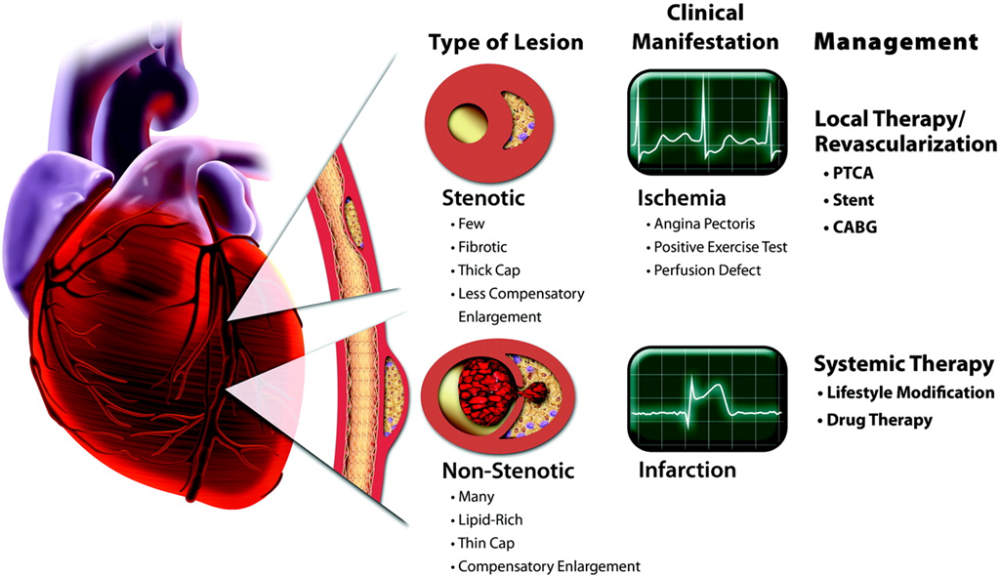
İmaging and other examinations
Invasive or non-invasive (CT-angiography, MR-angiography)
Echocardiography
MRI
contrast-enhanced CT

Slide 10
Suspection
chest pain, that appears at rest or during physical exertion
chest discomfort/ dispnea
Suspicion is raised :
History of smoking
Diabetes
Hypertension
Hyperlipidemia
Obesity
Coronary syndromes in the family
ST elevation on ECG
Wall motion abnormality on echocardiography
Perfusion defect on scintigraphy
ST segment change on ECG stress test
Increased troponin and CK-MB

Slide 11
Confirmation of diagnosis
Invasive or non-invasive angiography should be done to confirm coronary syndrome.
In angiography, the appearance of narrowing or occlusion in the coronary vessels determines the diagnosis.

Slide 12
Differential diagnosis
Aortic dissection
Pulmonary embolism
Perforation of gastric and duodenal ulcer
Pneumothorax
Esophageal rupture and mediastinitis
Acute pancreatitis
Intercostal neuralgia and musculoskeletal chest pain

Slide 13
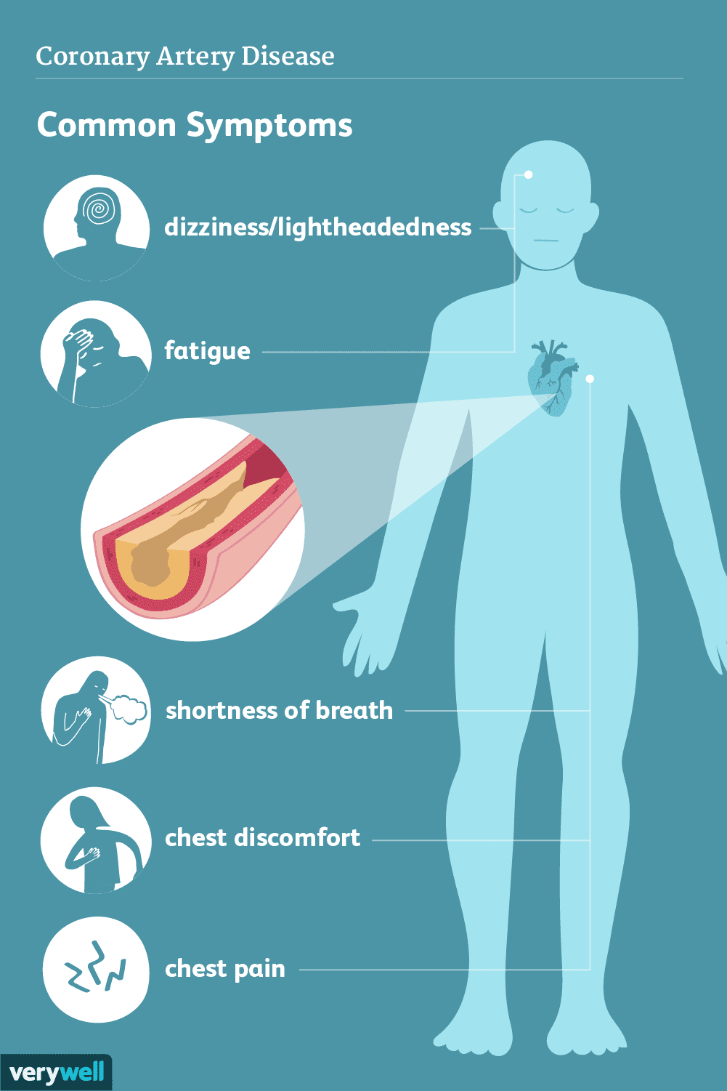
Diagnostic criteries
• Chest pain or shortness of breath at rest or with physical exertion
• Coronary artery narrowing or occlusion in angiography

Slide 14
Denial of coronary syndrome
Coronary syndrome due to organic causes
can be ruled out by angiography.
It is difficult to rule out functional causes (for example, spasm)
perfusion scintigraphy,
pharmacological echocardiography can be useful.

Slide 15
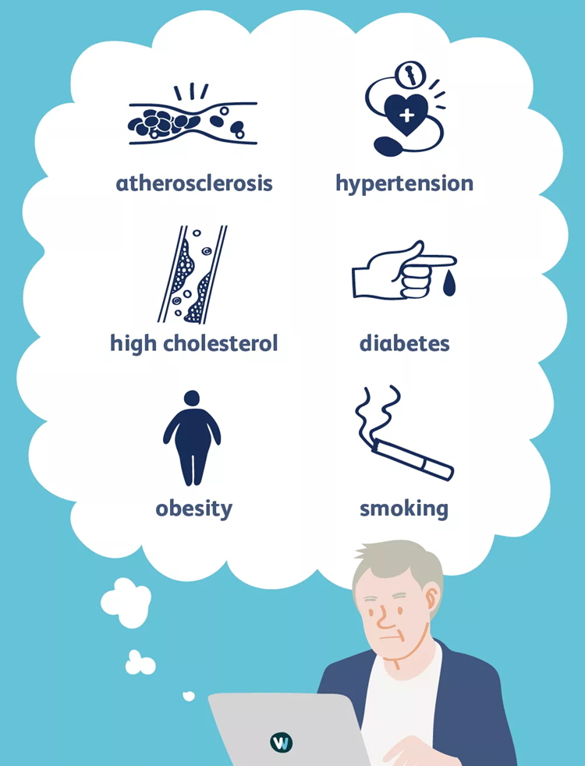
Determination of cause
In most cases, anamnesis and coexisting diseases help determine the cause of coronary syndrome.

Slide 16
Severity and stages
Clinical, laboratory, imaging, and functional tests can determine the type and severity of a disease.
Chest pain during physical exertion, discomfort in the chest, shortness of breath, reduction of pain with nitroglycerin, and blocked or narrowed blood vessels on angiography are characteristic of chronic coronary syndrome (stable angina).
Myocardial infarction is characterized by chest pain, discomfort, shortness of breath, elevated biomarkers (troponin C and CK-MB), and occlusion or narrowing on angiography. The ECG can indicate ST-elevation or non-ST-elevation.
If chest pain, discomfort, and shortness of breath at rest are present along with visible narrowing or blockage on angiography, but biomarkers are normal, it indicates unstable angina.

Slide 17

Treatment principles
Chronic coronary syndrome should be treated by appropriate plan
Acute coronary syndrome should be treated urgently.
Revascularization – the restoration of blood supply to the myocardium is the main principle in the treatment of the coronary syndrome

Slide 18
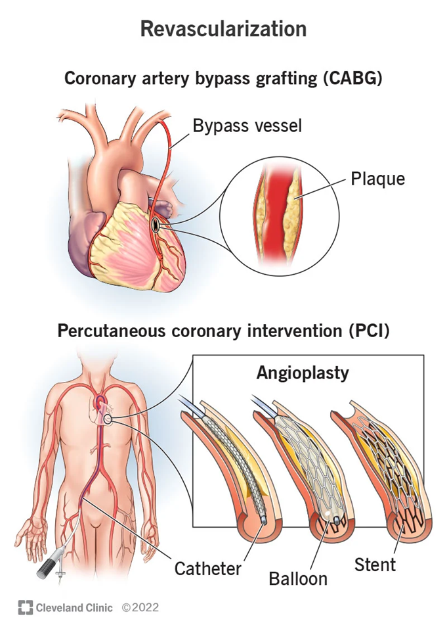

Treatment methods
Coronary artery bypass graft surgery (CABG)
Percutaneous coronary intervention (stend, angioplasty)
Medication

Slide 19

Indications for surgery
Left main coronary artery disease
Triple vessel disease
Coronary syndrome in diabetic patients
Left ventricular dysfunction
Stable and unstable angina pectoris
Acute myocardial infarction (if there are mechanical complications)
Failed percutaneous coronary intervention
Inefficiency of medical treatment in improving the quality of life

Slide 20
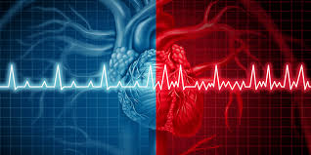
Contraindications
Pulmonary hypertension
Absence of viable myocardium.
Inoperability due to the patient's general condition and coexisting diseases

Slide 21
Treatment approach
In chronic coronary syndrome, the following approach is more often applied:
If the patient has an anatomical condition that may be useful for revascularization (left main coronary artery and narrowings, triple vessel disease), CABG or percutaneous coronary intervention is performed.
In other cases, the first choice is drug treatment.
If a patient cannot tolerate or is unsatisfied with drug treatment, revascularization is performed.
In acute coronary syndrome, the approach is generally as follows:
Urgent hospitalization
Stabilization and monitorization are performed with the ABCDE approach.
Myocardial infarction tests
Anticoagulant, aspirin, beta blocker, and nitroglycerin are given (if there are no contraindications).
It is recommended that percutaneous coronary intervention be carried out within the first 90 minutes when feasible.
If a patient presents with complicated acute coronary syndrome, CABG may be indicated.

Slide 22
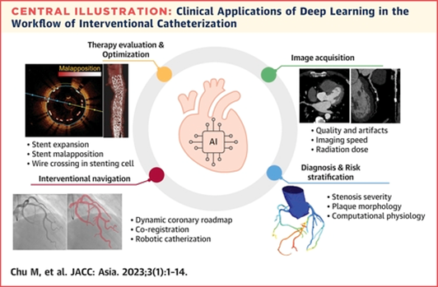

Prognosis
The prognosis is good in patients who underwent planned surgery and preserved left ventricular function.
Prognosis is not always good in patients with coexisting diseases and who required urgent intervention.

Slide 23

Profilaction
Smoking cessation and alcohol abstinence
Treatment of hypercholesteremia
Hypertension control
Diabetes control
Stress avoid
Depression treatment
Active lifestyle
But lifestyle
changes may help

Slide 24
Screening
After the age of 45 in men
after the age of 55 in women
Recommended annually check-up examinations:
clinical examinations
ECG
Echocardiography
ECG stress test or non-invasive angiography(if indicated)

Slide 25
Follow up
Patients with chronic coronary syndrome should periodically undergo ECG, echocardiography and, if necessary, angiography.
In patients with acute coronary syndrome, biomarkers are checked in addition to ECG and echocardiography

Slide 26

Rehablitation
Rehabilitation after CABG surgery lasts for about 1-2 months, early-starting process leads to early recovery of patients.

Slide 27

Characteristics in special groups
Especially in young patients, vascular occlusion leads to more complications and the prognosis is not very good.

Slide 28

Thank you for attention.

