Slide 1
Acute superficial phlebitis, thrombosis and thrombophlebitis
Acute superficial phlebitis, thrombosis and thrombophlebitis
Dr. Elvin İsazadə
Azerbayjan Medical University, 1-st Department of Surgery

Slide 2
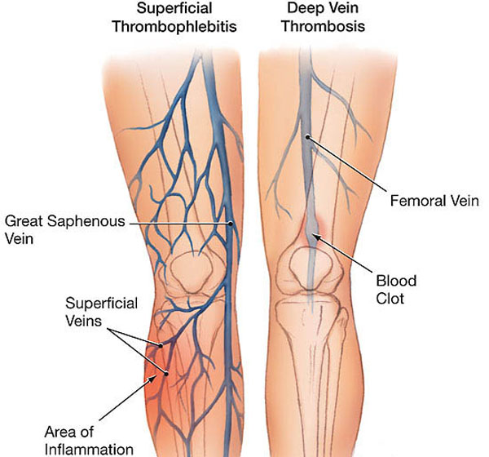
Defination
Acute superficial phlebitis, thrombosis and thrombophlebitis
Basic overview:
Phlebitis - Called inflammation of veins, there is no thrombus.
Thrombosis - There is a thrombus in the vein, there is no inflammation in the wall or it is weakly visible.
Thrombophlebitis (phlebothrombosis)-There is both a thrombus and inflammation in the vein.
Practical overview:
Superficial flebitis-İnflammation of the veins (pain, stiffness, redness, fever), there is no thrombosis, it is rare and usually goes well.
Superficial thrombophlebitis- Called inflammation and thrombosis that occurs in the branches of the main superficial veins, usually goes well, the risk of complications is low.
Superficial thrombosis- Thrombosis that occurs in the main superficial veins (great saphenous vein, lesser saphenous vein and additional saphenous vein), the risk of thromboembolism is high

Slide 3
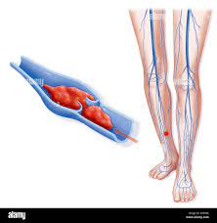
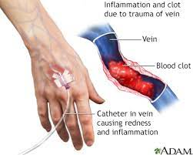
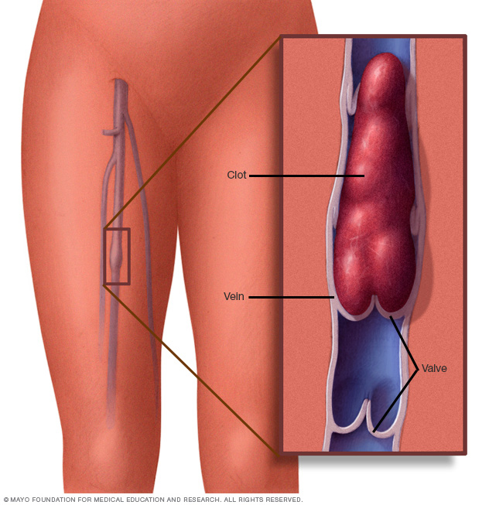
Classification
Acute superficial phlebitis, thrombosis and thrombophlebitis
By location:
Superficial phlebitis, thrombophlebitis, upper extremity thrombosis
Superficial phlebitis, thrombophlebitis, lower extremity thrombosis
According to the complication :
Uncomplicated
Complicated (DVT, thromboembolism, purulent thrombophlebitis, etc.)

Slide 4
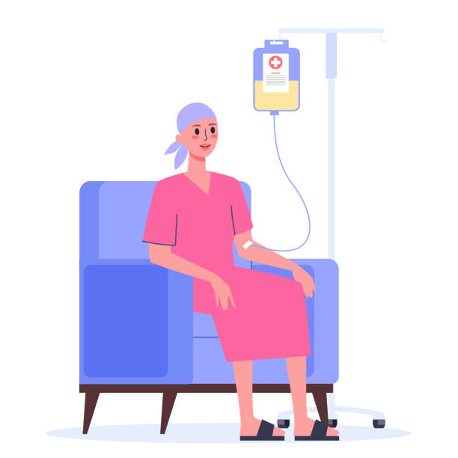


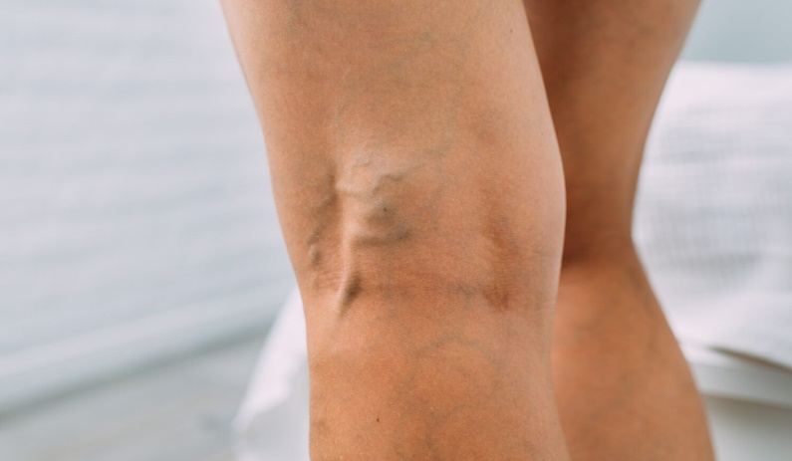
Etiology
Acute superficial phlebitis, thrombosis and thrombophlebitis
Lower extremities
Upper extremities
Pregnancy
Malignant diseases Hypercoagulation.
Varicose veins (90%)
Venous interventions
Operations
İntravenous catheterization

Slide 5
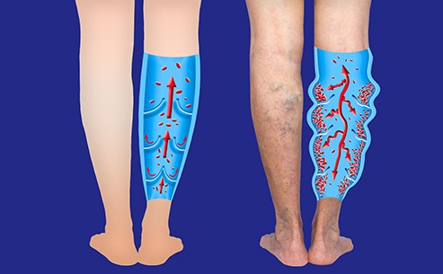
Pathogenesis
Acute superficial phlebitis, thrombosis and thrombophlebitis
Virchow's triad
Vascular wall damage
Stasis
Hypercoagulation

Slide 6
Natural history (clinical course)
Acute superficial phlebitis,
thrombosis and thrombophlebitis
The course of thrombotic-inflammatory diseases of superficial veins varies depending on the localization, character, and cause of the process.
In most cases, phlebitis and thrombophlebitis are benign, self-limited or limited to conservative treatment, whereas thrombosis tends to be a complication.
Superficial thrombosis begins with acute pain, redness, infiltrate and mild fever in the projection of the main vessels. In uncomplicated cases, pain and redness lasts for 2 weeks, absorption of infiltrate lasts up to 3 months. Progression, complications and recurrences can occur in about half of patients.
Phlebitis and thrombophlebitis usually begin with acute pain, redness, infiltrate and mild fever in the veins, especially in varicose veins.
Pain and redness usually last 1 week and absorption of the infiltrate takes 6-8 weeks. In very few cases, the process becomes progressive and complications occur.
Varicose veins, involvement of the main veins above the knee, venous interventions and infection in the body are important factors that create conditions for a complicated course.

Slide 7
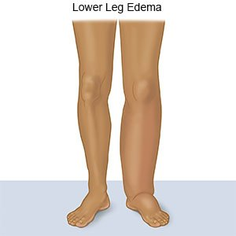
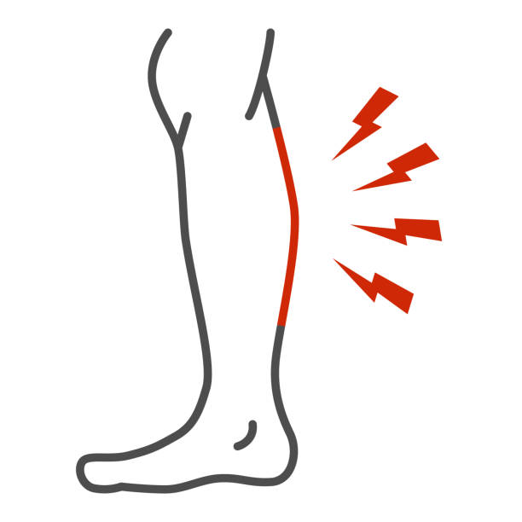
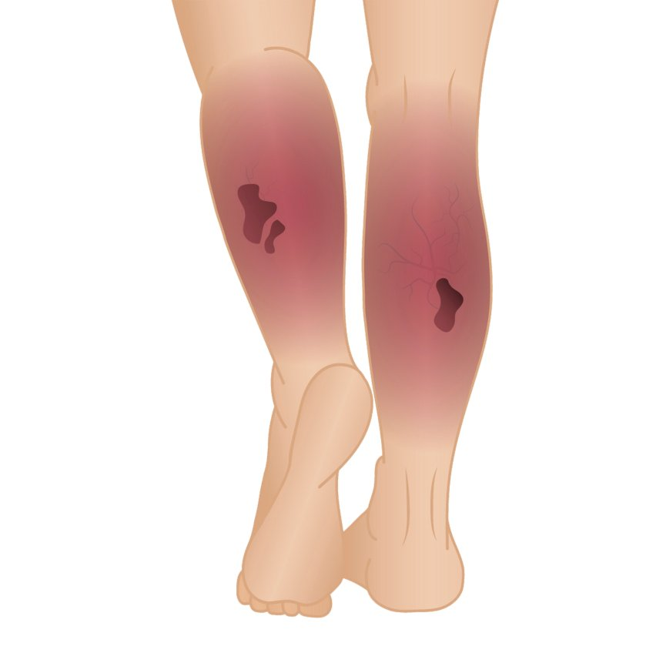
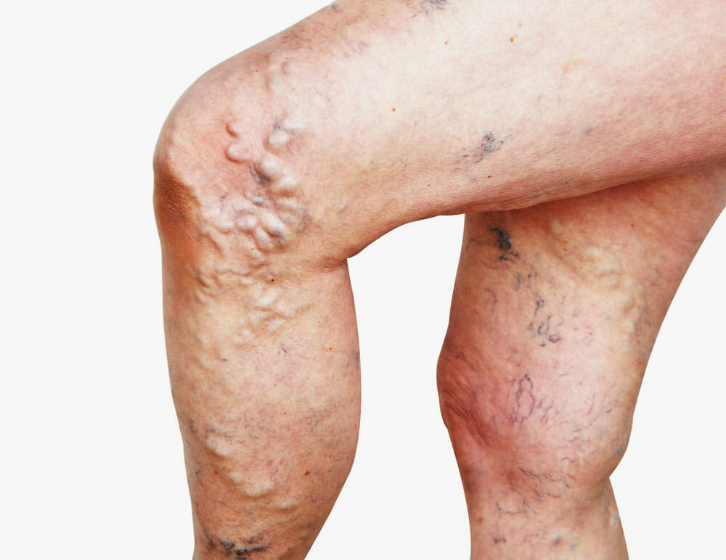
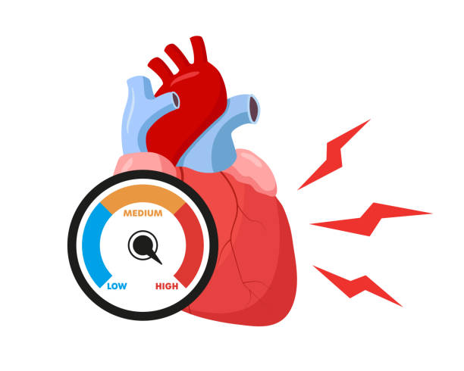
Clinical examination
Acute superficial phlebitis,
thrombosis and thrombophlebitis
Superficial phlebitis, thrombosis and thrombophlebitis are usually manifested by signs of acute venous inflammation and thrombosis
Edema
Pain
Redness, fever
Prominence of superficial veins
Subfebrile fever , tachycardia

Slide 8
Laboratory examination
Acute superficial phlebitis,
thrombosis and thrombophlebitis
İnflammation
Leukocytosis CRP increase
Thrombosis-fibrinolysis
D-dimer increase
Thrombophilia panel
Thromboelastography
Protein C and S Antithrombin, Antiphospholipids
Factor V Leyden test

Slide 9
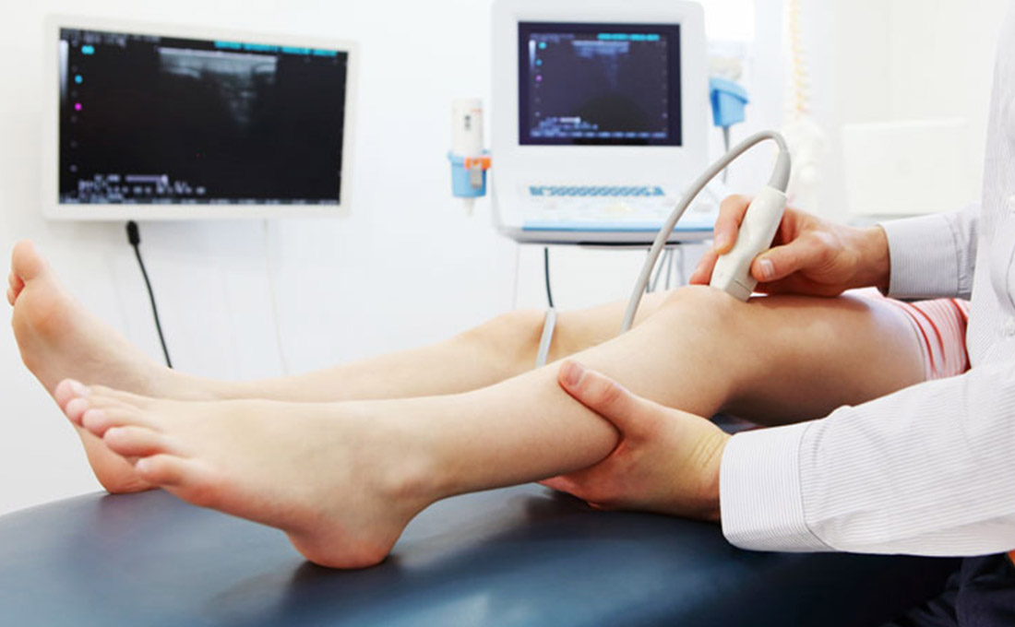
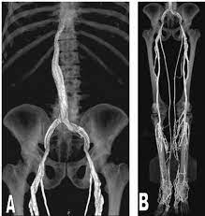
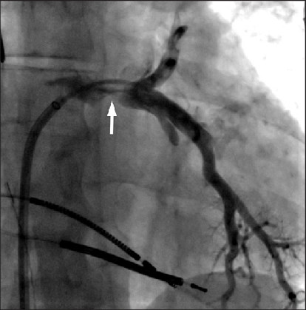
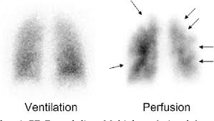
Imaging
Acute superficial phlebitis,
thrombosis and thrombophlebitis
Duplex ultrasonography (DUS)
CT venography
Ventilation-perfusion lung scintigraphy
Pulmonary venography

Slide 10
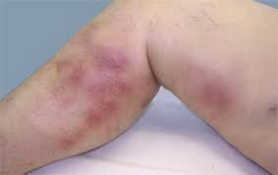
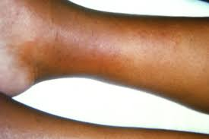
Suspision
Acute superficial phlebitis,
thrombosis and thrombophlebitis
Acute pain, painful infiltrate, redness and edema along the projection of the veins
- Those with varicose veins
- Venous interventions in the anamnesis
- Pregnancy
-History of thrombophilia (cancer, congenital thrombophilia)
-History of lower extremity vein diseases
- High level of D-dimer in the blood
Acute superficial phlebitis, thrombosis and thrombophlebitis

Slide 11
Confirmation
Acute superficial phlebitis,
thrombosis and thrombophlebitis
If DUS does not show thrombosis in the vein, but inflammation in the wall, the diagnosis of phlebitis is confirmed
If a thrombus appears in a superficial vein on DUS a diagnosis of thrombosis or thrombophlebitis is made according to the location of the thrombus: if the thrombus is in the main veins thrombosis is diagnosed, if it is in the branches of the main veins thrombophlebitis is diagnosed.
If DUS shows thrombus in deep veins as well as in superficial veins, it is called superficial thrombosis complicated by DVT.

Slide 12
Differential diagnosis
Acute superficial phlebitis,
thrombosis and thrombophlebitis
Cellulite
İnsect bite
Dermatitis
Tendinitis
Lymphangitis
Sarcoid granuloma
Popliteal (Baker) cyst.
Polyarteritis nodosa
Kaposi sarcoma
Erythema nodosum

Slide 13
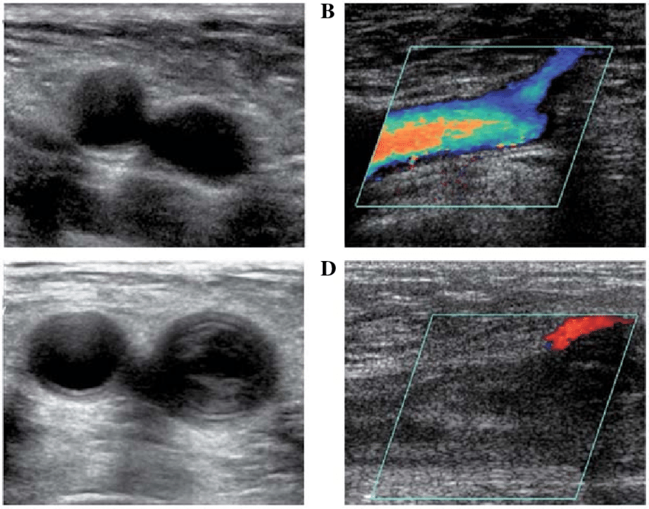
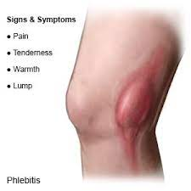
Diagnostic criteria
Acute superficial phlebitis,
thrombosis and thrombophlebitis
1
2
3
Criteria for superfical phlebitis:
Clinical signs (pain on venous projection pain, painful and warm infiltrate, redness, edema)
Absence of thrombus on DUS
Criteria for superficial thrombophlebitis :
Clinical signs (pain, painful and warm infiltrate, redness, edema)
Thrombus in branches of trunk superficial veins on DUS
Criteria for superficial thrombosis
Clinical signs (pain, painful and warm infiltrate, redness, edema)
Thrombus in trunk superficial veins on DUS.

Slide 14
How to deny it?
Acute superficial phlebitis,
thrombosis and thrombophlebitis
Absence of venous thrombus on imaging
Negative D-dimer blood test

Slide 15
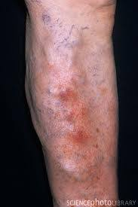
Determination of the cause
Acute superficial phlebitis,
thrombosis and thrombophlebitis
In most cases, clinical examinations are sufficient
In cases of unknown and recurrent thrombosis in the anamnesis, thrombophilic conditions should be investigated

Slide 16
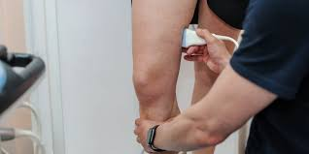
How to determine the severity and complications?
Acute superficial phlebitis,
thrombosis and thrombophlebitis
Clinical forms are determined by clinical and DUS
In addition to clinical and DUS, CT and other examinations are performed to determine complications.

Slide 17
Treatment principles
Acute superficial phlebitis,
thrombosis and thrombophlebitis
Anti-inflammatory
Prevention of thromboembolic complications

Slide 18
Treatment methods
Acute superficial phlebitis,
thrombosis and thrombophlebitis
1
2
3
Conservative treatment
Anti-inflammatory drugs (local or systemic)
Cold or hot applications
Lifting the leg
Elastic socks
Antibiotics as indicated
Anticoagulants as indicated
Surgical treatments
Thrombectomy
Venectomy
Ligation
Ligation of perforating vessels;
Drainage of pus
Endovenous interventions
Cava filter

Slide 19
Indications for surgery
Acute superficial phlebitis,
thrombosis and thrombophlebitis
Surgical treatment is performed in rare cases, usually for the prevention and treatment of complications in the presence of the following indications:
Purulent thrombophlebitis - drainage of pus
If there are contraindications to anticoagulant therapy for superficial thrombosis - proximal ligation of the main vein, ligation of perforating veins, venectomy
Surgical thrombectomy, venectomy in cases that do not respond to conservative treatment.
Intervention on varicose veins after the end of the acute phase.

Slide 20
Contraindications to the operation
Acute superficial phlebitis,
thrombosis and thrombophlebitis
Uncomplicated phlebitis and thrombophlebitis
Respond to conservative treatment

Slide 21
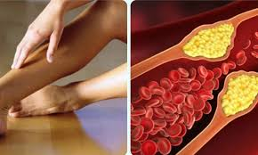
Treatment approach
Acute superficial phlebitis,
thrombosis and thrombophlebitis
All patients are initially treated with leg elevation, hot or cold applications, nonsteroidal anti-inflammatory drugs, mild compression, and early mobilization
Anticoagulants are added to the initial conservative treatment for superficial thrombosis and continued for 45 days
In phlebitis and thrombophlebitis, these treatments are continued for 7-10 days.
In superficial phlebitis, thrombophlebitis, and thrombosis due to varicose veins
If there is a positive response, patients are followed for 1.5-2 months. If there is no positive response, surgical excision, thrombectomy can be applied
- If anticoagulation is contraindicated, emergency surgical ligation (of superficial or perforating veins) or venectomy may be performed if thrombosis progresses to proximal or deep veins despite anticoagulant therapy.
surgical phlebectomy and endovenous ablations can be used for varicose veins after the acute phase has passed (usually after 2-3 months).

Slide 22
Prognosis
Acute superficial phlebitis,
thrombosis and thrombophlebitis
Both SVT and DVT have a good prognosis if treated promptly. Appropriate treatment should be started as soon as possible.
Negative prognostic factors:
Late treatment
Failure to eliminate the cause

Slide 23
Prophylaxis
Acute superficial phlebitis,
thrombosis and thrombophlebitis
Regular use of compression stockings
Epecially in cases of prolonged sitting, standing and inactivity.

Slide 24
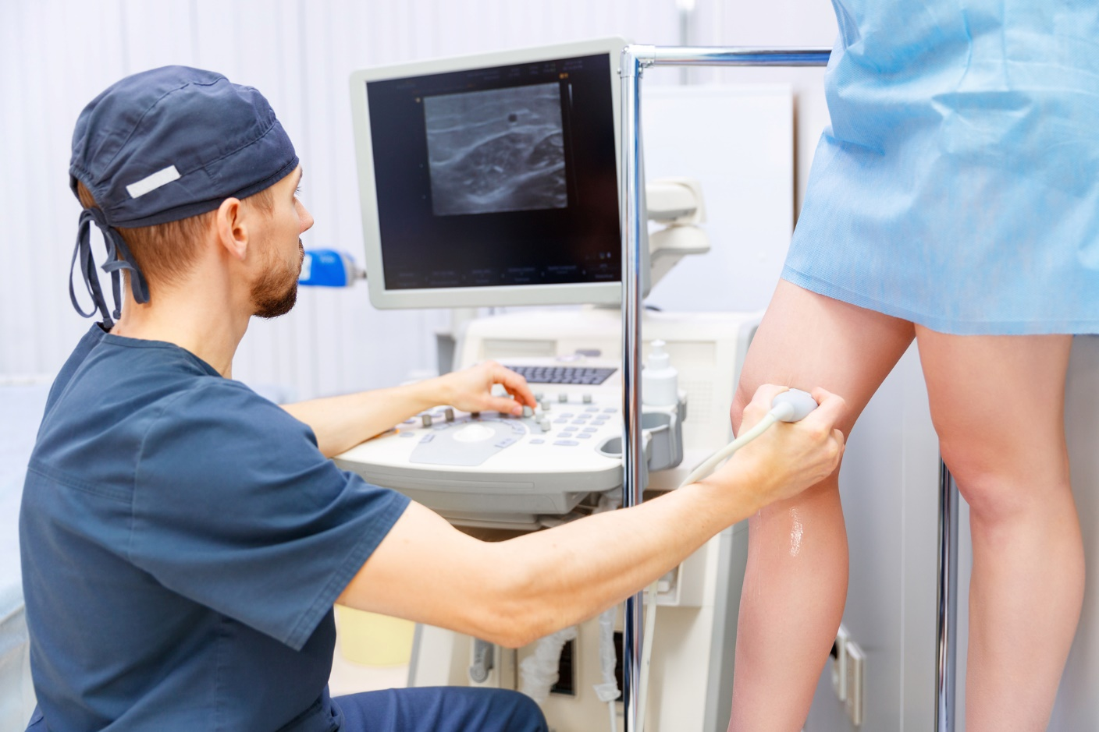
Screening
Acute superficial phlebitis,
thrombosis and thrombophlebitis
DUS is used for screening.

Slide 25
Follow up
Acute superficial phlebitis,
thrombosis and thrombophlebitis
D-dimer, CRP
DUS
Clinic

Slide 26
Acute superficial phlebitis,
thrombosis and thrombophlebitis
Thanks for your attention!

