Slide 1
Lower extremity peripheral artery disease
PhD Natavan Khidirova
Azerbaijan Medical University
1-st Departemnt of Surgery

Slide 2
Definition
Peripheral artery disease (PAD) refers to atherosclerosis (narrowing of arteries) other than the coronary arteries (aorta and its branches) and associated chronic ischemia. Previously, it was called obliterative atherosclerosis, occlusive peripheral arterial disease.
Since atherosclerotic occlusion is common in clinical practice, occlusive peripheral arterial disease caused by atherosclerosis are called PAD, and others are called non-atherosclerotic occlusion.

Slide 3
Classification
There are classifications of lower extremity PAD based on localization, size and severity.
Fontaine |  | Rutherford
Stage | Clinical | Stage | Clinical
I | Asymptomatic | I | Asymptomatic
 |  | II | Mild claudication
II | Claudication
 |  | III | Modest claudication
III | Rest pain | IV | Severe claudication
 |  | V | Ischemic ulcer or focal gangrene
IV | Ulcer/Gangrene
 |  | VI | Gangrene spreads from the transmetatarsal level to the proximal

Slide 4
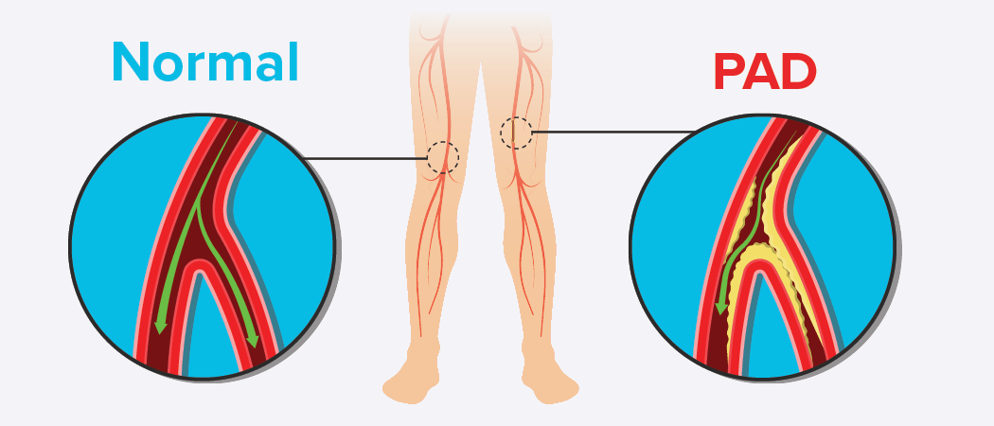
Causes and risk factors
Cause of PAD is atherosclerosis.
The risk factors of atherosclerosis are as follows:
smoking
hypertension
hyperlipidemia
diabetes
metabolic syndrome

Slide 5
Pathogenesis
The main pathogenetic mechanisms of PAD:
- atherosclerosis in the vessel wall
- tissue ischemia
Atheroma consists of a lipid core and proteins surrounding it.
Atherosclerosis gradually develops and blocks medium and small vessels, causing tissue hypoxia.

Slide 6
Pathomorphology
The main morphological changes in the muscles, nerves and skin of the lower limb are:
- ischemia
- fibrosis
- necrosis
- inflammation

Slide 7
Clinical course
PAD remains stable in 70-80% of cases, worsens in 10-20%, results in constant pain and gangrene in 1-2%, and intervention is performed in 4% of cases.
Asymptomatic
Intermittent claudication
Rest pain
Gangrene

Slide 8
Complications
Acute arterial thrombosis
Limb loss
Death
Deep vein thrombosis, Pulmonary Artery Thromboembolism
Kidney failure

Slide 9
Clinical examination
Clinical signs
Asymptomatic
Intermittent claudication (severe leg pain when walking)
Rest pain
Ulcer and gangrene
Physical examination
Skin atrophy
Hypoesthesia
Ulcer, gangrene
Absent pulse

Slide 10
Laboratory examination
There is no specific laboratory marker of PAD
Laboratory tests can be used to assess tissue ischemia and necrosis, complications.

Slide 11
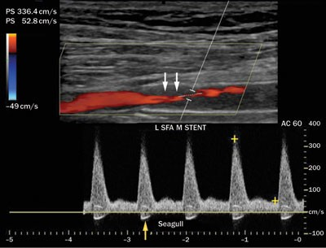
Diagnostic Imaging
Imaging is important to assess the rate, localization, and scale of the obstruction:
Doppler and Duplex DUS
MR angiography
CT angiography
Catheter arteriography

Slide 12
Ankle Brachial Index
Ankle Brachial Index (ABI) is considered the most sensitive indicator of PAD.
It is the ratio of the ankle and brachial blood pressures. Pressure is measured by doppler ultrasound in the supine position of the patient.
An index lower than 0.9 is a diagnostic sign for lower extremity peripheral artery disease.

Slide 13
Functional investigations
The walking test - the patient walks for 5 minutes, the dynamics of ankle pressure, ankle-brachial index and other indicators are examined.
Measurement of lower extremity pallor – can help determine the extent of PAD. The examination should be carried out in the supine position of the patient.
Stage IV - pallor is observed in the normal condition of the limbs.
Stage III - If there is no pallor, the limb is raised by 60°, pallor occurs within < 30 seconds.
Stage II - pallor occurs up to 60 seconds.
Stage I - pallor occurs in 60 seconds.
Stage 0 - even after 60 seconds there is no pallor.

Slide 14
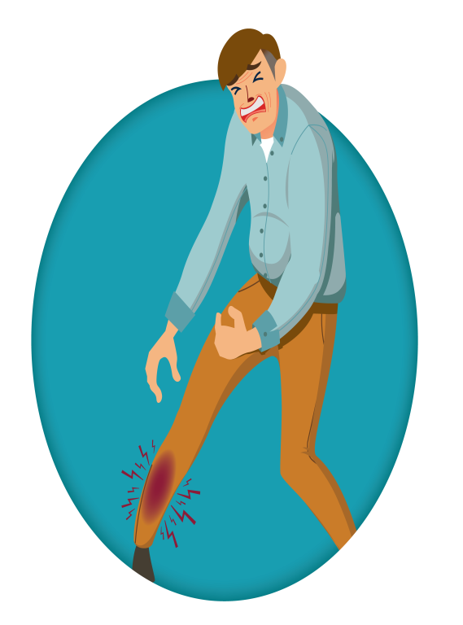
Suspicion of PAD
Intermittent claudication
Rest pain
Pallor in the lower extremity
Weak or absent pulse
Muscle weakness
Ulcer and gangrene

Slide 15
Confirmation of the diagnosis
To confirm the diagnosis:
Ankle-brachial index (ABI) is recorded with doppler
Arteries and veins are evaluated by DUS
CT and MR-angiography, arteriography are performed when it is not possible to clarify the diagnosis with these examinations or when patients are prepared for surgery.

Slide 16
Differential diagnosis
Spinal stenosis: compression of the cauda equina of the spinal cord causes neurogenic pain;
Osteochondrosis, coxarthrosis;
Nerve root damage (compression);
Popliteal Artery Entrapment Syndrome – compression by the medial head of the gastrocnemius muscle (compression syndrome).

Slide 17
Diagnostic criteria
Clinical - asymptomatic, intermittent claudication, rest pain, ulcer, gangrene
Ankle-brachial index <0.9
Arterial obstruction in imaging.

Slide 18
How to deny PAD
Ankle-brachial index greater than 0.9
Normal vessels on imaging

Slide 19
Treatment principles
Although PAD is usually stable, it can sometimes become progressive and cause complications.
Therefore, it should be observed and treated.
Treatment measures should be aimed at alleviating symptoms, reducing the risk of cardiovascular diseases and complications.

Slide 20
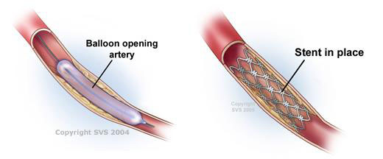
Treatment methods
Concervative
Reducing risk factors of atherosclerosis
Antithrombotic
Statins
Vasodilators
Physical exercises
Regenerative therapies (growth factors and stem cells, exosomes)
Surgical treatment
Shunt
Endarterectomy
Amputation
Endovascular interventions
Angioplasty
Stent
Endarterectomy

Slide 21
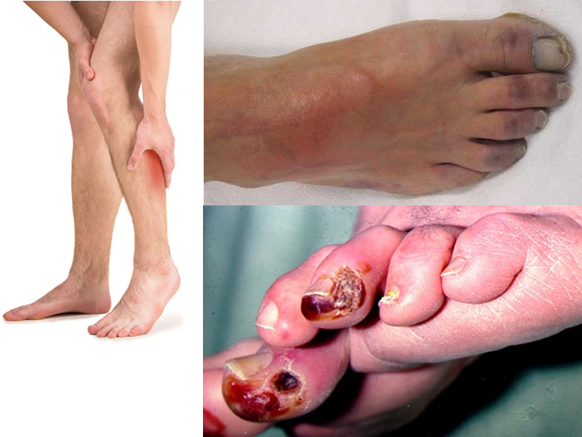
Indications for surgery
Symptomatic PAD –
Intermittent claudication,
rest pain, gangrene is an
indication for surgery

Slide 22
Contraindications to the operation
Absolute contraindications - patient's agonal or very severe general condition
Relative contraindications - severe concomitant illnesses - acute myocardial infarction, mild and life-threatening ischemia of patients with inoperable malignant tumors.

Slide 23
Treatment approach in PAD
First of all, the stage of the disease, the location and the size of the obstruction are taken into account
Asymptomatic
Intermittent claudication
Rest pain
Ulcer gangrene
Risk-reducing measures
Risk-reducing
Measures
Medical treatment
Revascularization if
indicated
Surgical
Endovascular
Hybrid revascularization
Amputation

Slide 24
Prognosis
The prognosis of the disease depends on the stage, which artery is damaged, risk factors, and the presence of co-morbidities. Progression of asymptomatic and intermittent claudication is low (10-20%), while constant pain and gangrene are progressive in most cases.

Slide 25
Prevention
Prophylaxis is the prevention of atherosclerosis:
smoking cessation
blood pressure and cholesterol level control
reduce weight
blood sugar control (for those with diabetes)
physical activity

Slide 26
Screening and follow-up
ABI, clinic
Asymptomatic patients should be monitored every 2 years, and symptomatic patients every 3-6 months through clinical and ABI

Slide 27
Rehabilitation and characteristics in special groups
Rehabilitation is carried out in a general manner.
There is not enough information about characteristics in special groups (child, pregnant etc.)

Slide 28
Thank you for your attention!

